Slide 1
Understanding and Boosting Self-Esteem LKS2
EDUCATION EMOTIONAL WELLBEING PRACTITIONER TEAM

Slide 2
How are you feeling today?
1
2
3
4
5
6
7
8
Notes:
AGREEMENT- Calibri (body) font throughout
Headings- Font size- 60 and in bold
Headings in capitals for now

Slide 3
Aims of this lesson
By the end of this lesson you will:
Understand what self-esteem is
Discuss what may lower self-esteem
Learn ways to boost self-esteem

Slide 4
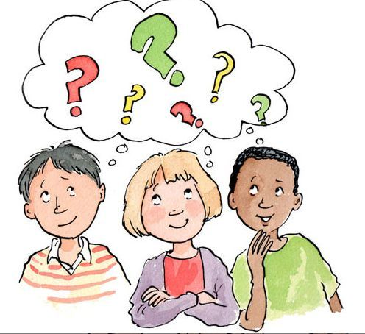
Group Agreement
Listen to others
Share if you want to share
If it’s not your story, don’t tell it

Slide 5
What is Self-Esteem?
Self-Esteem is how we THINK and FEEL about ourselves.
It is how much we:
Like ourselves
Want to try something new
Stand up for ourselves
Know what we are good at
Accept mistakes and move on from them
Share our opinions.

Slide 6
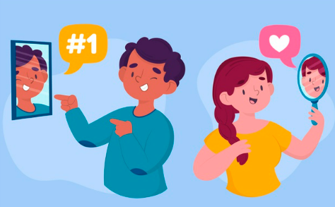
High Self-Esteem
- We feel good about ourselves.
Question: When was the last time you did something good?
- We are confident in who we are and in our abilities.
Question: What are you good at?
- We are not too worried about what other people think or how much we get wrong.
Question: How do you feel when you get something wrong?
- We believe we can achieve if we keep trying.
Question: What was the last thing you achieved?

Slide 7
Activity 1: Discussion
High self-esteem | Low self-esteem
 | Worried about trying something new
 | Thinking negatively
 | Finding it hard to make friends
 | Can’t stand up for yourself
 | Not sure what you are good at
Using these examples of low self-esteem, discuss what high self-esteem would look like.

Slide 8
Why is self-esteem important?
Helps you when you don’t get things right the first time
Helps you with your learning in class
Motivates you to achieve your goals
- Can help you feel able to share your worries and problem solve
- Can help you change your negative thoughts into positives
- Helps you with your friendships
- Can improve your confidence
- Motivates you to keep trying or try something new

Slide 9
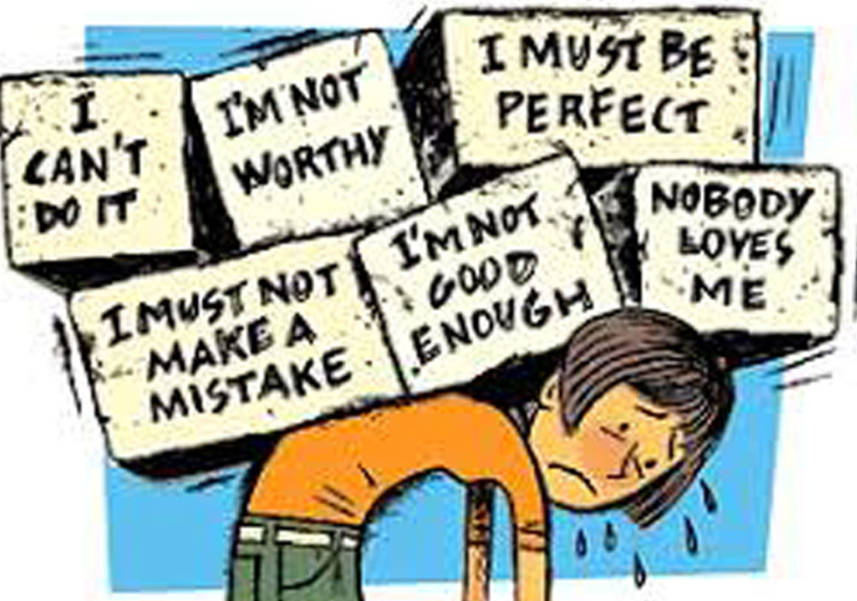
What can reduce self-esteem?
Falling out with friends
Difficult learning inside and outside of school
Not getting something right the first time
- Setting goals that are too hard to reach
- Not asking for help if you need it
Not talking about worries
Not celebrating your achievements
Not being kind to yourself

Slide 10
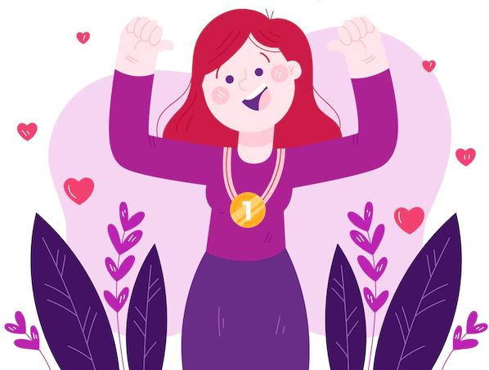
How to boost your self-esteem
Try your best at everything
2. Take part and contribute
3. Have an ‘I can’ attitude
4. Practice and improve
5. List your skills
6. Focus on the positives
7. Do the things you enjoy
8. Spend time with different people
9. Say ‘no’ if you need to
10. Share your opinions and ideas

Slide 11
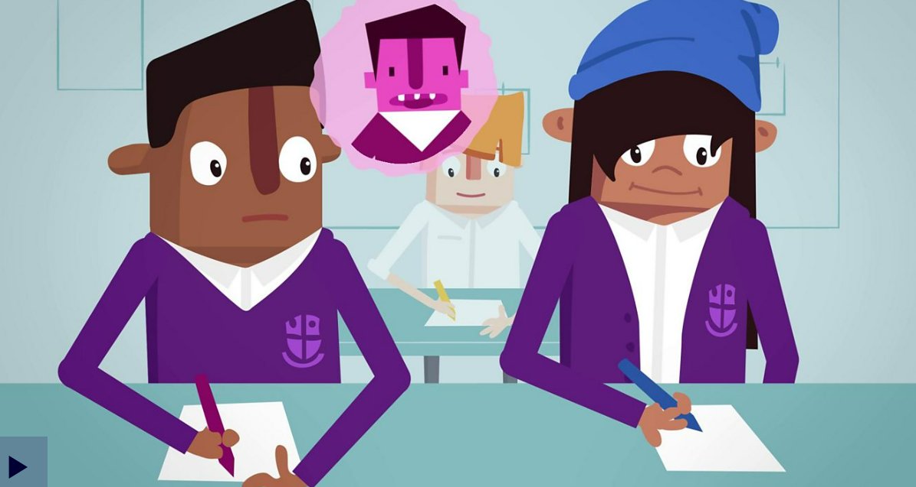
Boosting Self-esteem
PSHE KS2: How to develop a positive mindset - BBC Teach
Notes:
This slide can be moved around or deleted to suit the powerpoint
Video length- a maximum of 3 minutes, video being approx. 3 minutes

Slide 12
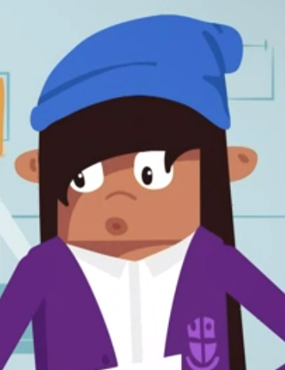
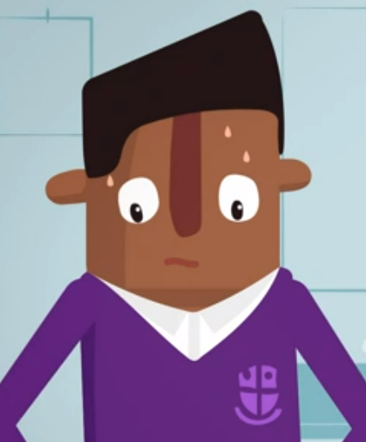
Discuss
What was Lucas finding difficult?
How did Meesha help Lucas?
Notes:
This slide can be moved around or deleted to suit the powerpoint
Video length- a maximum of 3 minutes, video being approx. 3 minutes

Slide 13
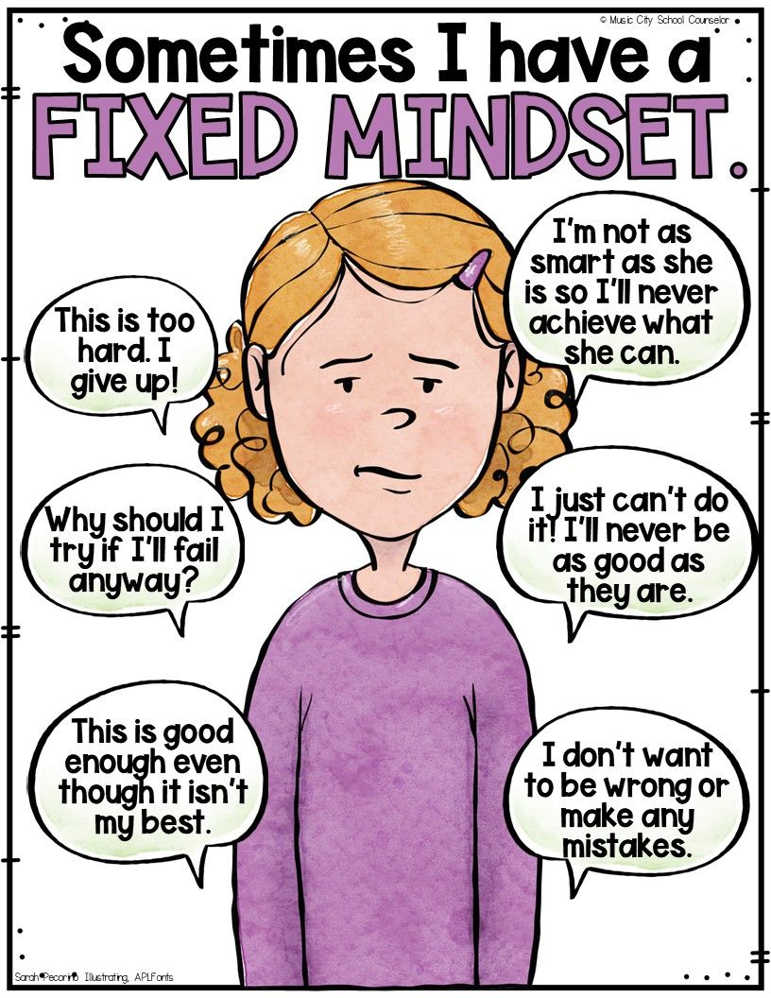
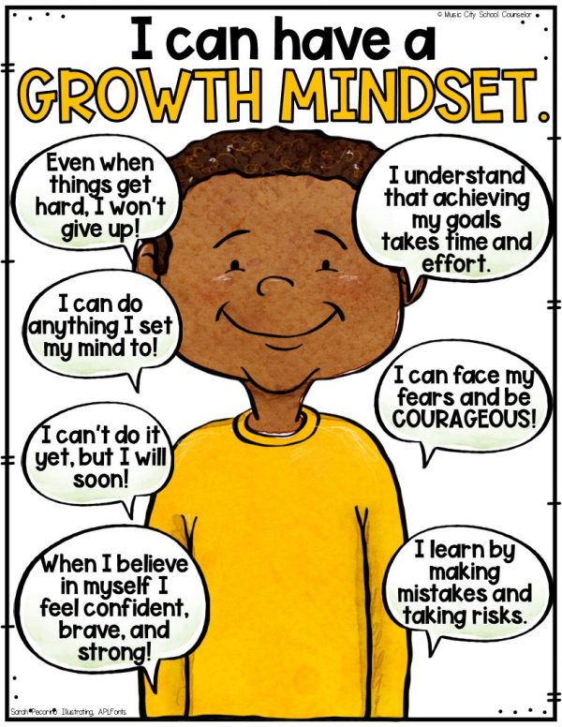
Strategies-Growth Mindset thinking
BUT

Slide 14
Activity 2: List my skills
Things I know I am good at
Things my friends and teachers tell me I am good at
Things my family tell me I am good at

Slide 15
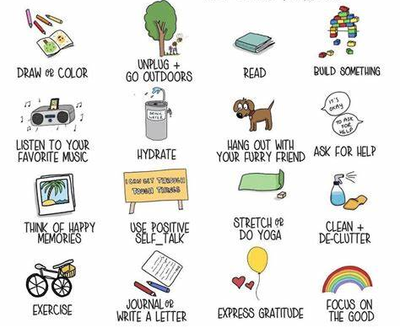
Self-care
At times when we have low self-esteem or feel like we need to boost our self-esteem, it’s important to do the things we enjoy. Think about what makes you happy and smile.

Slide 16
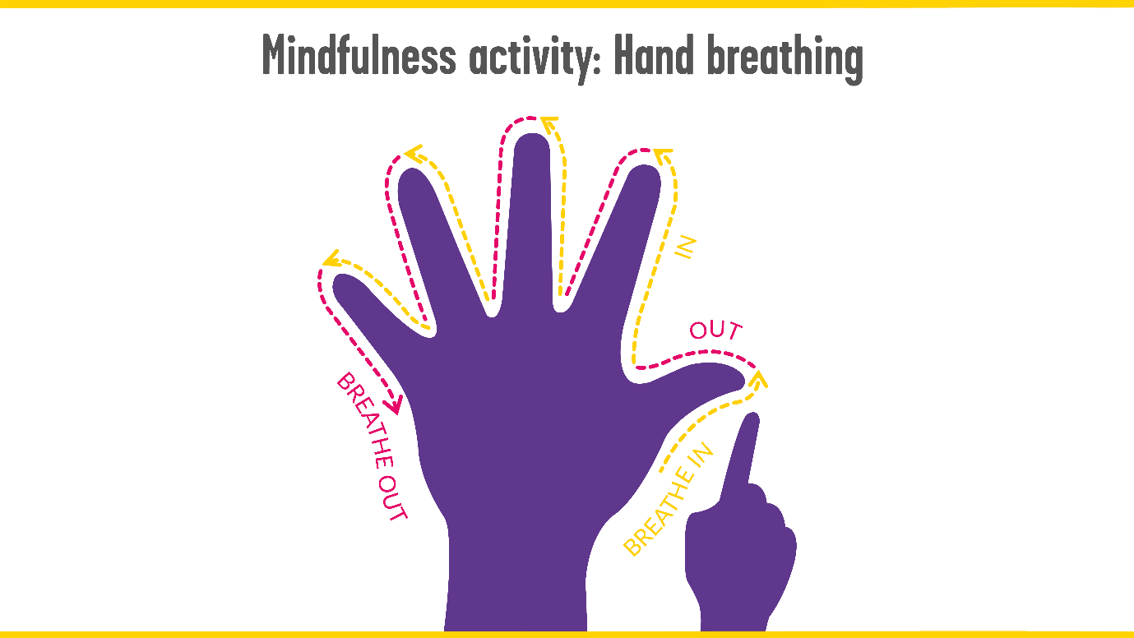
Mindfulness

Slide 17
Sharing your feelings
When you feel like you need to talk, talk to a trusted adult. A trusted adult can listen to you and give you advice and help.
Think of 5 trusted adults you know and write their names on the fingers of an outline of your hand.
If you are not sure about who your trusted adults are, talk to your teacher and family.
Class teacher
My Trusted Adults

Slide 18
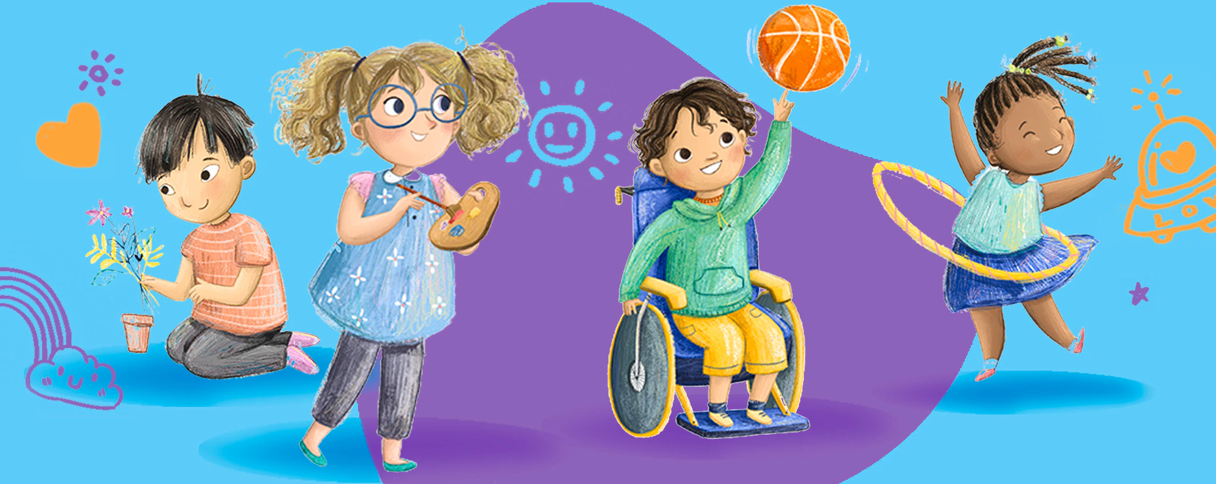
Summary
Everybody has self-esteem inside them. Some people have a little and some people have a lot. It is good for you and helps to build your confidence. There are many things you can do to boost your self-esteem.

Slide 19
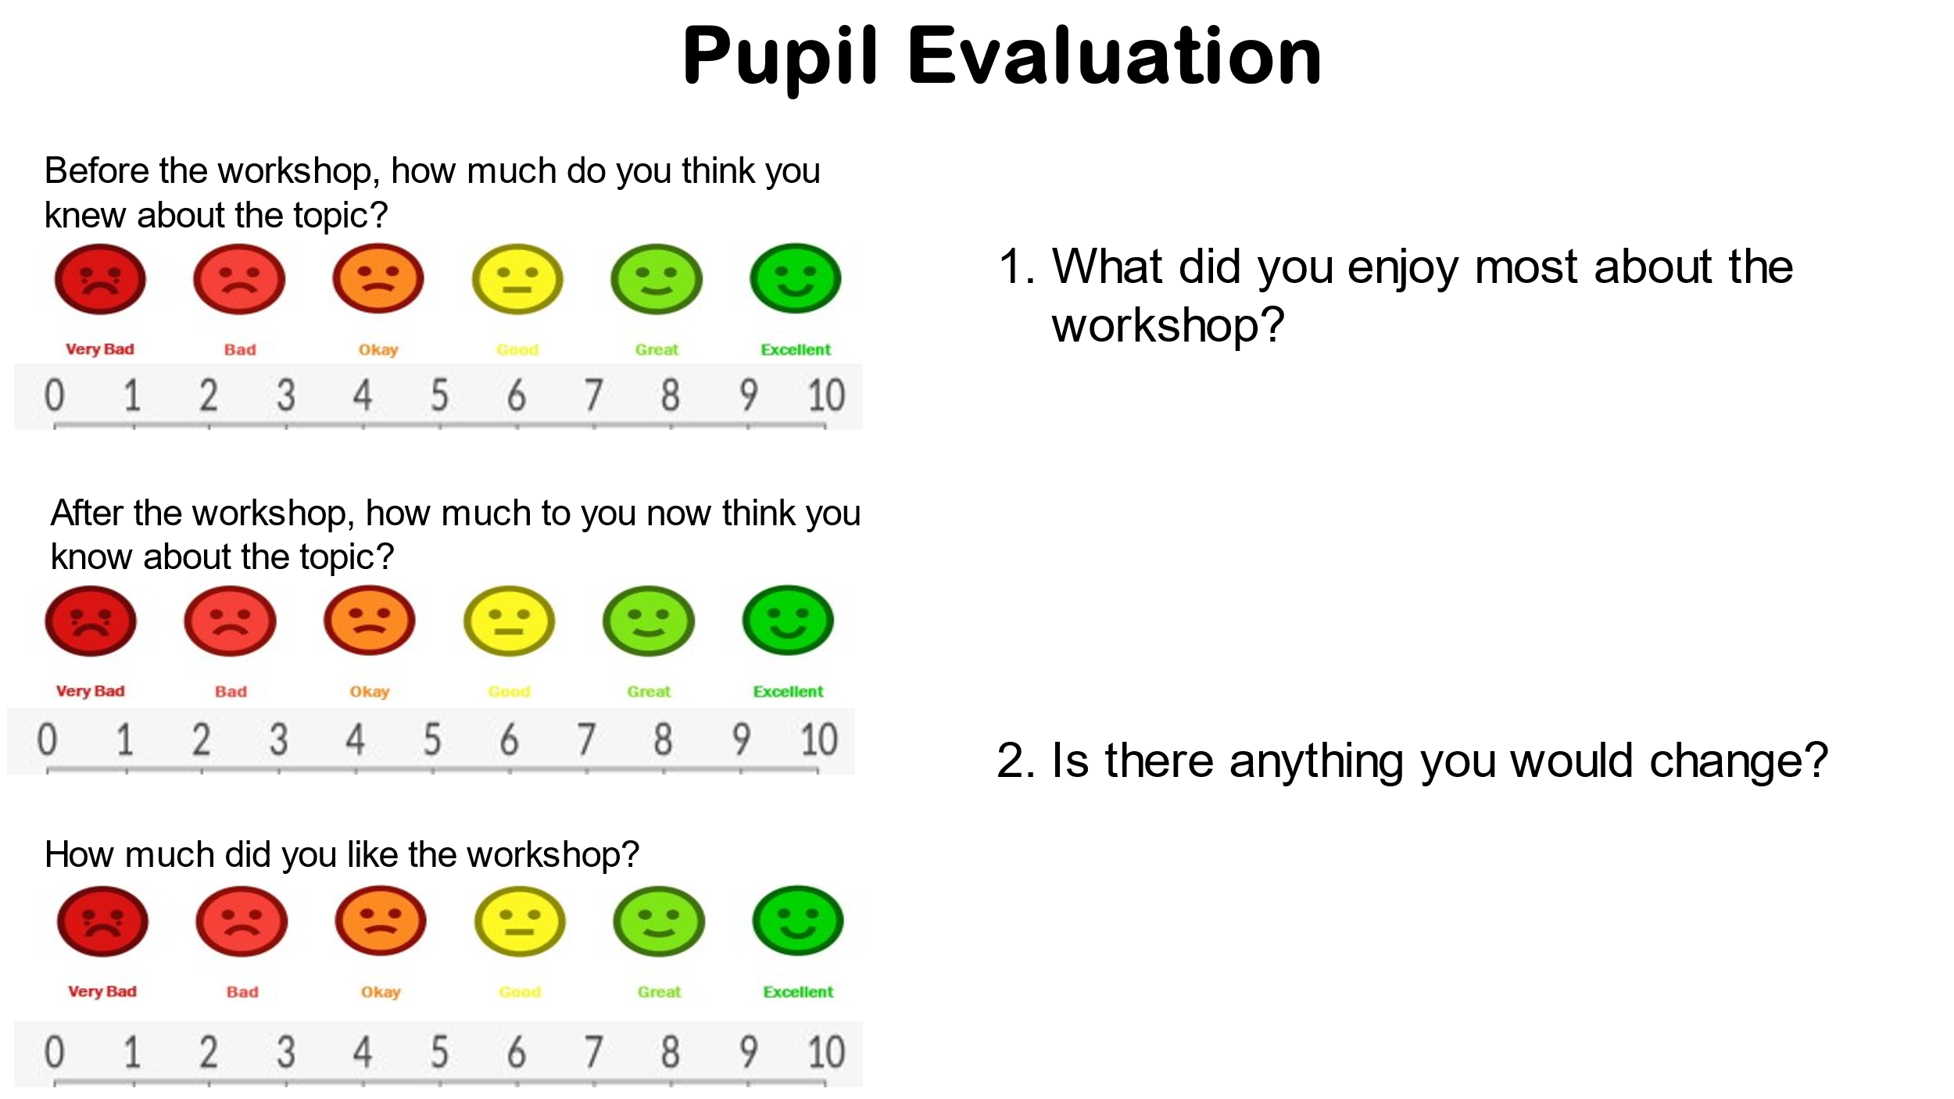
Evaluation

Slide 20
Thank you for listening.
If you need help with your self-esteem, please speak to your teacher as your teacher may be able to organise help for you from our team.
Teachers:
Please access the EEWP webpage for further details on how we support children and young people with their SEMH concerns.
| Bradford Schools Online

