Slide 1
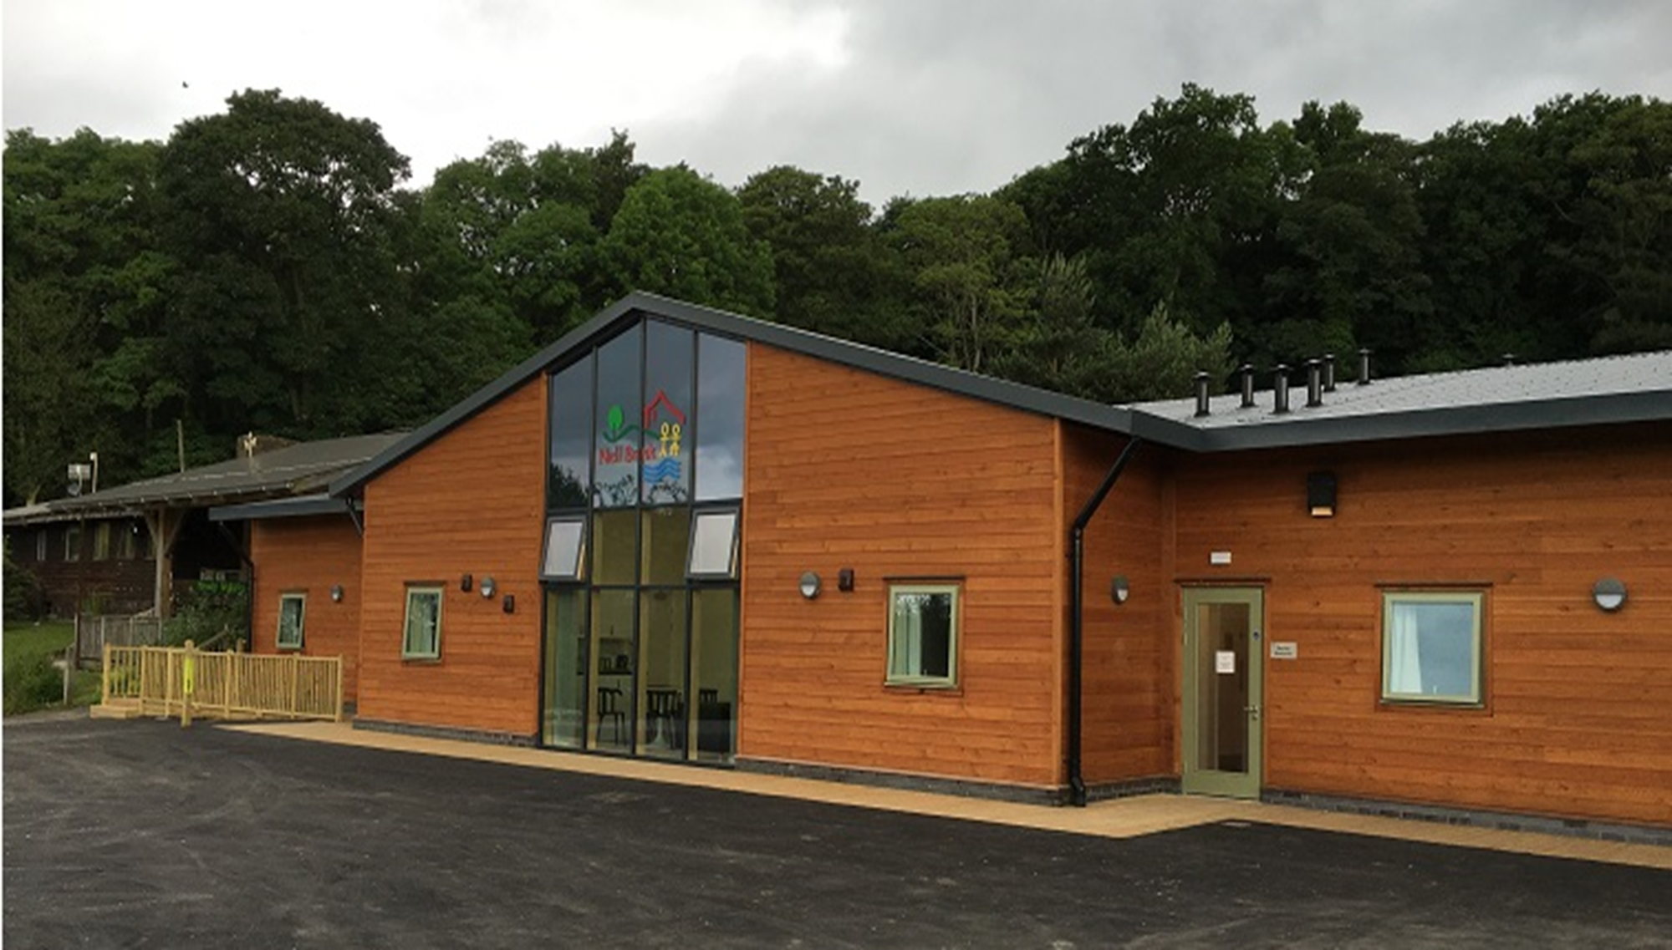

Year 4 Residential to Nell Bank
Wednesday 12th October until Friday 14th October
Department of Education and Life Skills
Early Years and Childcare Service

Slide 2
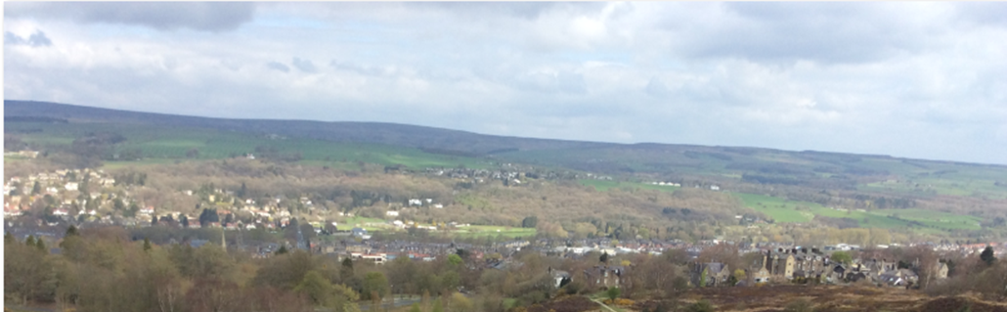
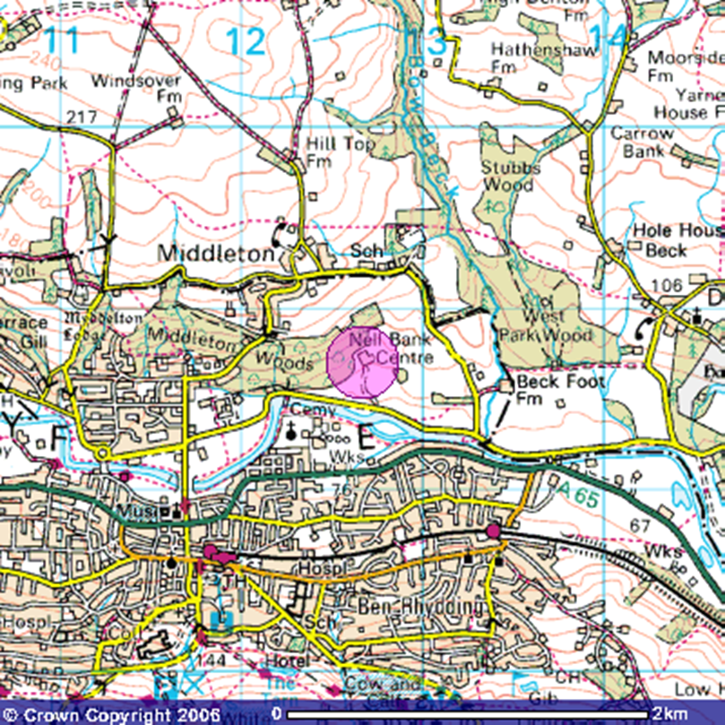
Location
Nell Bank is located on a south facing slope overlooking Ilkley moor.
The centre is sheltered by 100 acres of bluebell woodland.
This is a 30 minute drive away from school.

Slide 3
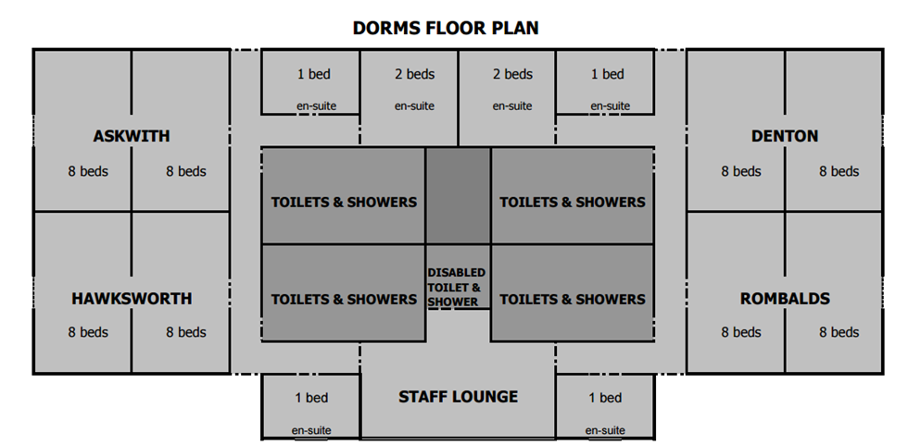
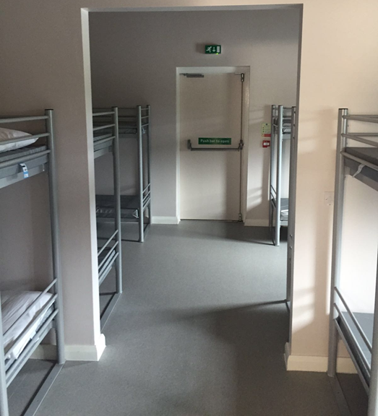
Accommodation
The dorms accommodate 64 children and 8 adults.
Each dorm has 8 bunk beds and sleeps 16 children. There is a partitioned wall between the 4 bunk beds.
Boys and girls are separated and each have their own washing areas which include showers, toilets and a sink area.
The outside doors are fitted with door alarms and the windows have a limit on how wide they open.
Before visiting, children will be able to choose who they want to share a room with and this is taken into account when organising the sleeping arrangements.

Slide 4

Food
Tuesday
Lunch
Ham, cheese, tuna or egg sandwich
Walkers crisps, drink (water, apple or orange juice)
Homemade biscuit or flapjack
Apple
Evening meal
Pasta bolognaise served with crusty bread.
Cheese and tomato pasta bake served with crusty bread.
Chicken curry (Halal) with chapattis
Pudding – Homemade jam and custard sponge
Wednesday
Packed lunch – Provided by the school dinner service and will be charged through school meals.
Monday
Lunch
Bring your own
Evening meal
Butchers sausages – served with mashed potato, sweetcorn and peas.
Sheesh kebab (Halal) – served with mashed potato, sweetcorn and peas.
Oven baked jacket potato – served with a choice of tuna mayonnaise, Heinz baked beans and cheese with mixed side salad.
Pudding – Homemade chocolate fudge cake with vanilla ice cream.

Slide 5
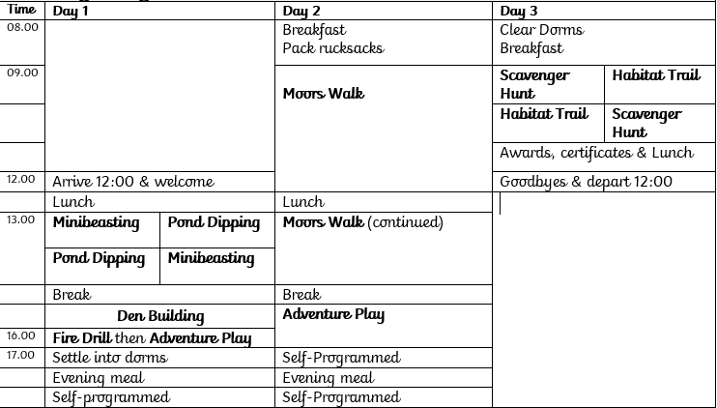
Residential Activities

Slide 6
Mini beast hunt
Science
https://www.blakehillprimary.co.uk/website/nell_bank_residential/577505
Orienteering
Geography/PE
All the activities have a link to the objectives taught in year 4.
Take a look at the current year 4 children enjoying the residential this academic year.
Pond Dipping
Science
Adventure
Playground
Rivers and Settlements
Geography/History
Den building
Moors Walk
Geography
Team Building

Slide 7
Risk Assessments
Staff have considerable experience and expertise in risk analysis and Nell Bank has an excellent safety record.
All our risk assessments are shared with visiting group leaders to assist their planning.
Nearer to the time, we will send out a medical form which will allow you to state any medication your child takes and the administration of medication whilst we are away.
Please note, any communication whilst we are at Nell Bank will be shared via Facebook, Twitter or website posts. No direct contact will be made to parents unless in emergency cases.

Slide 8
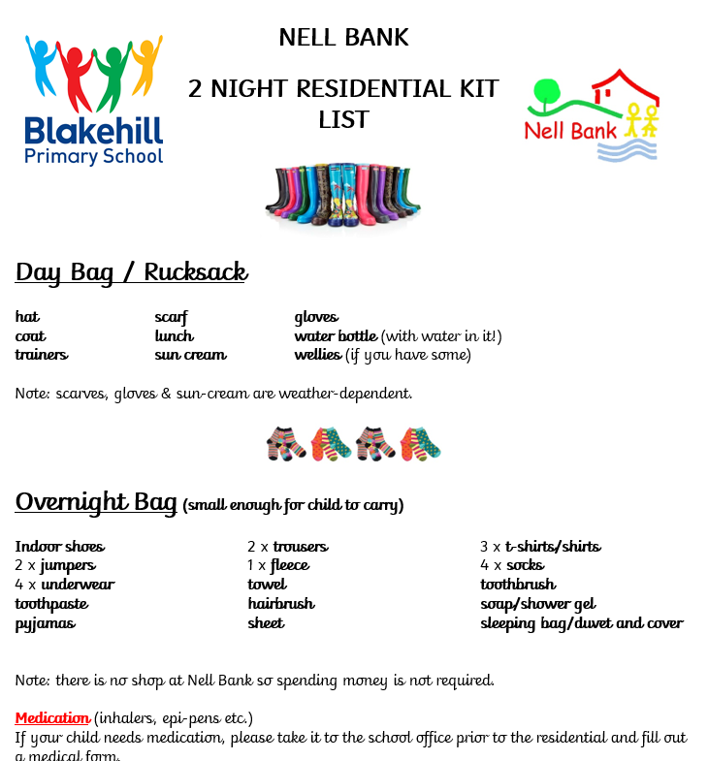
Kit list and cost
The cost of the trip will be up to £120.
A payment will be set up on Parent Pay
and you will be informed once this goes live.
A non refundable deposit of £30 will need to be paid to secure your child’s place.
Payments can be made in instalments.
The payment will need to be made in full by September.

Slide 9

Questions

