Slide 1
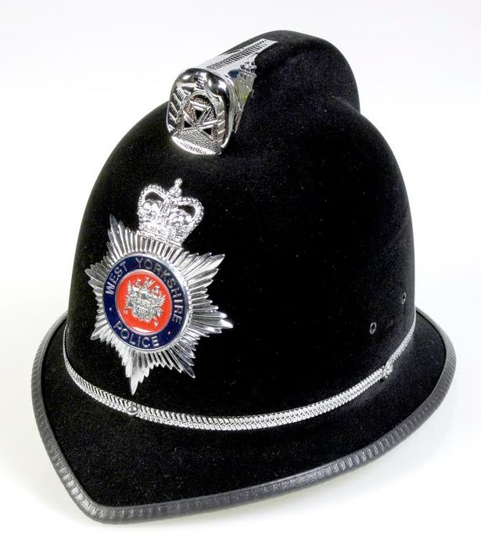


Weapons Awareness

Slide 2
National Statistics
47,119 Police-recorded offences involving a knife or sharp instrument in the 12 months to September 2020 Source - Officer for National Statistics

Slide 3
Why You?
More than 1,000 children were caught carrying knives in schools in 2019- with the youngest aged just four Source – Home Office

Slide 4
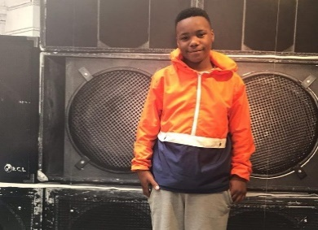

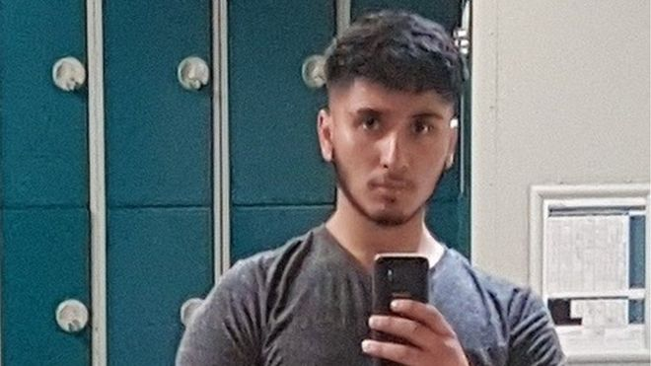


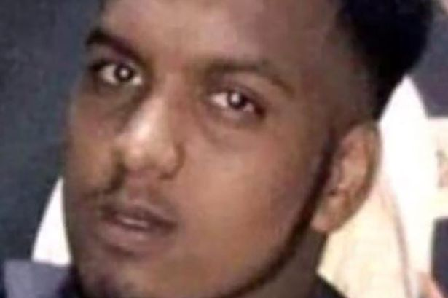
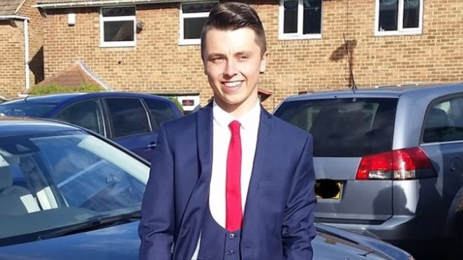

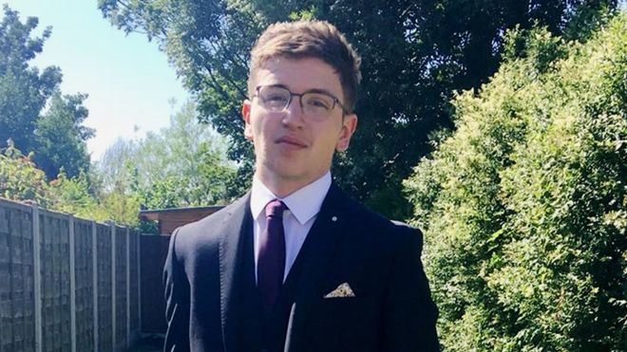
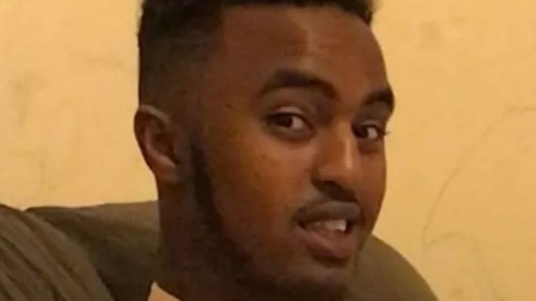
Nedim Bilgin
Aged 17
Abdullah Muhammad
Aged 16
Jaden Moodie
Aged 14
Jodie Chesney Aged 17
Ayub Hussain
Aged 17
Yousef Ghaleb Makki
Aged 17
Sidali Mohamed
Aged 16
Connor Brown Aged 18
Hazrat Umar Aged 18
Abdirashid Mohamoud
Aged 17
Notes:
1 in 3 people are injured by their own knives.

Slide 5
So why do people carry knives or use weapons?
Part of a gang
For protection
To use
To look cool
Peer pressure
Because they think ‘everyone else is carrying’

Slide 6
What is a weapon?
In law an offensive weapon is defined as:-
Any article made or adapted for use to causing injury to the person, or intended by the person having it with him for such use.

Slide 7
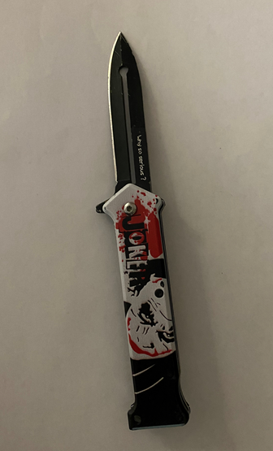
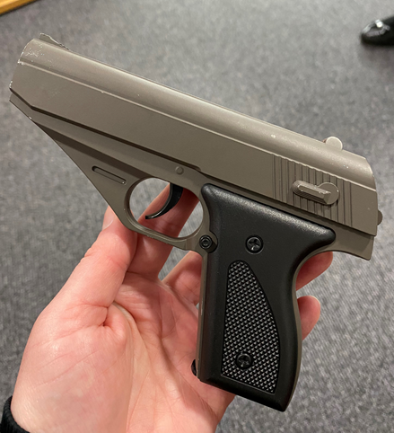
This is a metal BB gun that fires small plastic pellets. The flick knife has a real blade that could cause a real injury. Both of these were seized from primary schools in Bradford in 2022.

Slide 8
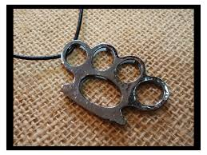
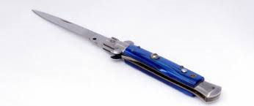
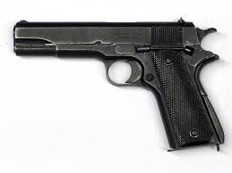
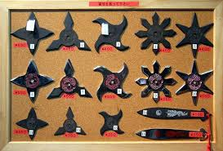
Examples of Weapons ‘MADE’ to cause injury

Slide 9
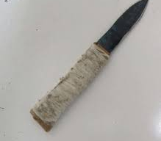
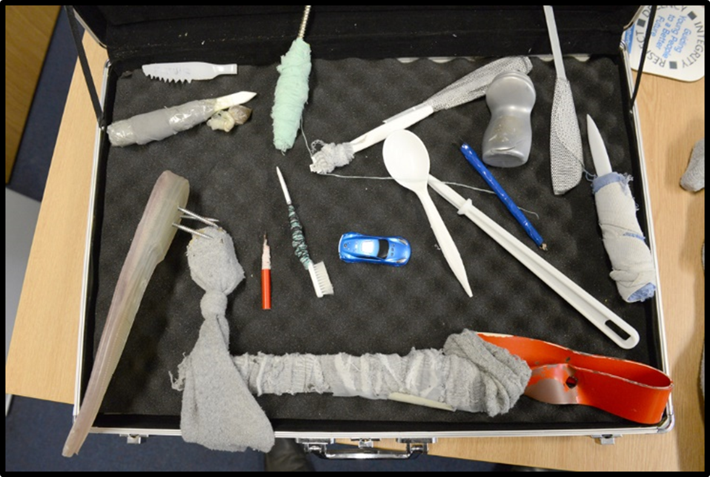
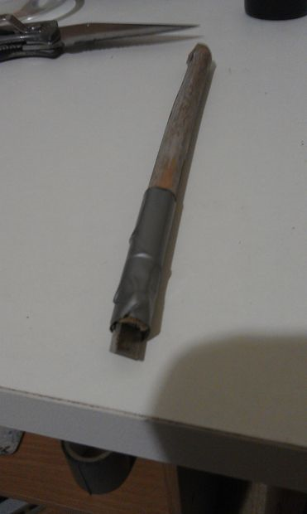
Examples of weapons ‘Adapted’ to cause injury.

Slide 10
So what are the consequences?

Slide 11
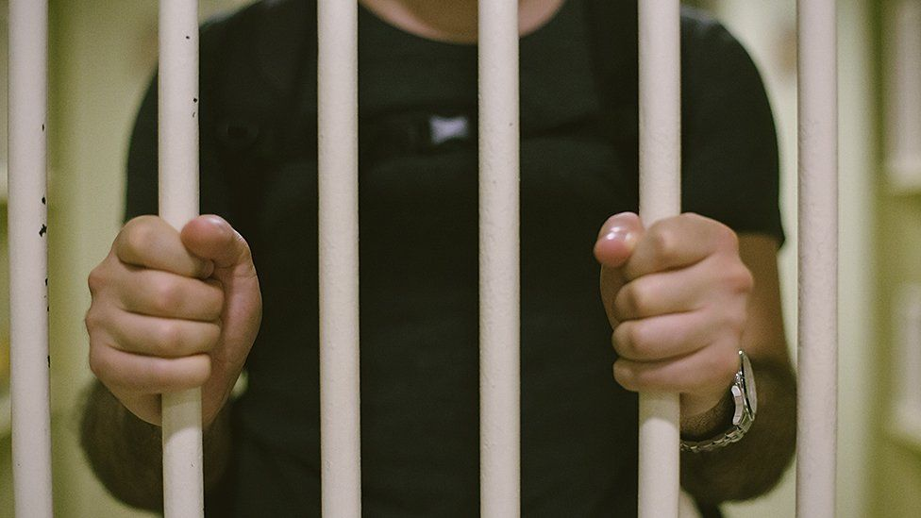

Slide 12
The effect of knife crime
How do you think knife crime would impact:-
The victim(s).
The victims families & loved ones.
The attacker.
Notes:
Split the class into three groups and give them each some flipchart paper and a pen. Give them each a heading to discuss for 5 minutes and then discuss the answers.
For suspect
Prison sentence.
Estranged from family/friendship network.
Criminal record.
Restricted travel abroad to certain countries.
Living with the consequences of the crime they have committed.

Slide 13
Knife Injuries
1 in 3 people who are injured with a knife are injured with their own knife.

Slide 14
True or False
“Its ok To Carry a knife if you don’t intend to use it”
FALSE
It is an offence to have a knife in public or on school premises.
Even if you are looking after the knife for someone else…even if it isn’t yours…even if you don’t intend to use it…even if you are only hiding it for a few minutes for someone…even if you are a girl…even if it’s being carried to defend yourself.

Slide 15
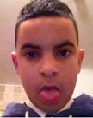
True or False
“You only get a warning for carrying a knife”
FALSE
You can get up to 4 years in prison just for carrying a knife.
18 year old Matthew Bryce-Trainor from Huddersfield was sentenced to 8 weeks in prison after a knife was found in his bag. The teenager looked stunned as he was led away by prison staff and his mother wept. He had been due to start university.

Slide 16
True or False
“A knife can do as much damage to someone as a gun”
TRUE
The smallest wounds can prove fatal. Some people believe there are ‘safe places’ to stab (Leg/Arm). The truth is there are no safe places to stab.

Slide 17
True or False
“Teachers can search students for weapons, but only with the students permission”
FALSE
Teachers can search you even if you don’t consent. They do not require your parent or carers permission.

Slide 18
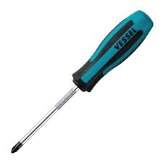
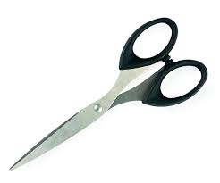
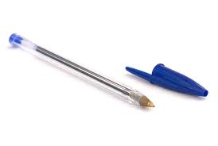
True or False
“Its LEGAL to carry a sharp object that isn’t a knife”
TRUE – BUT…..
Any pointed or bladed item is an offensive weapon if it is used to threaten or harm another person in a public place (including school).

Slide 19
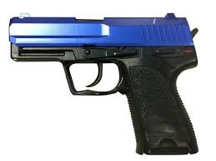
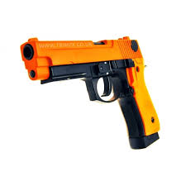
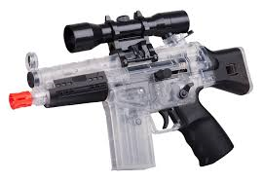
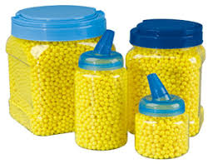
What about BB Guns?
Up to 10 Years Imprisonment
What is the maximum sentence for possession of an imitation firearm in a public place?

Slide 20
BB Guns Continued
Firearms officers will treat ALL guns as REAL until they have been examined. (irrespective of its colour)
A firearms officer only has a split second to decide if a weapon is REAL or IMITATION
Notes:
Some Criminals will spray paint REAL weapons orange/blue to disguise it as an imitation for CCTV purposes

Slide 21
Please Remember
DO NOT CARRY A WEAPON UNDER ANY CIRCUMSTANCES
If you know someone who is carrying a knife text 88551 with their details (name, school, school year, nickname, any other useful information)
Or
Speak to a trusted adult in school (teacher, safer schools Police officer, Child Protection Staff)

