Slide 1

Support & report
I can explain how someone can get help if they are having problems and identify when to tell a trusted adult.
I can demonstrate how to support others (including those who are having difficulties) online.

Slide 2
What does ‘Support’ mean to you?
List your ideas.

Slide 3

Discussion Point
When might young people your age need help or support?

Slide 4
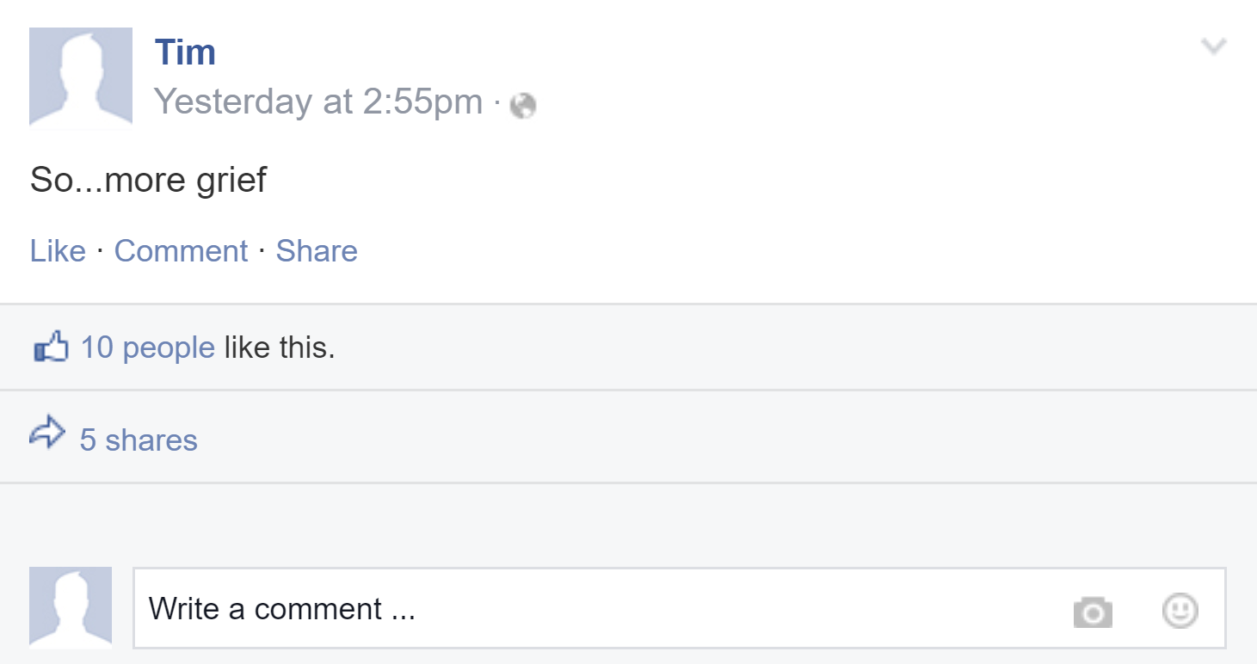

Slide 5
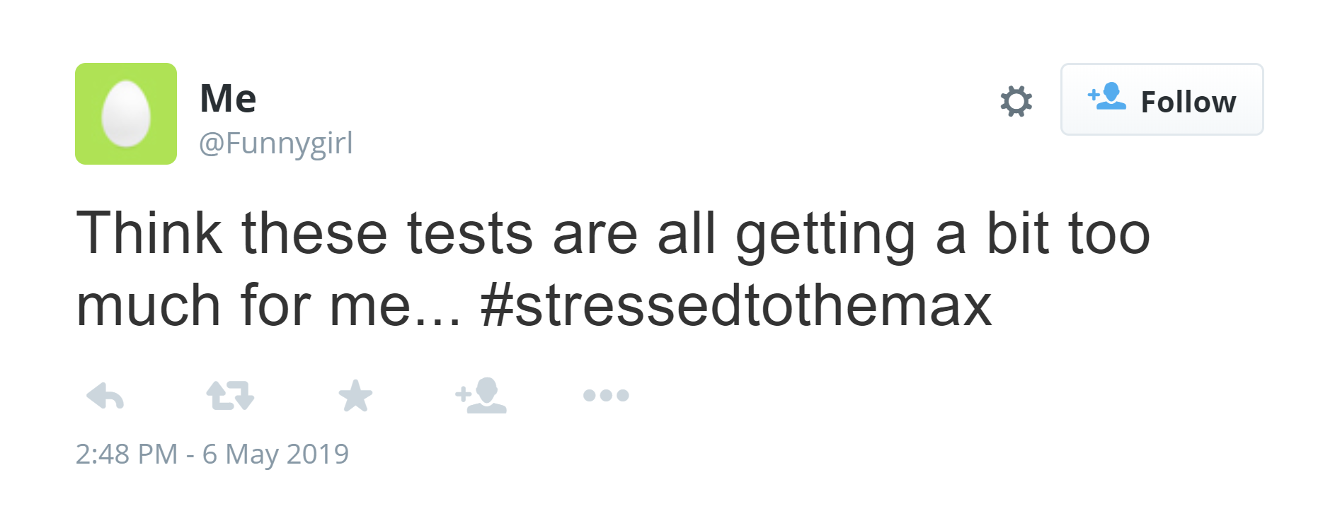

Slide 6
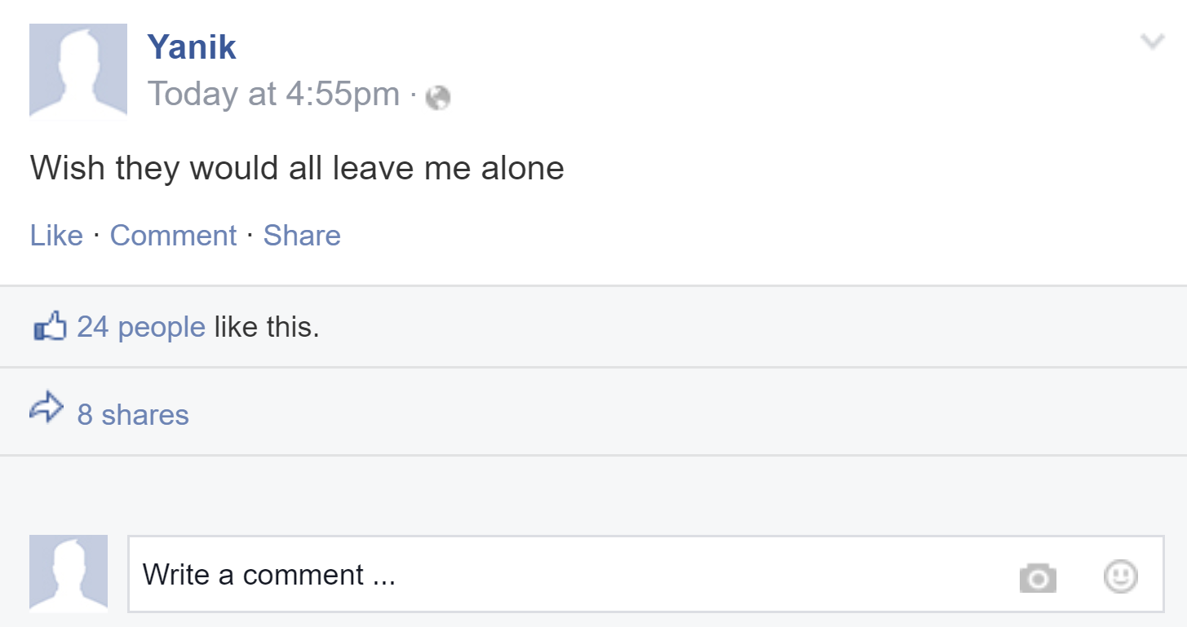

Slide 7
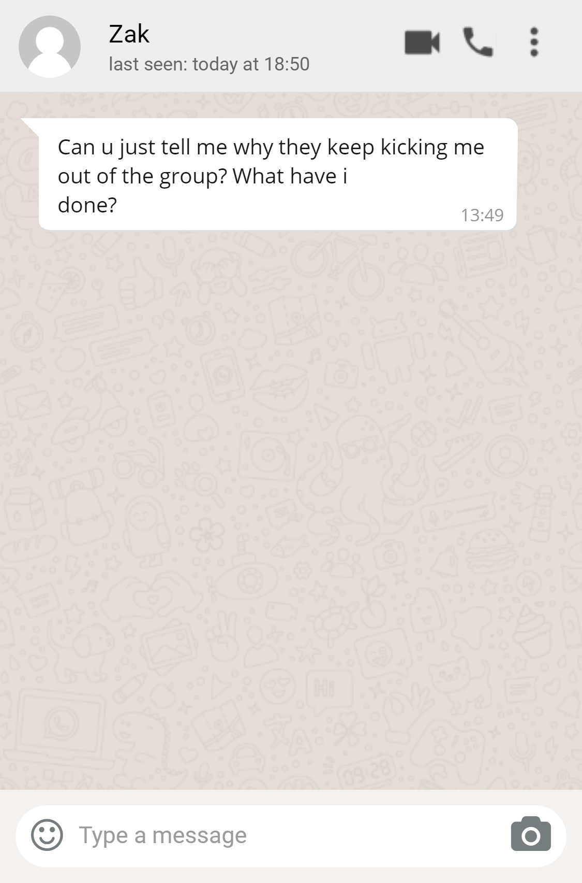

Slide 8
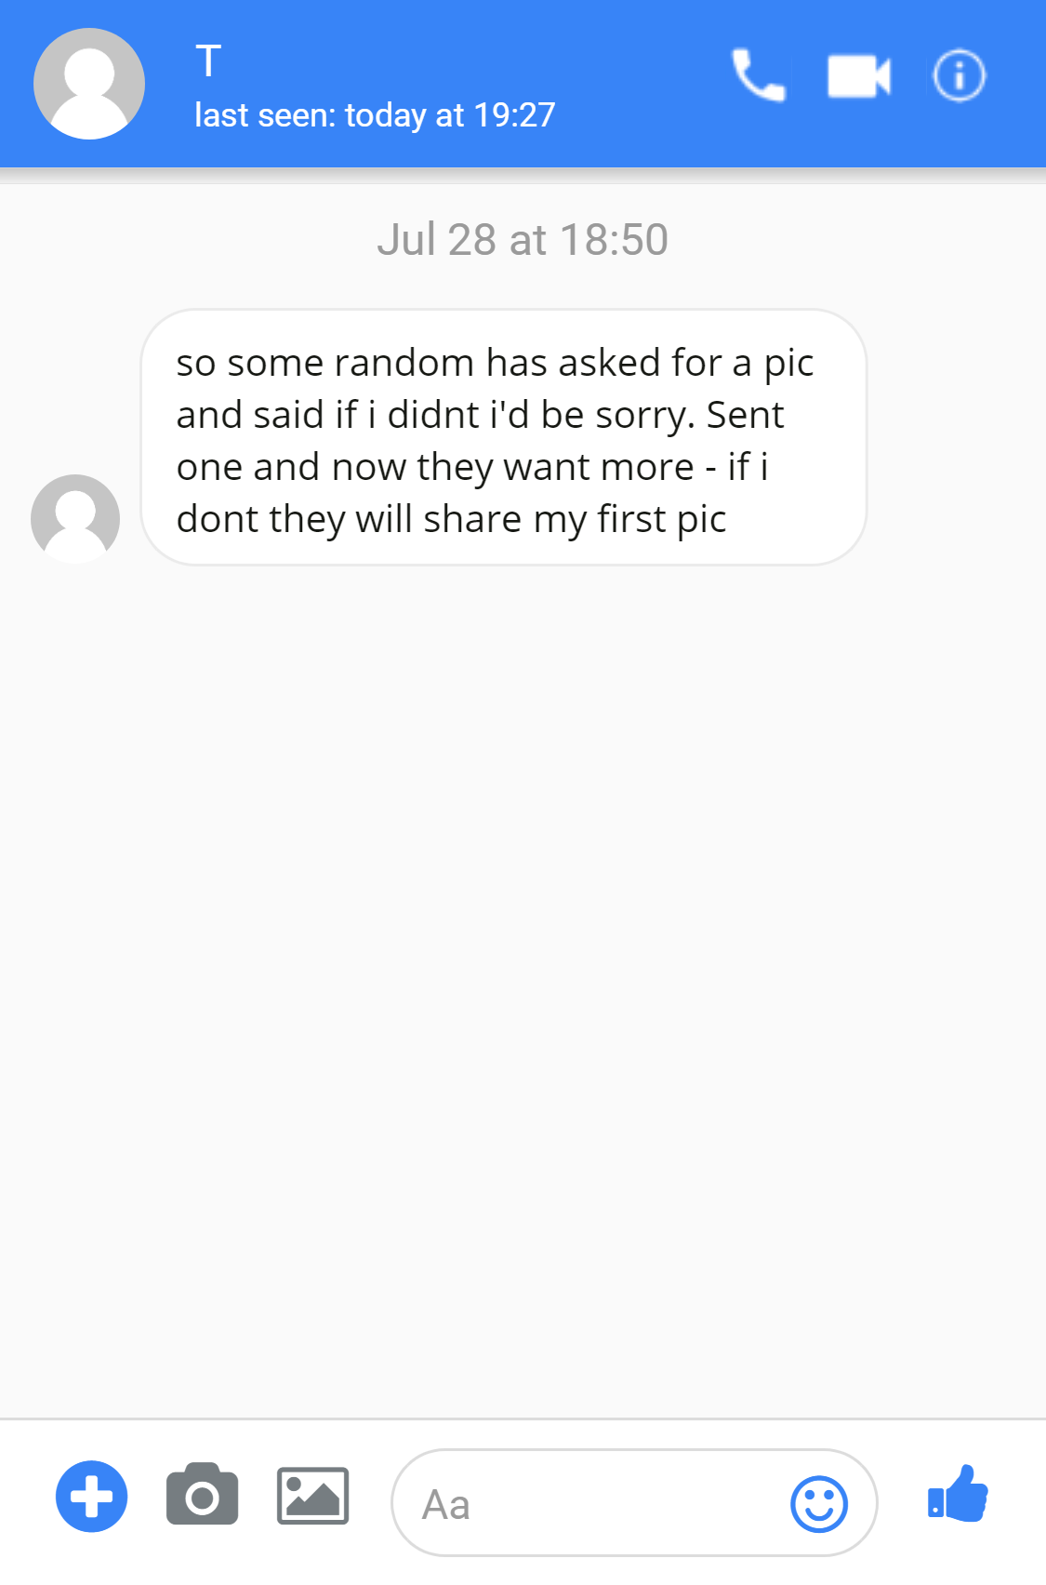

Slide 9
What reporting routes do you know?

Slide 10
Reporting - who, what and how?
Someone asks your friend to send them some ‘cute’ pictures of themselves on social media - they are older than your friend...

Slide 11
Reporting - who, what and how?
Your friend has started to post a lot of posts to do with exercise and eating less....

Slide 12
Reporting - who, what and how?
You have started to receive lots of abusive posts on YouTube...

Slide 13
Reporting - who, what and how?
You are receiving nasty messages on social media from lots of unknown accounts...

Slide 14
Reporting - who, what and how?
One of your friends has gone off to meet someone they met online. You know the person is quite a bit older...

Slide 15
Reporting - who, what and how?
Your friend is gaming until the early morning and it’s starting to affect their mood...

