Slide 1
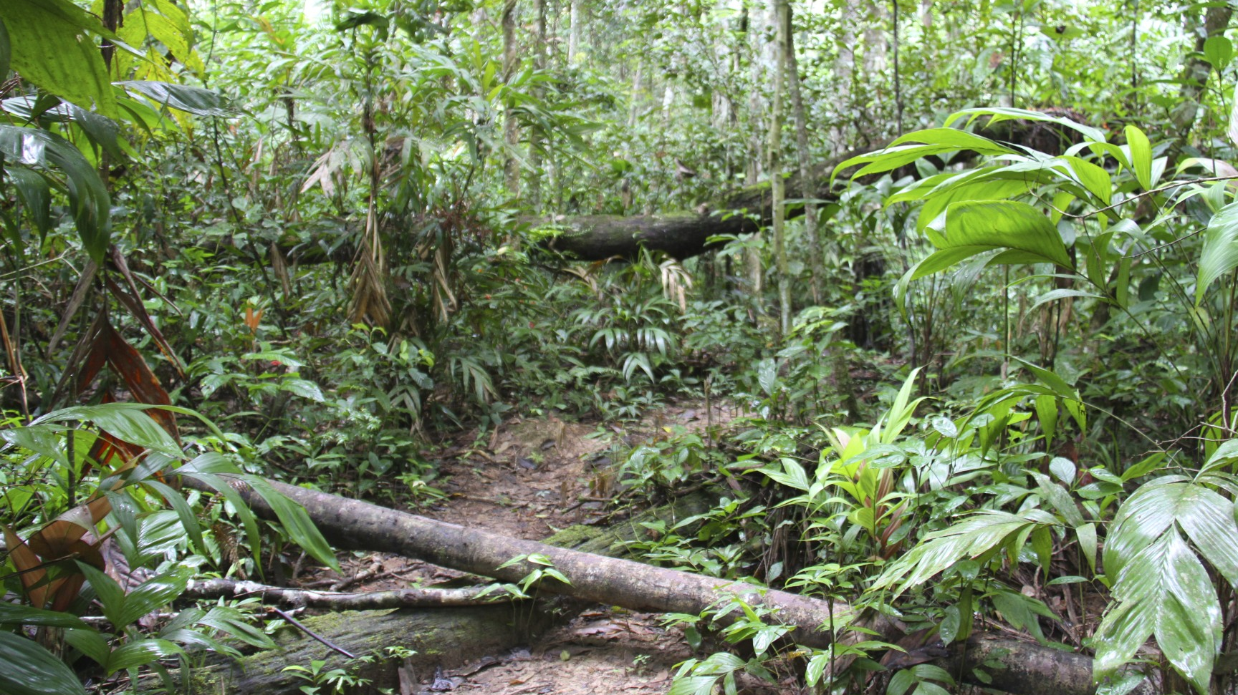
The deadliest animals of the Amazon Rainforest
By Joe Gatenby-Barraclough

Slide 2
Contents
Overview of the deadly creatures of the Amazon Rainforest.
The piranha
The brazilian wandering spider
The green anaconda
The poison dart frog
The most deadly of all: The jaguar
Conclusion and honorable mentions

Slide 3
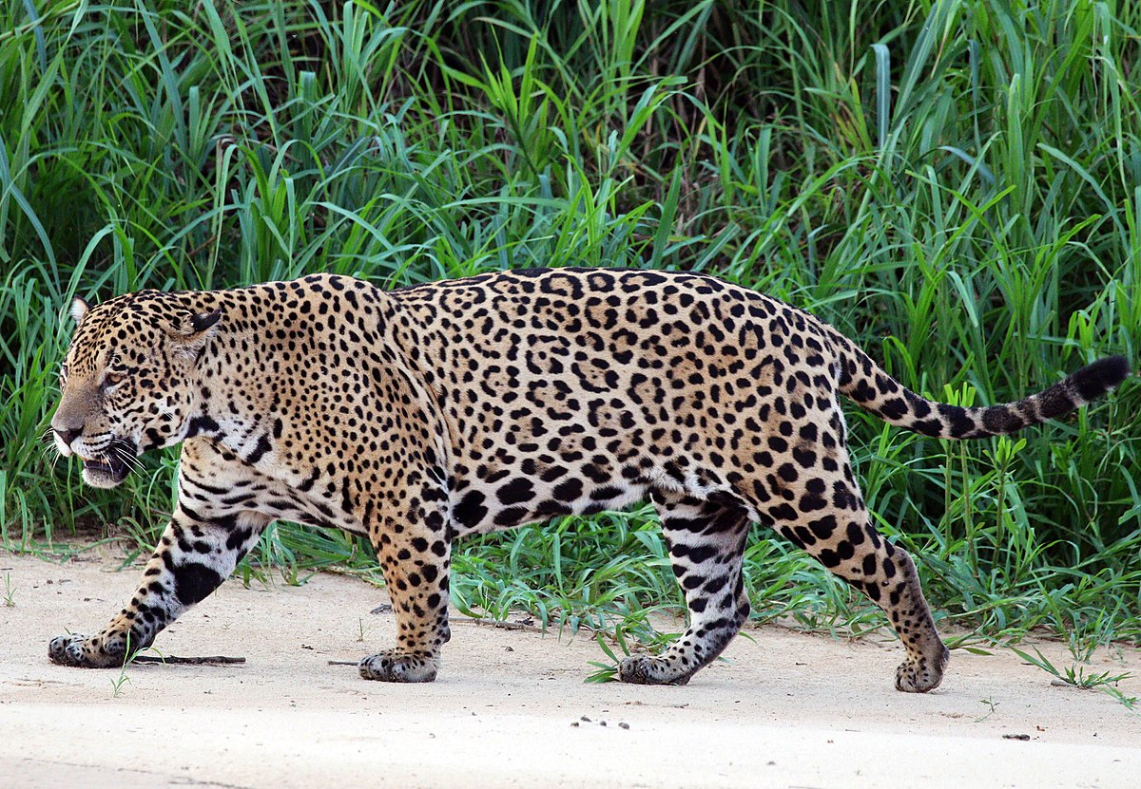
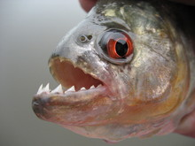
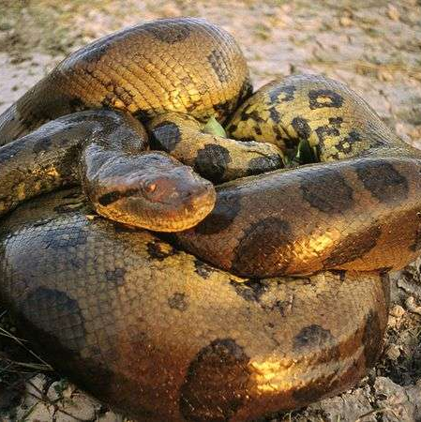
An overview of the deadly creatures of the Amazon Rainforest
The Amazon Rainforest is the home to plenty of animals, including some of the deadliest in the whole world, but are all so unique and different that it's kind of surprising that all of them live in the same place. When you think of the deadly animals in the rainforest however, you may think of the ferocious caiman (it's similar to alligators and crocodiles) or the king vulture, which are deadly but not as deadly as some. Even something as small as an ant can be one of the most deadly animals in the world. Some of the actual deadliest are the poison dart frog, green anaconda and piranha.

Slide 4
Piranha
Piranha are truly the Amazon's deadliest fish, though it may be small, its jaws are mighty. Piranhas are often seen in large shoals swimming through lakes and rivers. Though there are a few different kinds of piranhas, the deadliest is easily the red-bellied piranha which can tear flesh off bone in just a matter of minutes.
Many people think that piranhas are blood-thirsty carnivores but that isn't true. Piranhas are omnivores that will not only eat fish and bugs, but they will eat plants as well.
What makes a piranha so deadly, you might ask. Well that is its row of razor sharp fangs!
I certainly wouldn't want to anger a shoal of piranhas in the rainforest. Would you?

Slide 5
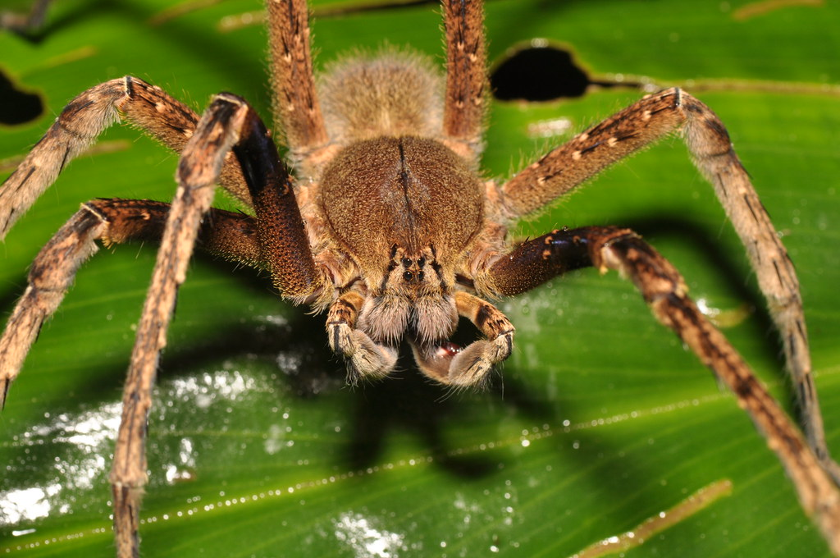
Brazilian Wandering Spider
The brazilian wandering is a small but super insect! It's the deadliest spider you'll find in the Amazon. You'd better watch out for this injecting insect. If you aggitate this arachnid, it will use its deadliest weapon to make you regret ever crossing paths with it.
This nightmarish thing eats things its size or larger. These include insects, other spiders and even small amphipians, reptiles and mice. Good thing it's not our size, otherwise it would probably be having us for lunch!
This arachnid alchemist's deadliest weapon is its venom. If it gets chance and injects you with its potent poison the symptoms you will face include pain radiating to the chest, an increased heart rate, dizziness, nausea, coldness, drooling and vomiting. People can truly say that this spider is deadly!

Slide 6
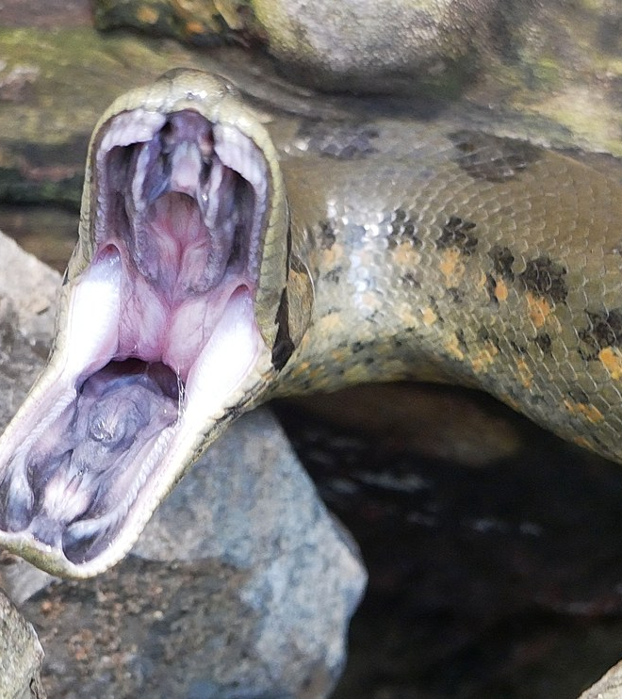
Green Anaconda
This deadly reptile uses its strong jaws to capture its prey, uses its body to suffocate them and then swallows them whole. This is a very effective hunting technique too. If they wanted to then they could actually swallow a human whole.
Green anacondas usually prey on fish, reptiles( including caiman), amphibians, tapirs, deer, dogs, capybaras, sheep, and any other animals that come down to drink from the water where the anaconda resides.
Green anacondas are a kind of snake that thrives in the water even more than they do on land. Even with their large bodies, they can move quite quickly in the water. This is definitely a dangerous animal.

Slide 7
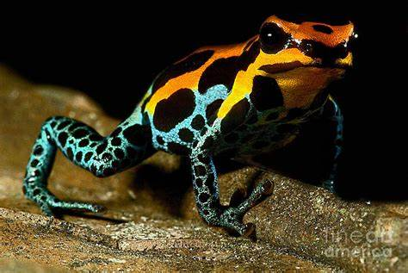
Poison Dart Frog
This vibrant-coloured amphibian is a key part in hunting in indigenous tribes. Their bodies are covered in a potent poison that people in the past rubbed darts( arrows) against that paralyzes and slowly kills anything that touches or eats it.
It preys on all kinds of bugs including fruit flies, termites, ants, young crickets, and some smaller species of beetles. Only one thing eats this animal though, the leimadophis Epinephelus, which is a species of snake that has adapted to its venom.
Poison dart frogs may not be the biggest but their poison definitely makes up for it.

Slide 8
The deadliest of all: The jaguar
The jaguar is a ferocious feline. It’s the deadliest animal in the Amazon Rainforest. It uses its ninja-like camouflage to sneak up on its prey, and then pounces, unleashing the fatal blow. This big cat will kill you if you annoy it. It will do this by biting something that every animal( including people) has; the neck.
This smart creature hunts multiple animals including peccaries, capybaras, pacas, agoutis, deer, opossum, rabbits, armadillos, tapirs, caimans, turtles, livestock and other various reptiles, birds and fish species. That’s A LOT!
Unlike the amount of prey it hunts, nothing really hunts jaguars. They are deadly apex predators that you could call the king of the rainforest!

Slide 10
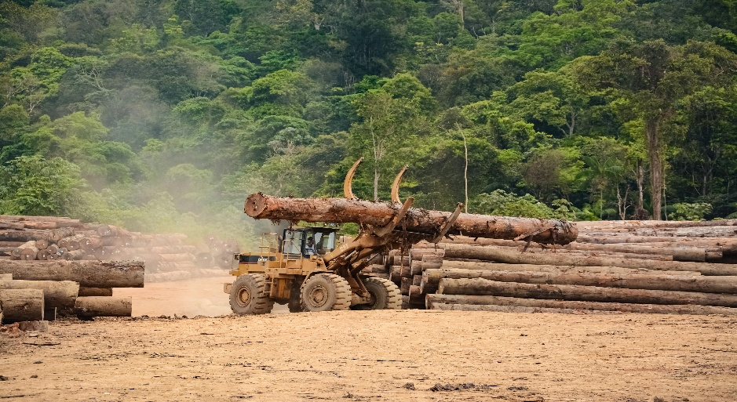
Conclusion
Deforestation
One of the biggest threats to the animals of the rainforest is deforestation, which is the destruction of a large area of trees at a time. More than a football pitch is destroyed in the Amazon Rainforest each minute.
Honourable mentions
There are some animals that are quite deadly but I haven’t given a full page about them. This is either because they aren’t the deadliest or you would expect them to be deadly.
Caiman- A crocodile- like creature that preys on multiple different animals using their strong body.
Electric eel- An aquatic animal that uses electricity to hunt prey in the water by electrifying it.
Bull shark- A species of shark that is quite aggressive and will attack and overwhelm anything.
Reforestation
This is a new plan that is about replanting seeds to grow the trees that have been cut down. This is a robot made by ABB to help reforestation and can plant enough seeds to fill two football fields in one day.

