Slide 2
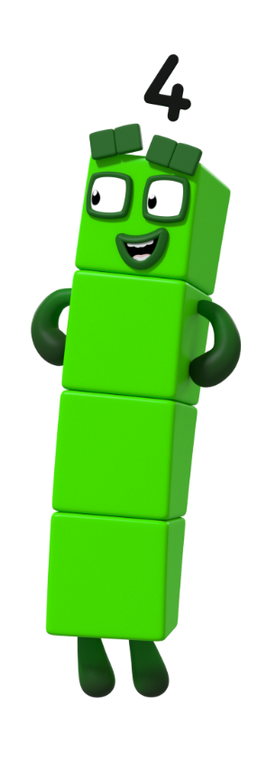
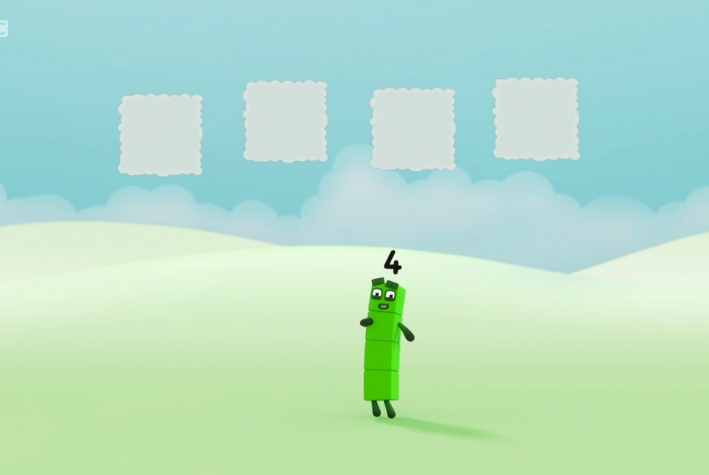
next
How many clouds can you see?
I can see…
1
2
3
4
That’s right! There are 4 clouds!
Click me!

Slide 3

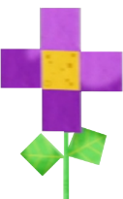
next
Can you count the flowers?
I think there are 4 flowers. Am I right? How do you know?

Slide 4

next
Let’s check!
How do you know it’s 4? Is there a different way to show 4?

Slide 5

next
Can you see 4 in this picture?
Can you show me 4 on your fingers?

Slide 6
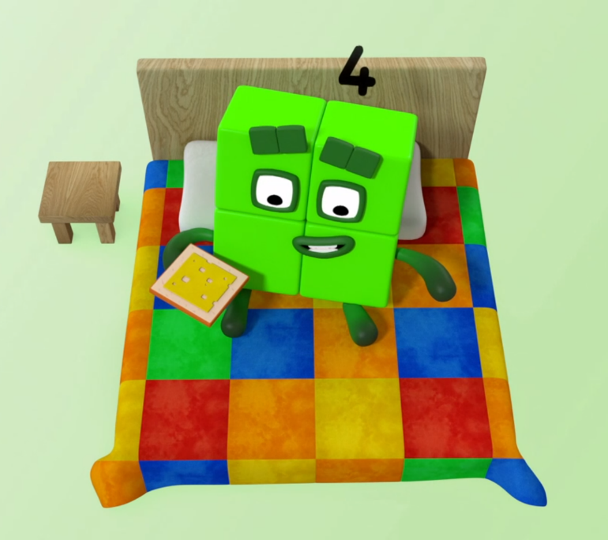
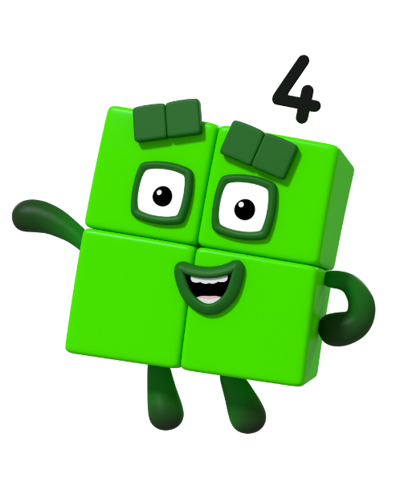
next
Did you spot my favourite shape? What shape is it? How many sides does it have?
Can you see 4 here?

Slide 7
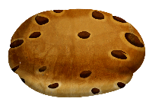
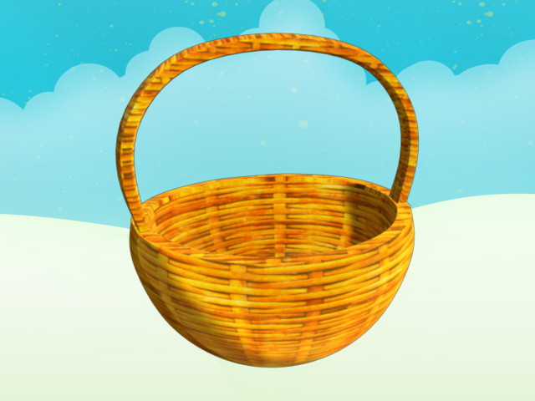
next
I think there are 3 buns. Am I right? How do you know?
Can you count the buns?

Slide 8

next
Let’s check!
Count the buns with me.

Slide 9
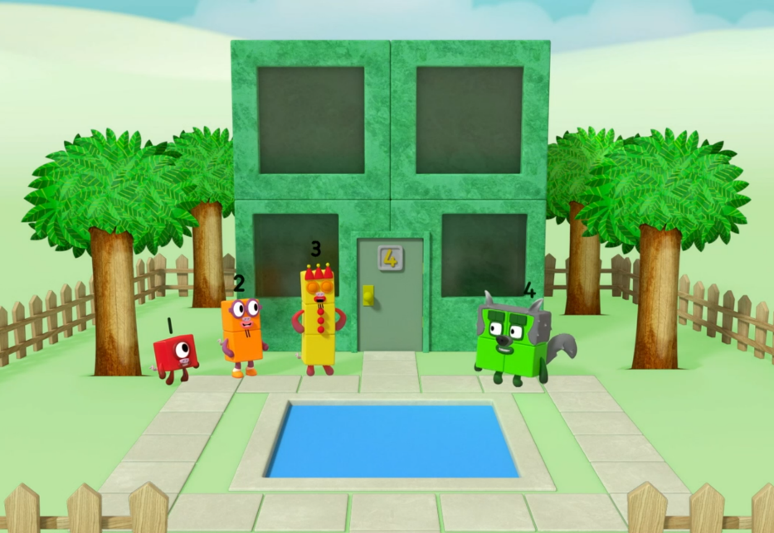
next
Can you see 4 in this picture?
Tell a friend what you found. Can you count them together to check?

Slide 10
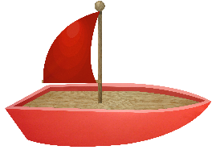

next
I need 2 more boats to make 4.
How many boats can you see? How many more boats do I need to make 4?

Slide 11


next
How many bees can you see?
How many more flowers do we need for each bee to have their own flower? How can you work it out?
I need 3 more flowers for the bees to have 1 each.

Slide 12
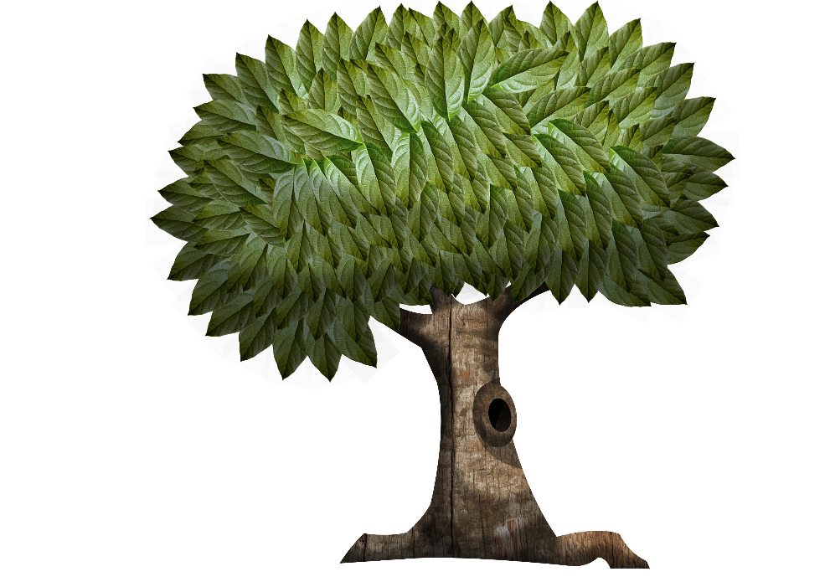

next
How many apples can you see? How many more apples do I need to make 4?
1 more apple makes 4.
3 + 1 = 4

Slide 13






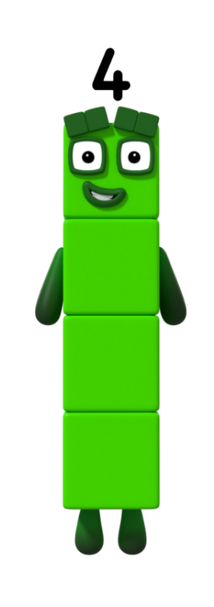

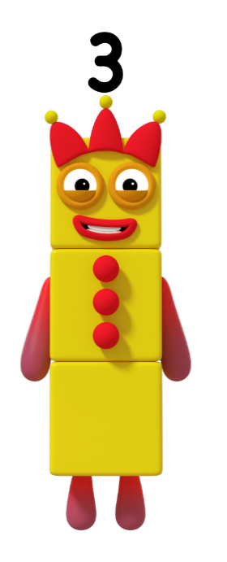

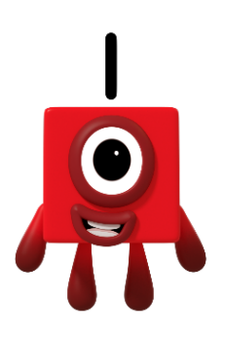
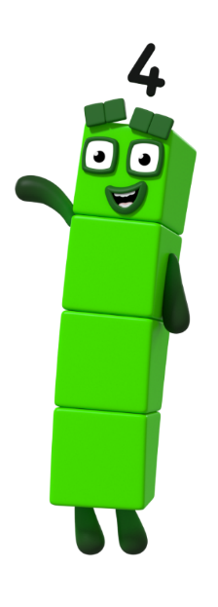

next
+
=
3 + 1 = 4

Slide 14

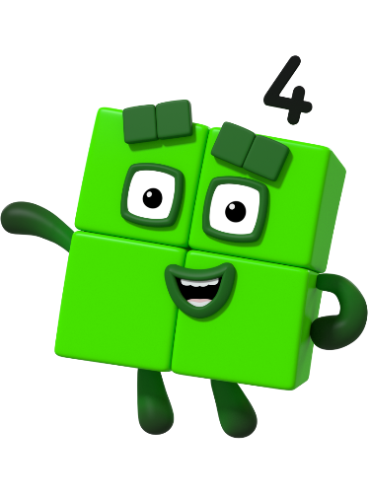


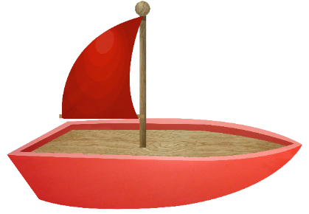
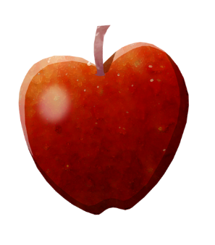

Can you remember the different ways that you saw 4? Say, “I can see…”

