Slide 1
THE AMAZON RAINFOREST PLANTS AND ANIMALS
Presented by: Grace Poole 6GH

Slide 2
The Amazon has a massive variety of plants and animals such as towering trees over 200 ft tall ! An animal in the Amazon rainforest could be a sloth .

Slide 3
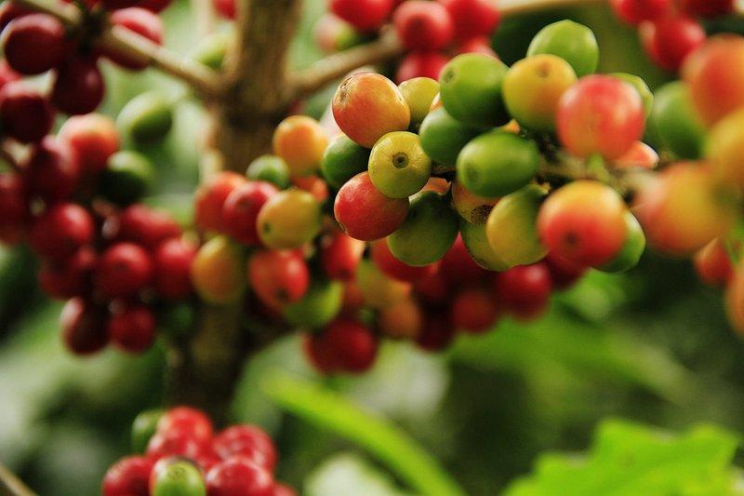
COFFEE PLANT ( COFFEE ARABIA)
Now this looks like our normal grapes but these are actually Coffee plants ! Can you believe that !
Coffee trees are evergreens that produce white blossoms and coffee at the same time ! The tree lives for over 50 years

Slide 4
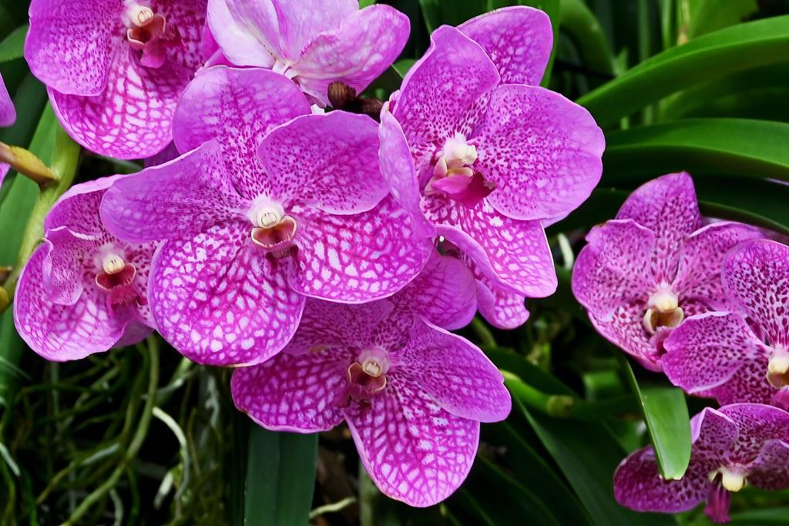
ORCHIDS
Now Orchids are our normal plants that we can buy in the shops but they are actually apart of a family (Orcidacaeae) and it is a diverse plant you can find it anywhere except the glaciers !

Slide 5
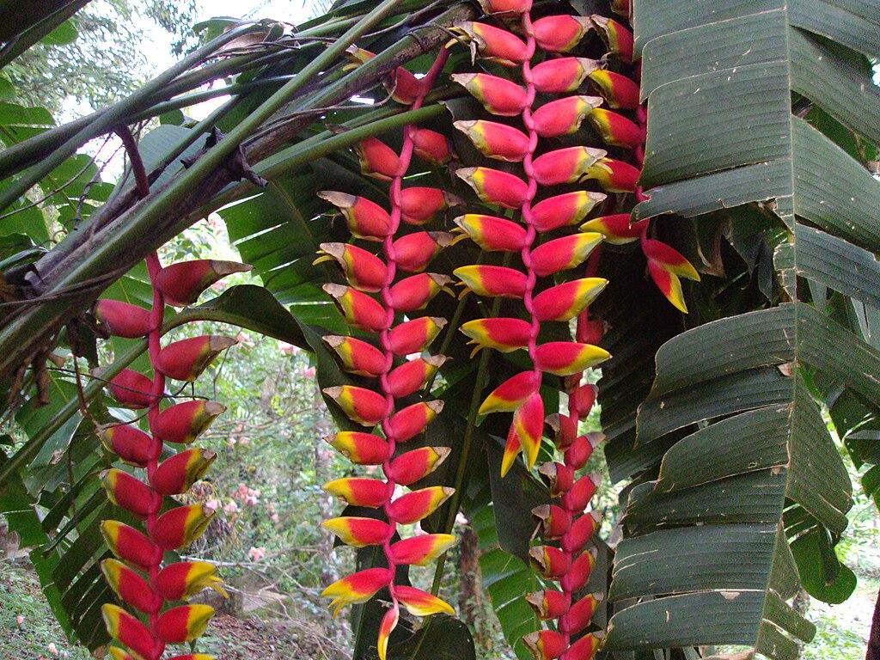
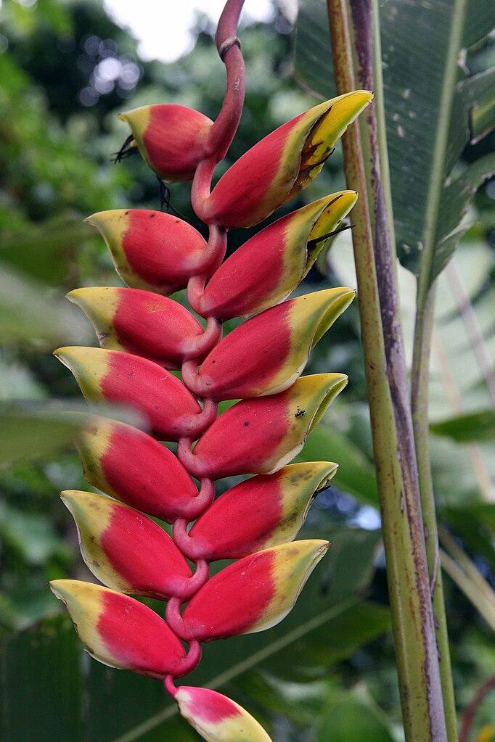
LOBSTER CLAWS
The lobster claws are actually also apart of a family . (Heliconiaceae) These plants are the most known species are native to Tropical Americas,but few are indigenous to certain areas of the western Pacific Maluku in Indonesia but are mostly found in tropicals

Slide 6
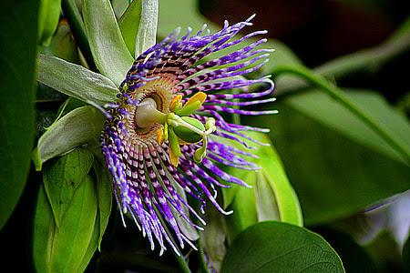
PASSION FLOWERS
Passion flowers are known for there variety in colours and have about 550 different species of flowering plants! They also have indigenous groups in the Amazon Rainforest and that is where we get passion fruit juice from!

Slide 7

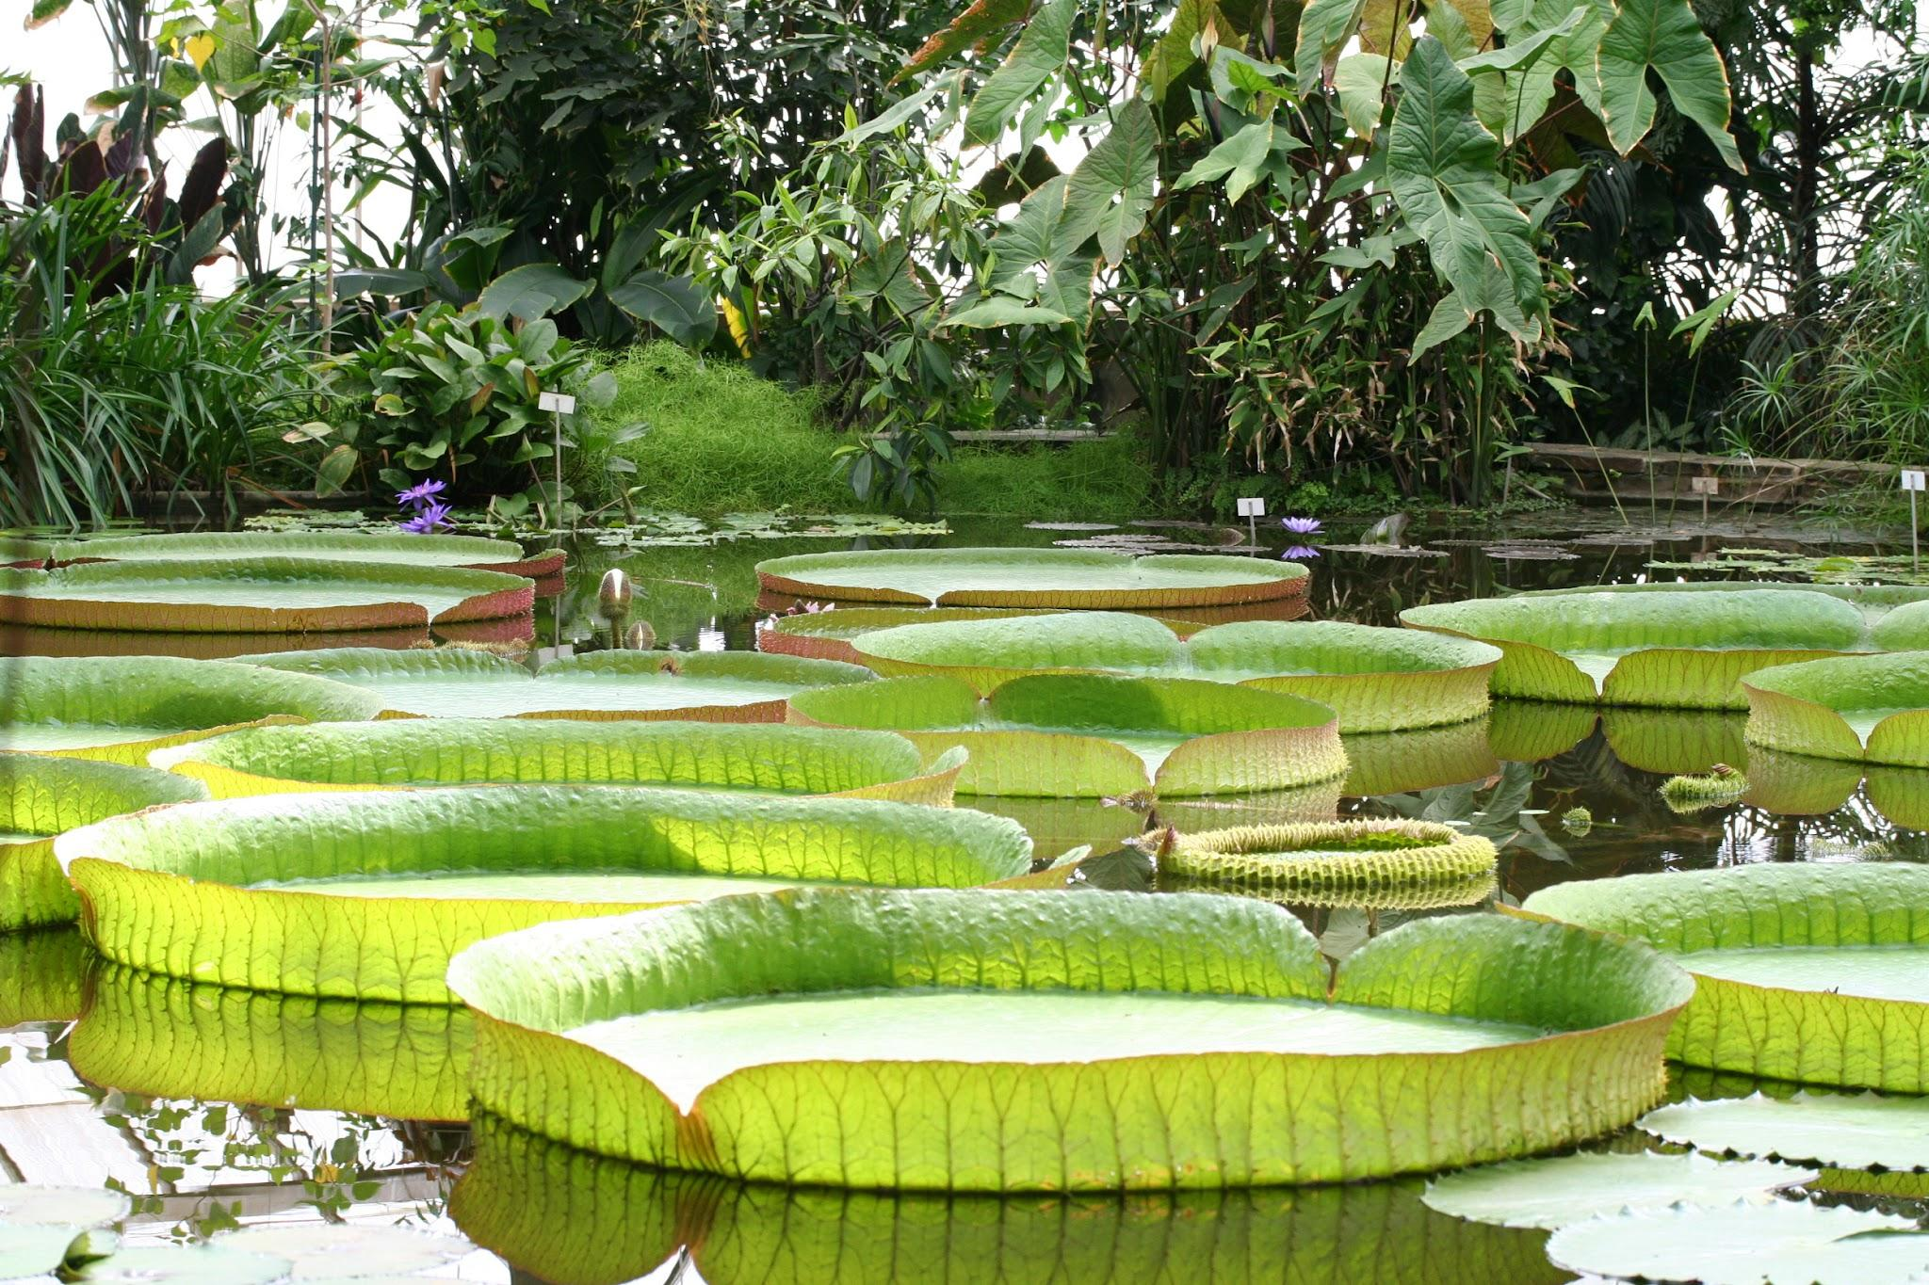
WATER LILY VICTORIA AMAZONIA
The Victoria Amazonia plant is the second largest plant in the amazon and is in the lily plants family Also is the largest lily plant in the world !

Slide 8
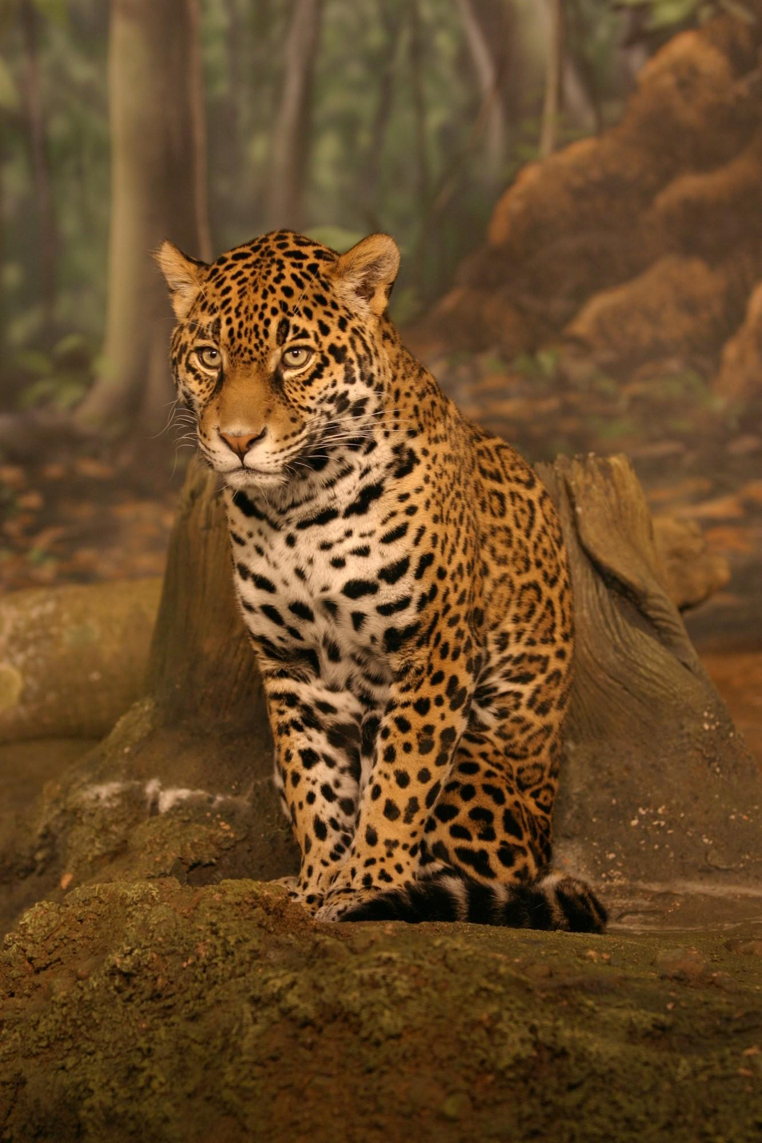
JAGUARS
Jaguars are prone to water. These big cats are very big with a length of 1.85 meters and is the 3rd largest animal in the world !

Slide 9
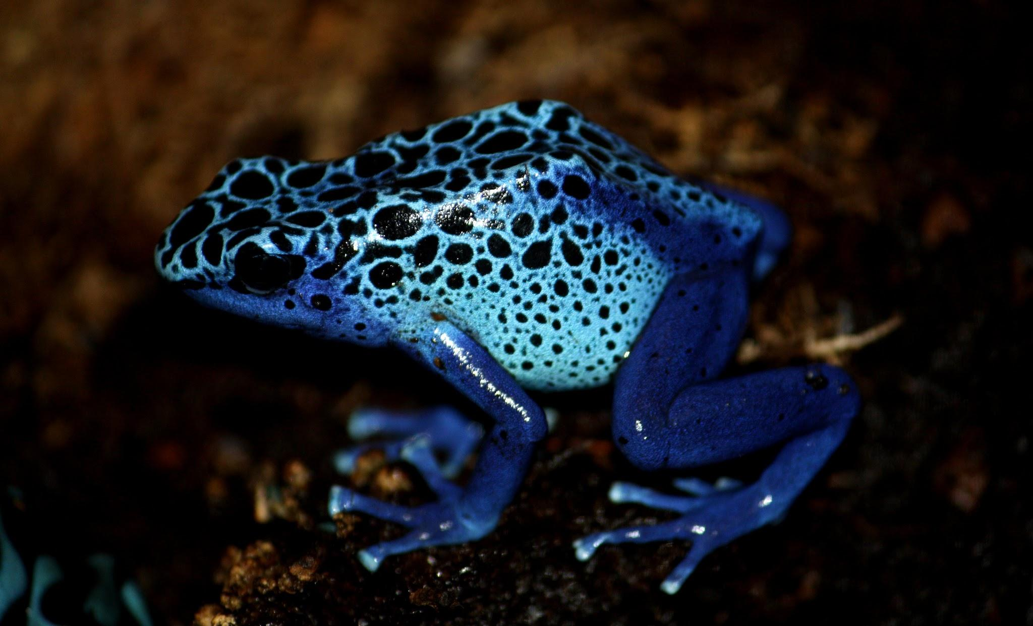
POISON DART FROGS
Poison dart frogs are very poisonous, in fact they can kill 2000 mice in one touch! Poison dart frogs has this poison on their skin so if you touch them you will cause slight numbness and death !

Slide 10
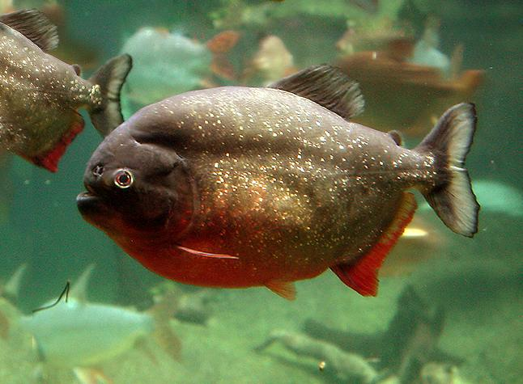
RED-BELLIED PIRANHA
Now this fish lives in the water . The Red-bellied piranha is known actually for its name Red Piranha . These are native to South America found in the Amazon Paraguay , Parana . This animal is dedicated to freshwater habitats .

Slide 11
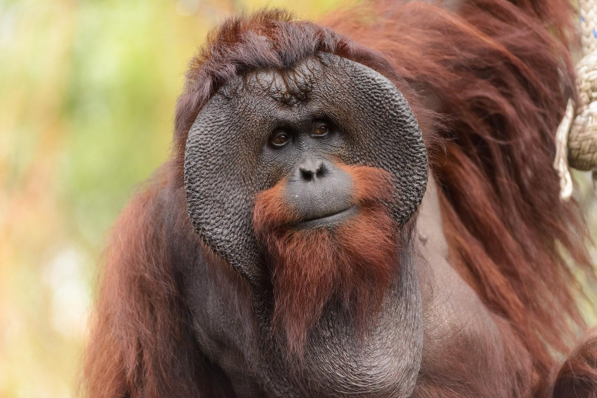
ORANGUTANS
Orangutans are great apes to the rainforests of Indonesia and Malaysia. They are now only found in parts of Borneo and Sumatra and during the Pleistocene they ranged throughout Southeast Asia and South China. Classified in the genus Pongo,orangutans were originally considered to be one of the species .

Slide 12
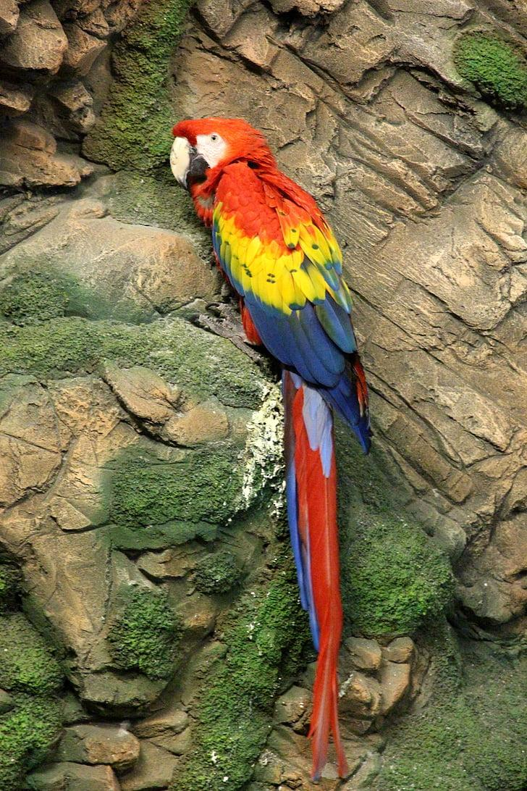
SCARLET MACAW
The Scarlet Macaw is a bird in the Amazon rainforest but is also named the red-and-yellow red and blue macaw . The macaw is a large : yellow,red and blue neotropolic parrot is native to humid evergreen forests of Americas .

