Slide 3
Adult Guidance
This presentation is designed to support practitioners with helping children and young people to understand two different special educational needs - Autism Spectrum Condition (ASC) and Attention Deficit Hyperactivity Disorder (ADHD).
This presentation is designed to give a simple overview of each need. It is not designed to cover every trait or characteristic. We understand and recognise that both special educational needs differ and that they are individual to each child.
The information given here is intended for general guidance purposes only and may not apply to your specific situation.

Slide 4
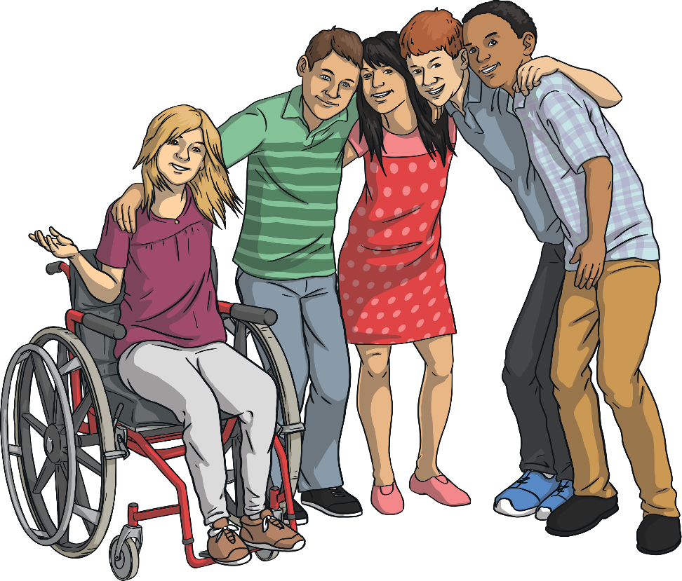
Understanding Each Other
We are all different and we are all individual.
Some people have a special educational need or disability, such as Autism or ADHD, that makes them unique in their own way.
You may have friends in your class that are neurodivergent.
Neurodiversity is a word to describe brain differences. Every brain is unique and every individual brain works in different ways.

Slide 5
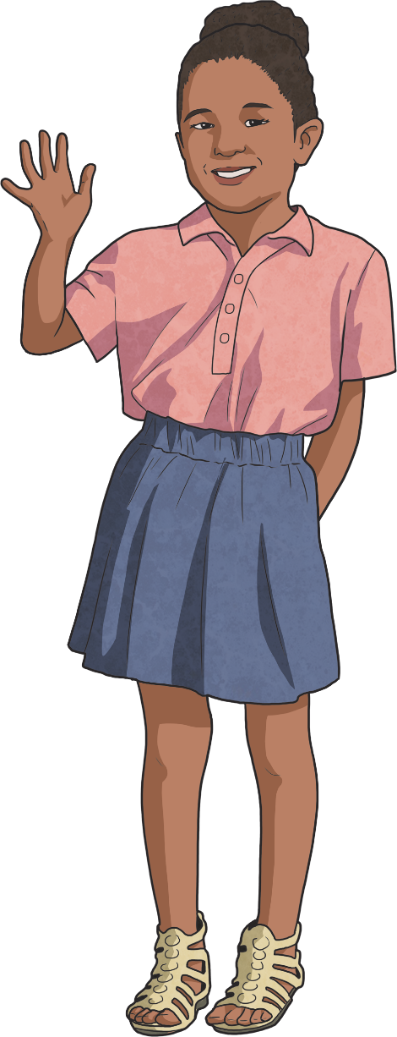
How Do You Know If Someone Is Neurodivergent?
Due to how our brains work, everyone interprets sensory and physical information differently.
Neurodiverse conditions include:
Attention Deficit Hyperactivity Disorder (ADHD)
Autism Spectrum Condition (ASC)
dyslexia
dysgraphia
There are many more types of neurodiversity. This list just includes a few.
It can be difficult to recognise neurodiversity as it is not a visible condition and every person will be unique.

Slide 6
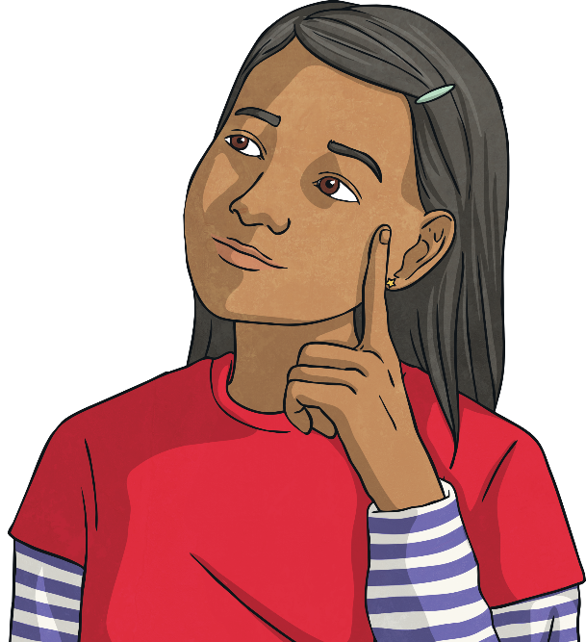
What Is Autism?
Autism is a lifelong condition. An Autistic person may see, hear and feel things in the world differently to neurotypical people.
Some Autistic children and adults may also have additional learning needs, although this is not always the case. The amount of support an Autistic person needs is unique to each individual.
Lots of Autistic children go to mainstream schools, while others require support at special schools.
Emotions can be difficult for all children to handle. It is important to understand this about our neurotypical and neurodivergent friends. Some Autistic children may carry out certain actions again and again. This is called ‘stimming’ and it can help them to regulate how they are feeling.

Slide 7
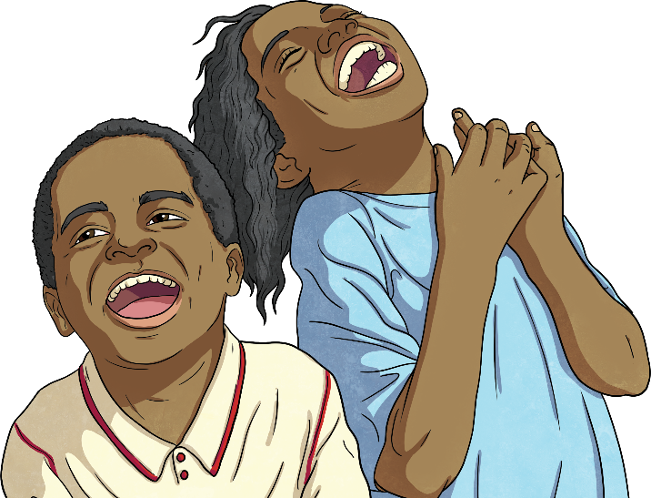
What Is Autism?
Some Autistic children might interact with others in a different way. They may talk a lot or they may prefer not to speak and this is OK. Everyone communicates differently and we must respect individual choices.
Certain tastes, textures, smells and sounds can be overwhelming for some children - this is called 'sensory overload'. They may avoid certain situations, activities or places because of this. However, on the other hand, some people may be sensory seekers and some will seek out certain tastes, smells, textures and sounds because it comforts them.
You might know friends, family or members of your community who are Autistic or have another form of neurodiversity.

Slide 8
How Can We Help?
Be patient and understanding with all of your friends.
Be clear when you communicate with others. Some children may take things literally. This means phrases like ‘wait a minute’ may be understood by the other person as needing to wait exactly one minute.
Some people find joining in with games at breaktimes or with group activities very stressful. Try to make these situations more comfortable by not forcing anyone to do something the way you do if it makes them anxious. Respect that everyone makes individual choices.
Remember that everyone is unique and this should be accepted. We must appreciate each other’s diversities.

Slide 9
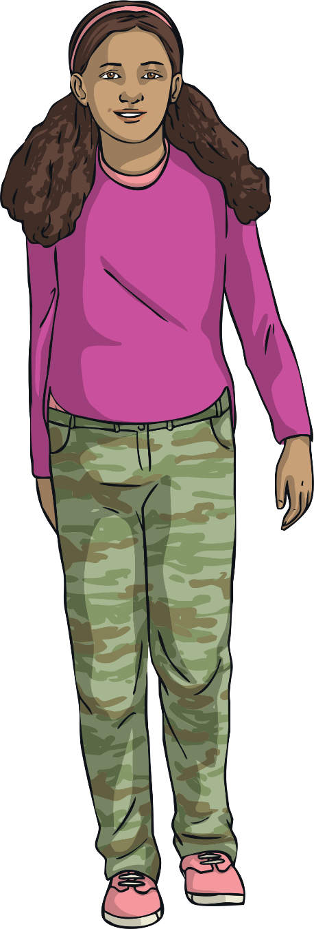
What Is ADHD?
A child who has a diagnosis of ADHD may find it harder to control their activity level and their reactions to what is going on around them. Sometimes, they can be impulsive.
Some children find it difficult to concentrate on tasks for long periods of time. However if it is something they enjoy, some children can be hyper-focused and complete their work quickly.

Slide 10
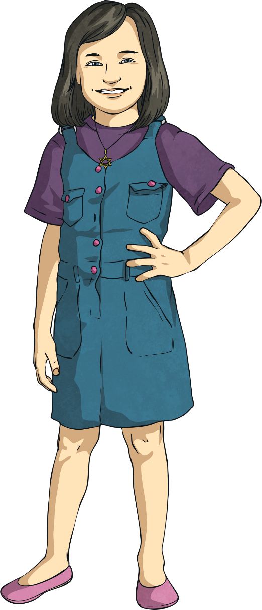
What Is ADHD?
Some children with ADHD may have difficulty following instructions or listening in the classroom.
Some children with ADHD may move excessively or fidget. They may find it difficult to settle themselves in lessons or when they have to concentrate.
Most children with ADHD go to mainstream school, while some require support in special schools.
You might know friends, family members or people in your community with ADHD or another form of neurodiversity.

Slide 11
How Can We Help?
Be patient and understanding with your friends who have a diagnosis of ADHD. You may need to repeat yourself or check they have understood what you have said.
Friends may sometimes need a quiet space to calm down or time out of the classroom. You can help them to find a safe space and let a teacher know where they are.
Some children may find it difficult to understand rules and wait their turn. They may find it challenging if they lose when playing a game. How do you think you could help in this situation?

Slide 12
How Can We Help?
Friends who have a diagnosis of ADHD may like to use a fidget object, such as a small toy, a ball to squeeze or some special putty.
Some children may prefer to sit in a quiet area to help them avoid distractions and focus on their learning.
Sometimes, children with ADHD may do things unexpectedly and this may take you by surprise.

Slide 13
The Same but Different!
Remember:
Everyone is unique and this should be accepted.
We must appreciate each other’s diversities.

