Slide 1
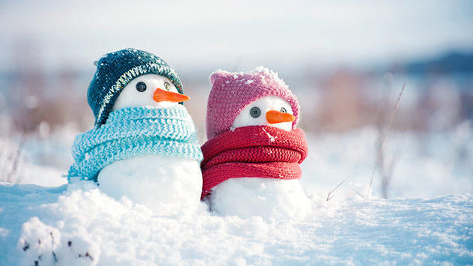
Happy Snow Day from Year Two!
We are very excited that today is a snow day but we are going to miss seeing you all today! We would like you all to have lots and lots of fun in the snow and stay safe! We are excited to hear all your stories and adventures when we return to school. Please send in photos of wonderful snowmen and any other fun you have in the snow! We would love to see them! We have popped a few learning ideas below just in case you are missing school today!

Slide 2
English Home Learning
If you would like to practise some English you can have a go at writing some step by step instructions on how to build a snowman. We know you may have already built one but can you remember what you need to do?
When you do this the main focus is to practise your clear sentence writing skills. Remember, phonics sounds, finger spaces, clear graphemes, full stop at the end of each sentence and capital letter at the beginning.
Ideally we would like you to try to use some verbs. E.g Put a small stick on each side of the middle ball to give your snowman arms. If you bring your instructions into school, we will be giving out some house points.

Slide 3
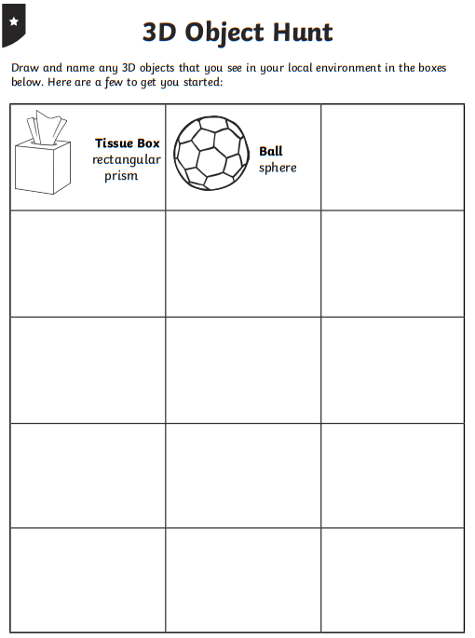
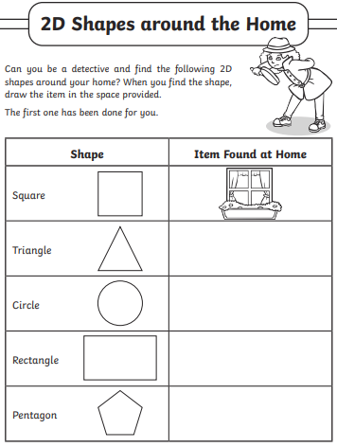
Maths Home Learning
Let's revisit shapes. Think about 2D and 3D shapes.
Can you go on a shape hunt around the house?
Think about…
Does the shape have curved sides or straight sides?
Does it have corners, how many?,
Does the shape have faces? (3D) what shape are they? Can you see another 2D shape in the face?
Record what you find. What shape is the most common in your home?
https://www.youtube.com/watch?v=guNdJ5MtX1A

Slide 4
Computing Home Learning
Recapping our learning before Christmas, we looked at taking photographs.
Your task is to take some snowy photos (inside or outside). These can be through the window, what can you see?
We looked at:
Landscape or portrait, which should we use?
Is the subject in the middle of the photograph?
What does a good photograph look like?
Is it blurry? How can we fix that?

Slide 5
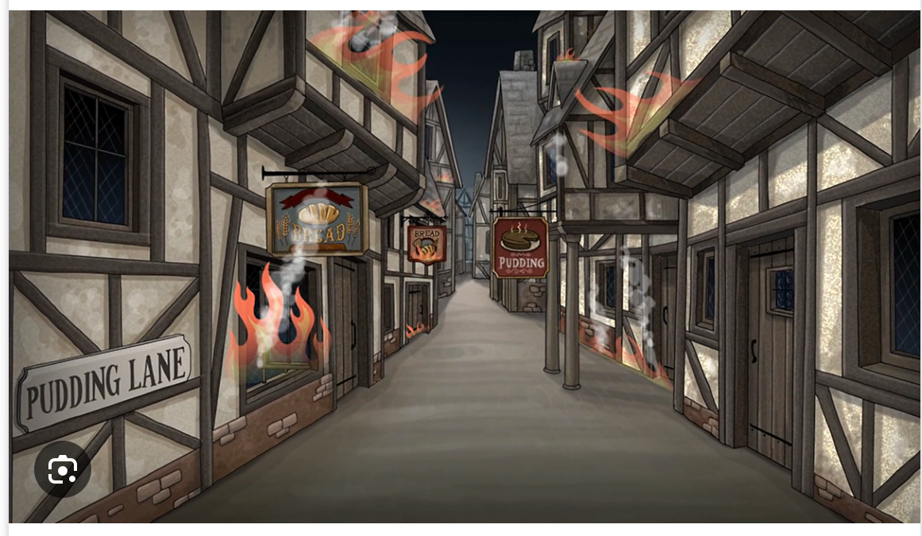
History Home Learning
https://www.bbc.co.uk/bitesize/articles/z4msn9q
How did the Great Fire of London start? When did it happen?
Draw a picture of the bakery and make a list of all the facts you have learnt.

