Slide 1
How to Apply Online for a School Place
City of Bradford Metropolitan District Council
Department of Children’s Services
School Admissions Team

Slide 2
Go to the Website
Go to www.bradford.gov.uk/admissions and click on ‘Apply now for a place at school’.
This takes you to the Citizen Portal.

Slide 3
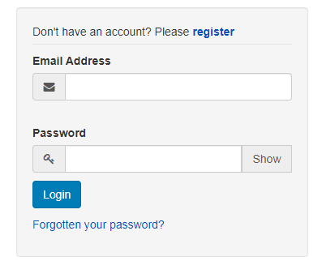
Creating an Account - Step 1
Click on ‘register’.

Slide 4
Creating an Account - Step 2
Fill in the details requested.
Ensure the password meets the criteria
(at least 10 characters in total, at least 2 numbers, at least 1 lower case letter, at least 1 upper case letter and at least 1 special character such as ? or !).
Click on ‘Submit Registration’.

Slide 5
Creating an Account - Step 3
You will be sent an email once you have clicked on ‘Submit Registration’.
Please log in to your email account and view the email. Please check your spam folder if necessary.
Please click on the link in the email to confirm your email address and complete the registration process.

Slide 6
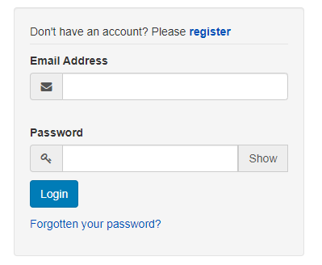
Submitting an Application – Step 1 Login to Citizen Portal Account
Enter your email address and
password and then click ‘Login’.
If you have forgotten your password, please click the ‘Forgotten your password?’ link to receive an automated password reset email. Follow the instructions in the email to re-set your password. If the automated email does not arrive within 30 minutes (and you have checked in your spam folder), please contact the Admissions Team on 01274 439200 and we will be able to manually send you the password reset email.

Slide 7
Important Notes
If you used the Citizen Portal to make an application in the past, please check that your address, telephone number, etc. in the 'My Account' section are still correct, and edit them if they are not, before you make your new application.
If you are helping a friend/family member to apply, please ensure the parent's details (name, address, phone number, email address, etc.) are given in the 'My Account' section, not yours. The parent needs to be present when the application is submitted to confirm that they have parental responsibility for the child and that all the details submitted are correct.

Slide 8
Submitting an Application – Step 2 Click on ‘apply for a school place’
This can be located at the bottom of the screen.

Slide 9
Submitting an Application – Step 3 Adding the Child’s Details
If the child’s details are not already there to select at the bottom of the page, click on ‘Add child’, enter your child’s details and then press ‘Add child’ again once you have filled them in.
If this does not apply, go to Step 4.

Slide 10
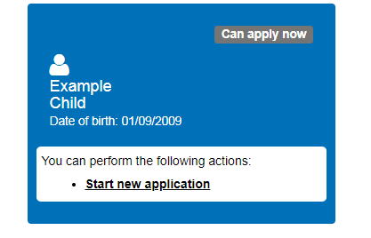
Submitting an Application – Step 4 Click on ‘Start new application’
Select the correct child at the bottom
of the page, and click on
‘Start new application’.
This will only appear if the online application process is open and the child’s DOB (as entered by the parent) falls into the standard date of birth range for applications.
If a child is formally offset, parents must apply on a paper form.
Late applications must be made on a paper form.

Slide 11
Submitting an Application – Step 5 Checking Your Home Authority
Check that your address falls under Bradford district, by clicking on ‘Check Now’.
If it does not, you must apply through the authority in which you are resident. You can still apply for Bradford district schools through you home authority.
If your address does fall under Bradford district, click on ‘Continue to Apply’.

Slide 12
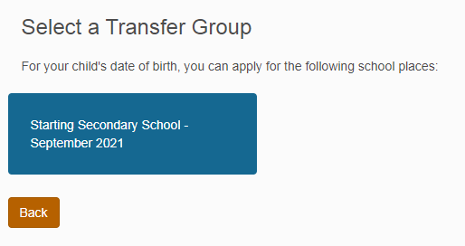
Submitting an Application – Step 6 Selecting a Transfer Group
Select the transfer group you wish to
submit an application for, e.g.
If you see the message below, then either the online application process is not open or the DOB entered for the child does not fall in the standard DOB range for the application you are trying to make.
If the closing date for applications has passed or your child is offset, you need to apply on a paper form.
If neither of these circumstances apply, please
check you have entered your child’s DOB
correctly by looking in the ‘My Family’ section
of the website, and please correct it if necessary.

Slide 13
Submitting an Application – Step 7 Additional Child’s Details
Most applicants will just select ‘Next’, as they do not need to tick any of the boxes for the child they are applying for.
If the child is in public care, please indicate on this page. The application should be submitted by the social worker and the Care Authority must be selected.
If the child is one of a multiple birth, please indicate on this page.

Slide 14
Submitting an Application – Step 8 Address Details
If you have moved recently or plan to move by September, this page advises you of the proof we require and the deadline to return this.
If you have not yet moved, but you have details of the address you will be moving to and a moving date, please enter them on this page.

Slide 15
Submitting an Application – Step 9 Child’s Current School
This page may not appear for every transfer group.
If it appears and your child’s current school is not displayed, please select your child’s current school, using the search function.

Slide 16
Submitting an Application – Step 10 Adding School Preferences 1
Please list up to five preferences in the order you prefer them.
Use the search function to find the first school you wish to apply for, select it by clicking on the school’s name (not the website address), e.g.
and then tick applicable boxes and fill in relevant information.
You may also need to submit additional documents, such as a supplementary information form.
If requesting priority on exceptional medical/social grounds (if applicable), you will need to send in supporting documentation.

Slide 17
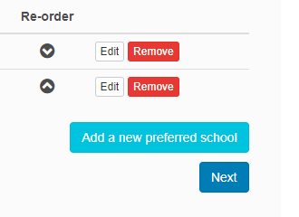
Submitting an Application – Step 10 Adding School Preferences
Once you have completed the information for your first preference, you can add another by selecting ‘Add a new preferred school’ and then filling in the information for the next preference.
This can be repeated until you have added all the preferences you wish, up to the maximum of 5.
If you want to edit, remove or re-order your
preferences, you can do this by clicking on
the relevant button.
Once you have added all the preferences
You wish (up to 5), click ‘Next’.

Slide 18
Submitting an Application – Step 11 Submitting the Application 1
Once you are happy that you have completed the application fully, please read the information on the submission page.
Allocation letters are emailed on offer day to parents who applied online, unless the tick is removed from the box below. If the tick is removed, the child’s allocation letter will be posted out on offer day.

Slide 19
Submitting an Application – Step 11 Submitting the Application 2
The declaration below must be ticked before you can submit the application.
Once you have submitted the application, you will be sent a brief emailing, confirming that your application has been submitted and listing your preferences. It will not include additional information included on the application, such as sibling details.
If you are not ready to submit the application, you can click on ‘Return Later’ to save the information you have already entered. Please remember to return and submit the application by the deadline.
You can go back into your application and make changes up to the closing date, even if you have already submitted it. If you go back in to a submitted application it becomes unsubmitted, and you must go all the way through to the final page and resubmit the application.

