Slide 1

Year 6
Parent Information Evening
Thursday 22nd January, 2026

Slide 2
Overview of the evening
Year 6 expectations
SATs
Transition to Secondary School
Bewerley Park Residential

Slide 3
Year 6 expectations
Home reading
At least 3 x a week.
To build reading stamina, introduction to new vocabulary and develop comprehension skills.
Evidence connecting good readers and good writers.

Slide 4
Year 6 expectations
Attendance
It is important that pupils attend school regularly.
Due to the depth of learning in Year 6, any absences will result in your child missing key aspects of the curriculum.
If there are issues, please come and speak to a member of the Year 6 team.

Slide 5

SATs

Slide 6
SATs week 2023
Date | Activity
Monday 11 May | English grammar, punctuation and spelling paper 1 English grammar, punctuation and spelling paper 2
Tuesday 12 May | English reading
Wednesday 13 May | Mathematics paper 1 Mathematics paper 2
Thursday 14 May | Mathematics paper 3
Additional arrangements will be made for the start of the day for Year 6.
Please ensure there are no absences
during this week.

Slide 7
What is a scaled score?
Each pupil will be given a raw mark (the number of marks they get on a test) which is then converted into a scaled score using a conversion table.
A scaled score of '100' represents the 'national standard'.
A scaled score of '100' or more means that a child is working at the national standard for a child of their age.
A scaled score of ‘110’ or more means that a child is working at greater depth against the national standard for a child of their age.

Slide 8
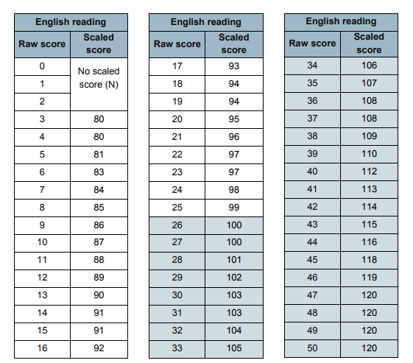
Scaled score conversion tables
25/50 - Age related expectation
39/50 - Greater Depth

Slide 9
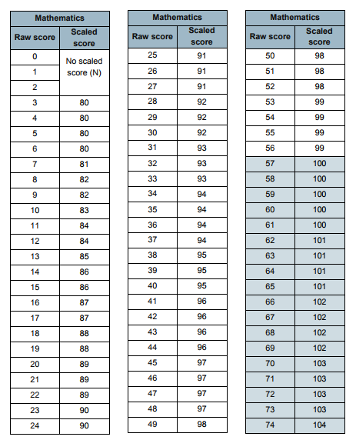
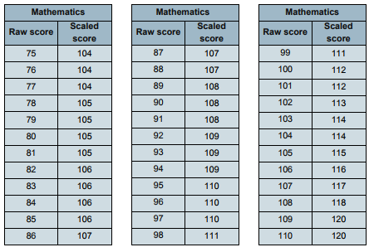
57/110 - Age related expectation
95/110 - Greater Depth

Slide 10
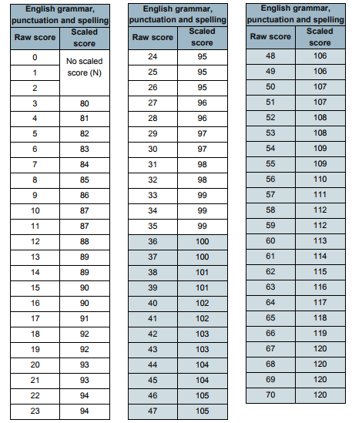
36/70 - Age related expectation
56/70 - Greater Depth

Slide 11
What does it all mean?
On publication of the test results in July 2026:
A child awarded a scaled score of 100 is judged to have met the ‘national standard’ in the area judged by the test and is said to be ‘working at the expected standard’.
A child awarded a scaled score of less than 100 is judged to have not yet met the national standard and is said to be ‘working towards the expected standard.’
A child awarded a scaled score of 110 or more is judged to have exceeded the national standard, demonstrating a higher than expected knowledge of the curriculum for their age, and is said to be ‘working at greater depth against the expected standard.’

Slide 12
English Grammar, Punctuation and Spelling
45 minute spelling, punctuation and grammar test involving short answer or simple explanation questions.
15 minute Spelling test based upon words learnt throughout Key Stage 2.
Marks from both test are added together. The spelling test alone is worth 20 marks. The grammar test is worth 50 marks.

Slide 13
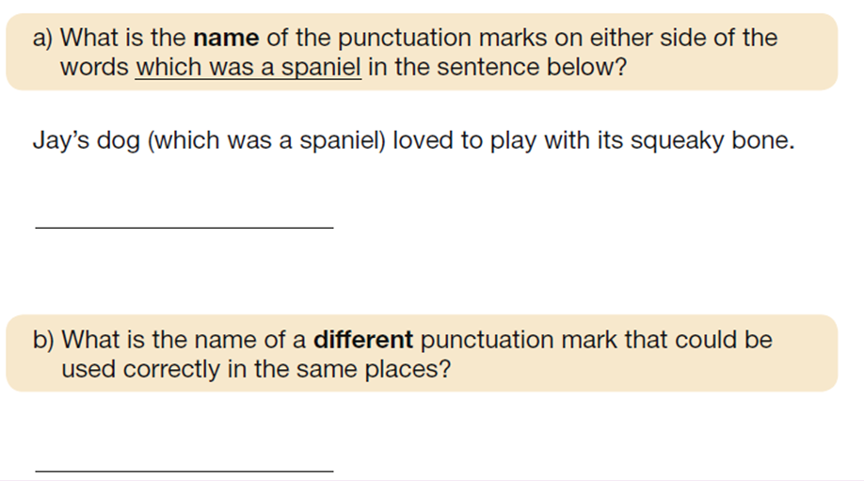
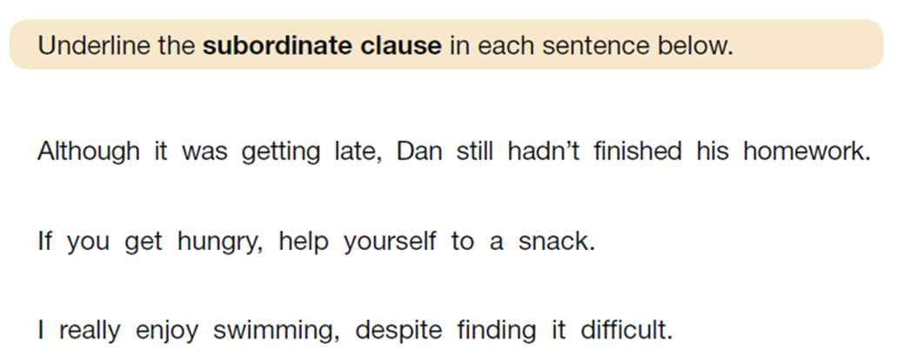

Slide 14
Reading
60 minutes.
3 unrelated texts and 1 answer booklet.
The questions are designed to assess the understanding of a child's reading through a variety of comprehension questions. Questions test children’s ability to retrieve and infer, to summarise and predict and their understanding of the author’s language choices.
Some questions are multiple choice or selected response, others require short answers and some require an extended response or explanation.

Slide 15
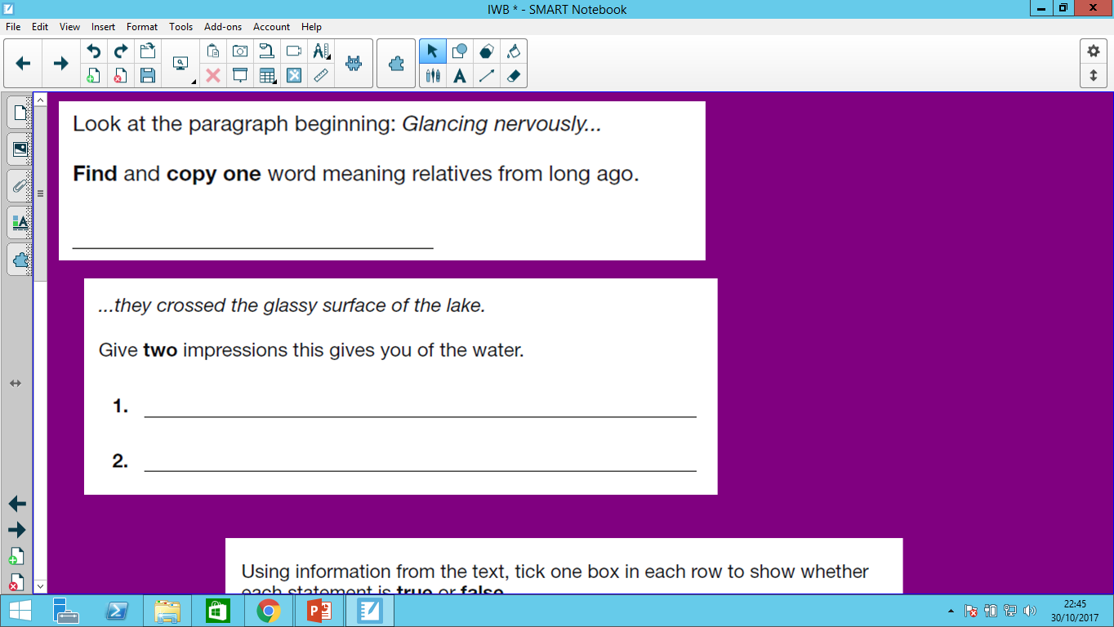

Slide 16
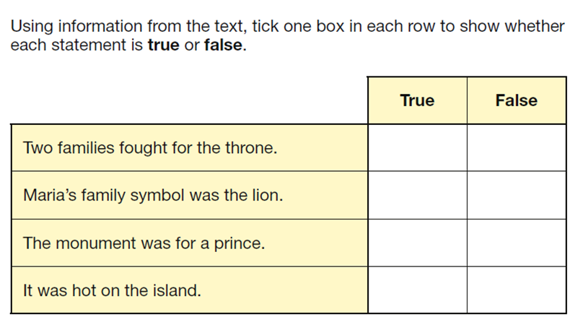
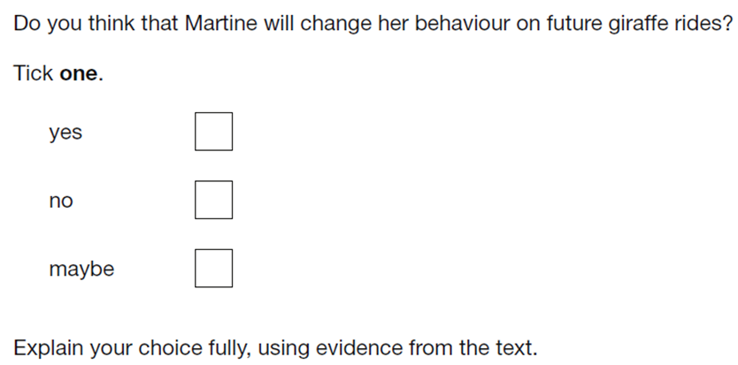

Slide 17
Mathematics
The children will sit three tests (Paper 1, 2 and 3).
Paper 1 (Arithmetic) 30 minutes. 36 questions that test calculation methods for all operations (+ - x ÷), including fractions, percentages and decimals. This alone is worth 40 marks.
Questions increase in difficulty as the children progress through it.
Paper 2 and 3 (Reasoning and Problem Solving) 40 minutes. Tests the application of calculation methods and other areas of the maths curriculum such as shape, measure, geometry and statistics.
Pupils must read each question carefully and there may be several steps involved in order to find a final answer.
Children can ask an adult to read a question to them.

Slide 18
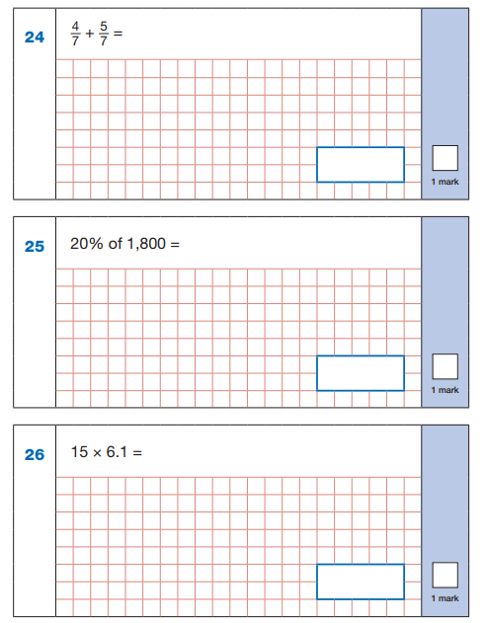
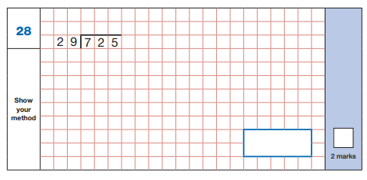
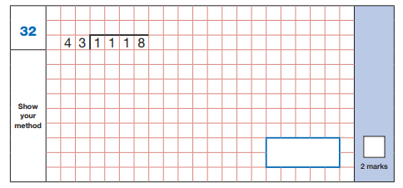

Slide 19
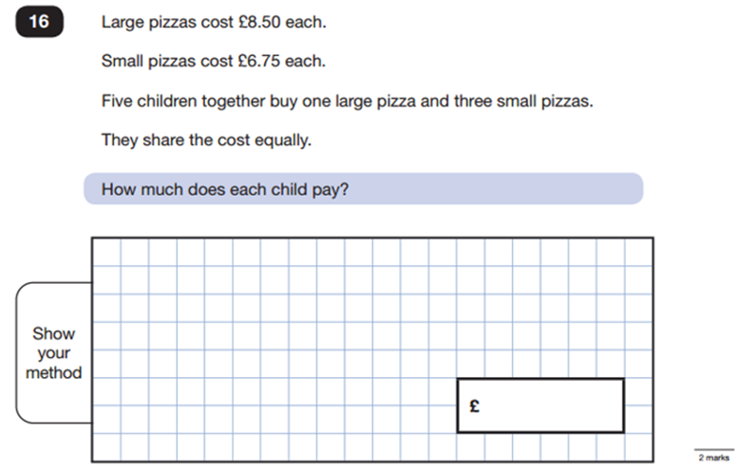
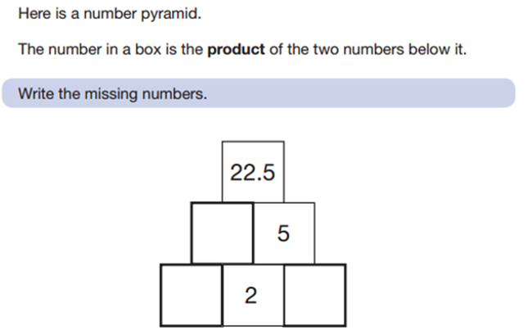

Slide 20
Writing
Once the SATs are over, our focus will move to writing. Writing is teacher assessed and outcomes are submitted by the end of June. We may have a moderator visit school to quality assure our judgements.
The judgements are as follows:
PKS
Working towards the expected standard
Working at the expected standard
Working at greater depth

Slide 21

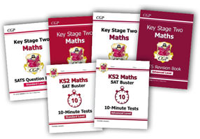
How can you help?
CPG revision books available (order by tomorrow).

Slide 22
How can you help?
First and foremost, support and reassure your child that there is nothing to worry about and that all we can ask for is them to try their best. Praise and encouragement works wonders!
Ensure your child has the best possible attendance at school.
Regular spelling and arithmetic (e.g. times tables) practise will be useful.
Listen to your child read regularly and discuss what they are reading with them.
Talk to your child about what they have learnt at school.
Make sure your child has plenty sleep and a healthy breakfast each morning.

Slide 23
Transition to Secondary
School
When and how does transition happen?
Who is there to help?
Growing up is hard to do – friendships and relationships

Slide 24
When and how does transition happen?
On Monday 2nd March, families will find out which secondary school their child has been offered a place at – you will need to accept this or appeal if unhappy with the allocation offer.
Once the children have taken their SATs in May, members of staff from secondary schools will begin to come to Blakehill to meet the children prior to their transition day.
Early July - most children attending secondary schools in Bradford have their transition day. We will let you know the date when it is confirmed.
Children who we feel need extra support during transition will have additional sessions at their school before and after this date.
Children attending Leeds Secondary Schools may have a different transition day.

Slide 25
Who is there to help?
Within school, class teachers will co-ordinate the transition process, liaising with school.
Mrs Shaw will provide additional support around transition.
Either Mrs Shaw or Year 6 TAs will attend the extra transition sessions with children.
Secondary schools will run a parents evening around the time of transition where key information will be shared.
During our curriculum time after the SATs, we will ensure time is dedicated to preparing the children for their transition to secondary school.

Slide 26

Any questions?

Slide 27


Slide 28
Thank you for listening.
Any questions?

