Slide 1
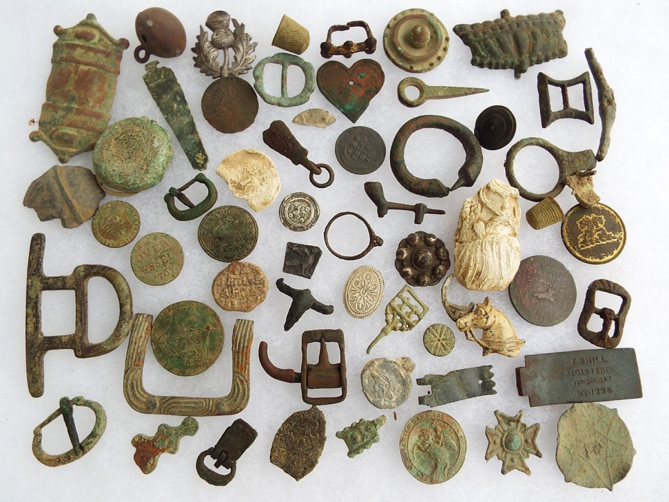
Archaeology
LO: To use enquiry skills to identify historical artefacts

Slide 2
Questions
What is archaeology?
The study of human activity through digging up items, fossils or remains from the ground.
Why is archaeology important?
Items are studied so that we can find out more about the people who lived during the time.

Slide 3
Activity Time
In this activity, you will take it in turns to sift through the earth to reveal historical artefacts. All of the artefacts buried in the soil trays have been dug up by metal detectorists in England and are genuine artefacts! This means they are primary sources. These provide very strong evidence about how people lived and what objects they had/used.

Slide 4
Activity Time
The artefacts date from Roman times, Anglo-Saxon/Viking, through to Medieval and later. It is your job to identify the artefacts and suggest a time period that you think they come from.
You need to study the artefacts carefully to get an idea of what they are.

Slide 5
Activity Time
Most of the artefacts are made from a metal called bronze, with some made from copper or lead. These materials are often found as they take many years to biodegrade (break down) in the earth.

Slide 6
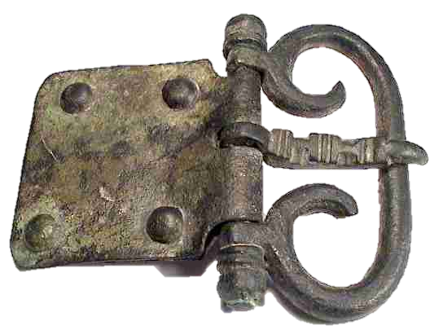
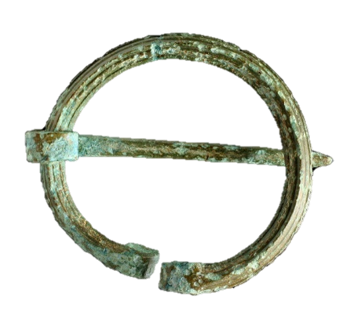
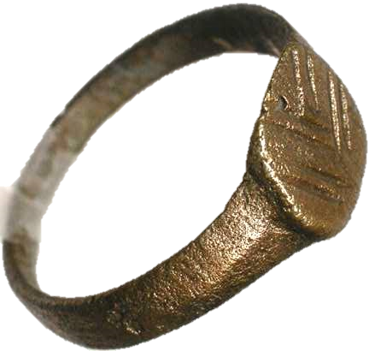
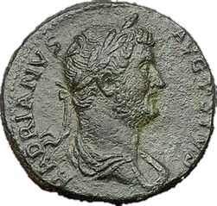
Activity Time
Artefacts include: brooches, buckles, rings, coins and many more.

Slide 7
Activity Time
When an artefact has been unearthed, it will need to be brushed carefully and examined.
When you have examined the artefact, pass it to the person on your right.
The tray then passes to the person on your left.
When you get the artefact back after it’s been passed around your group, put it in the middle of the table.

Slide 8
Activity Time
Take care to only sieve OVER the tray to avoid unwanted mess!
Treat all of the artefacts delicately.
Make sure all of the artefacts go back in your tray at the end of the session.

Slide 9
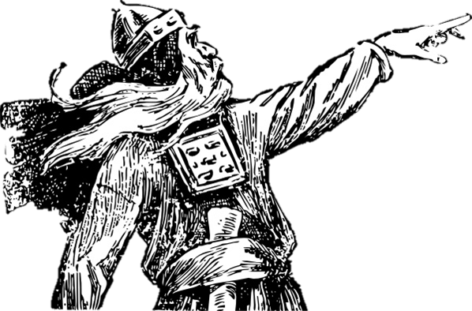
Activity Time
It is now time for you to become an archaeologist! Go forth and enquire!

Slide 10
The next slides are for after the archaeological dig…

Slide 11
Question Time
A lot of the artefacts are belt buckles. Where are the leather belts that go with them?

Slide 12
Question Time
The leather biodegrades (breaks down) after many years in the ground.

Slide 13
Question Time
Which artefact did you find the most interesting and why?

Slide 14
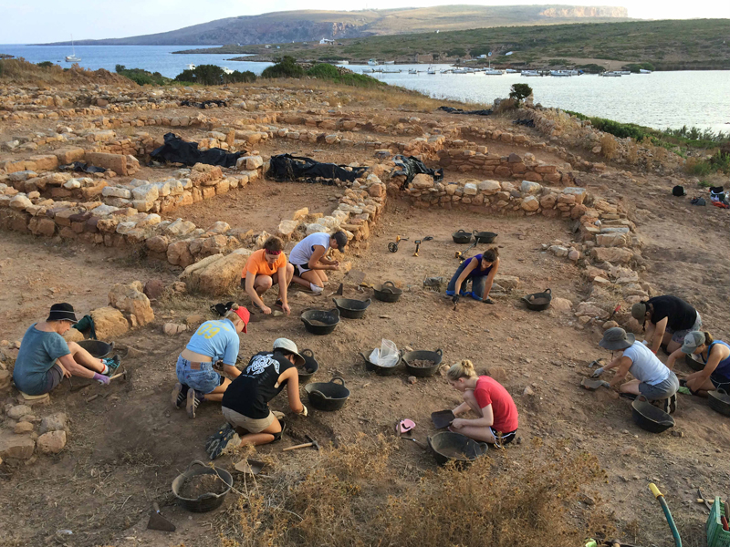
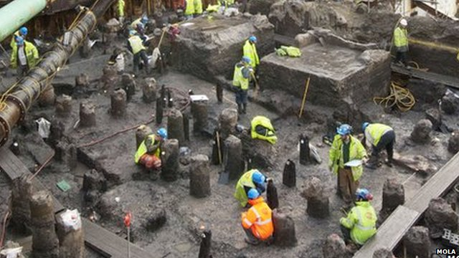
A message from Arthur…
“I hope you enjoyed being an archaeologist! A huge amount has been learned about the Anglo-Saxons/Vikings from archaeology. Without digging up artefacts, we would only have writing and drawings to learn about items from these times”.

