Slide 1
It’s Not Okay.. To be a Bully
Notes:
CHECK
Have I spoken with the class teacher first? (see separate checklist)?
Have I explained the ground rules? (Join in; hands up to answer; respect each others contributions)?
Have I introduced myself and my reason for being in school?

Slide 2
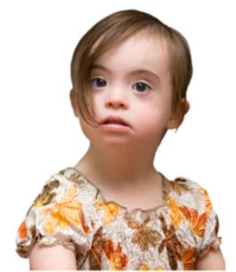
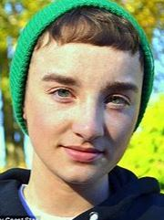
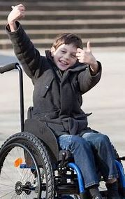
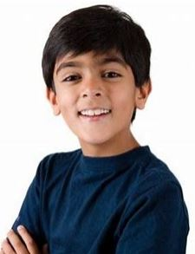
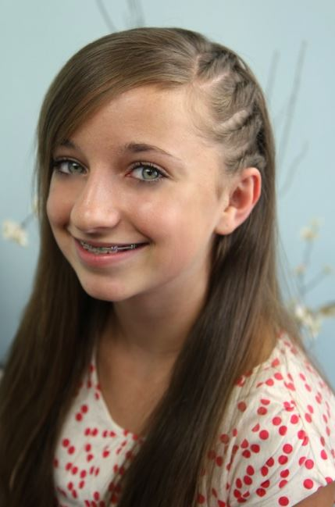
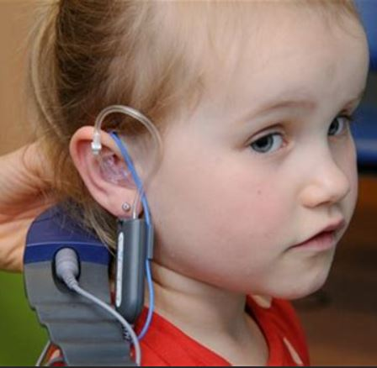
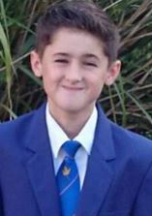
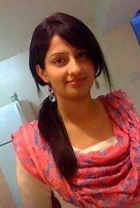
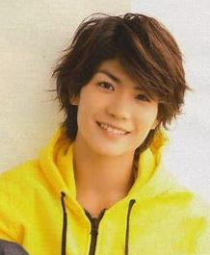
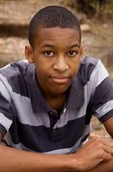
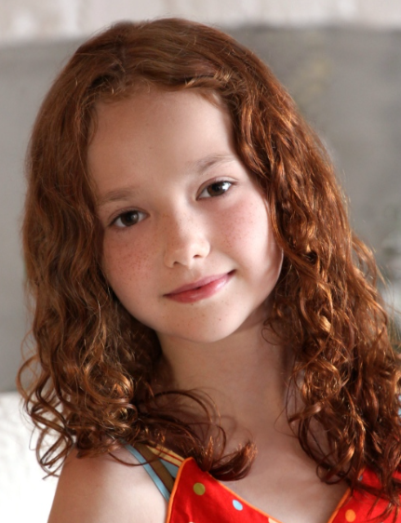
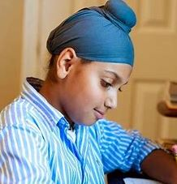
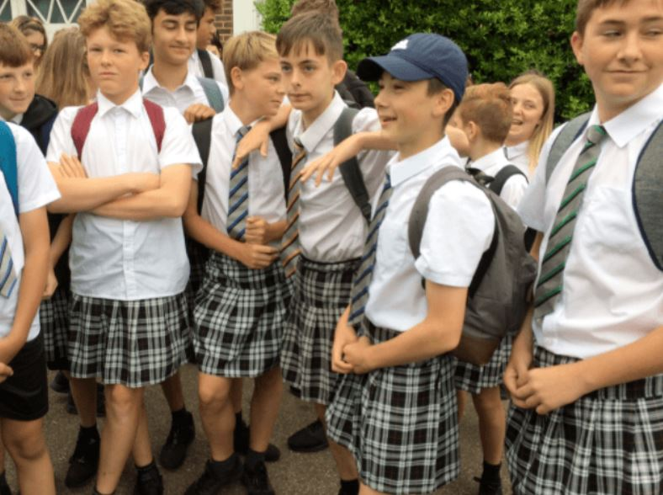
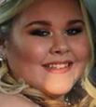
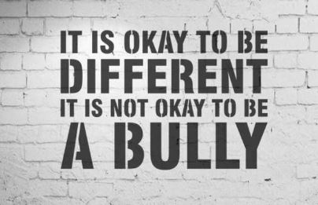
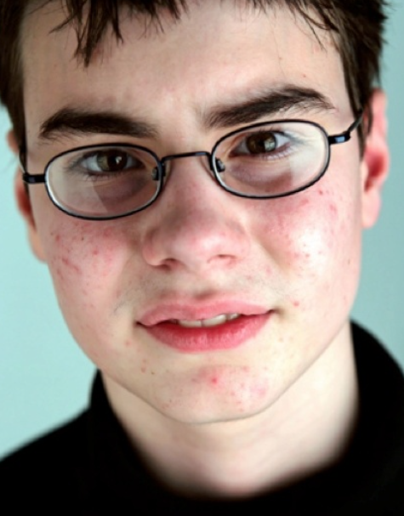
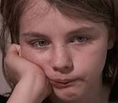
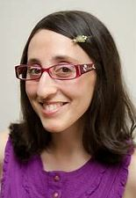
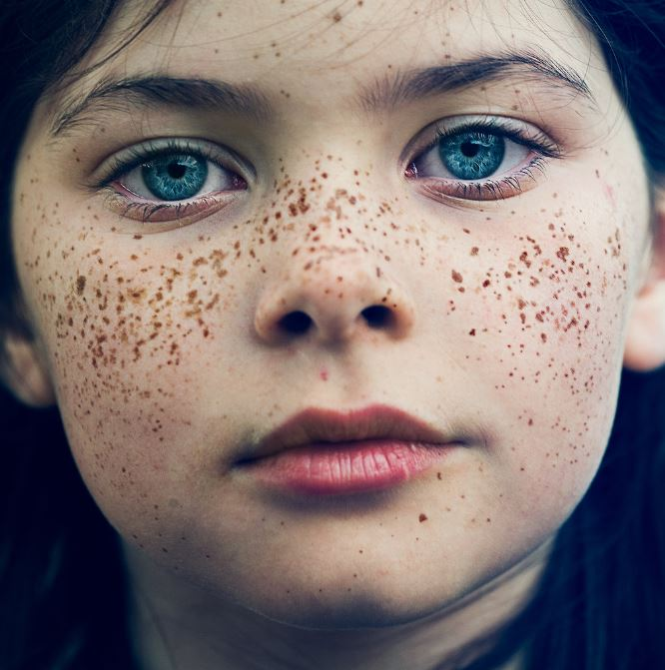
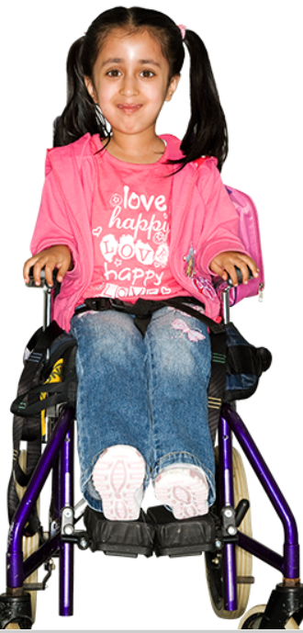
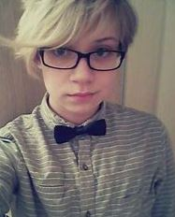
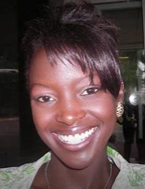
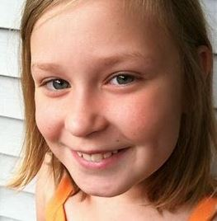
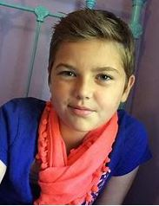
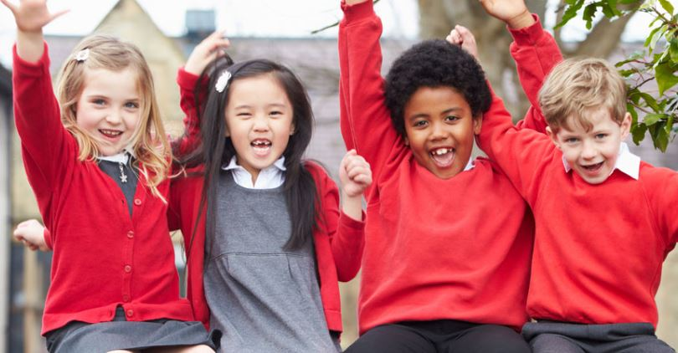
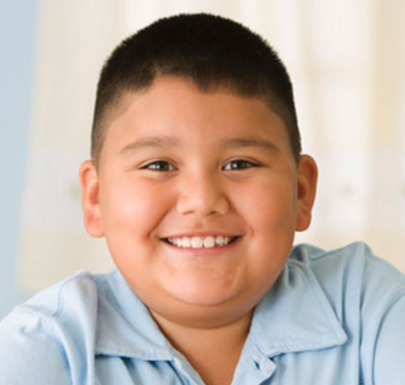
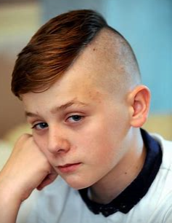
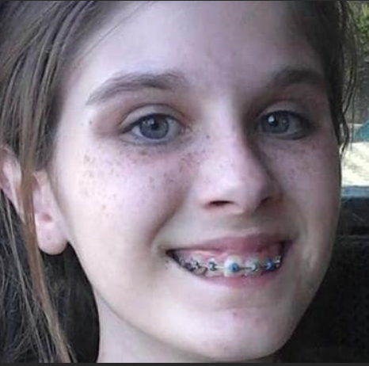
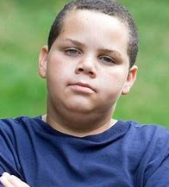
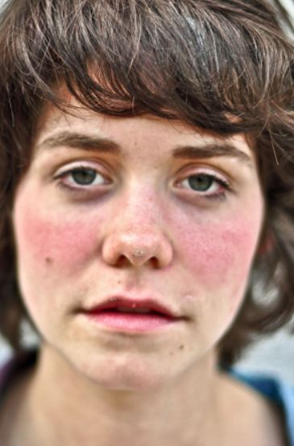
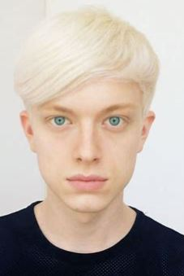
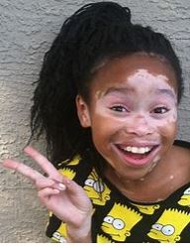
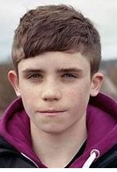
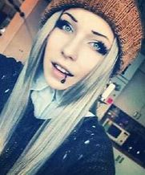
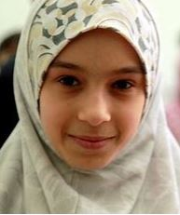
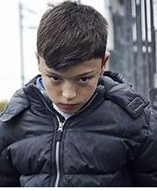
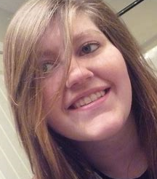
Notes:
We are all different. No two people are the same, and that is a good thing!
We are unique. Today is all about celebrating that difference (which is why we have had odd sock day – if this has just happened) and being respectful to each other.
There are many differences amongst the people on this slide.
Is there anyone of these people who deserves to be bullied? Can anyone think of anyone who they know who deserves to be bullied? IF – someone suggests someone (for example someone who has done something bad etc) state that even these people don’t deserve to be bullied. If someone has done something wrong, either the Law, or school will deal appropriately with that person, and help them put their mistake right, as we all make mistakes at some point in our life.
Even if someone has a different view or belief to ours, and we know we will never agree or see eye to eye with them, we respect them by agreeing to differ. This is ok. Agreeing to be different, and accept that, is ok.

Slide 3
Think of a word a bully might use, or a word that might hurt someone’s feelings
Write it on your sticky note
FACT
When you are happy, you walk at a brisk pace, smile often, and speak clearly and audibly.
When you are sad, you walk at a slower pace, smile less often, and speak with a slower, quieter voice.
Notes:
It’s very easy to say unkind and disrespectful or mocking words about someone, especially behind their back, online, or to others.
I know I have done it in the past, and I have also been on the receiving end of unkind words, and I’m sure most of you are just the same.
No rude or swear words – and write your word within reason – one that can be said out loud in the classroom.
I am going to walk around the room and I want you to stick your note on my as I walk past, and say the word out. Emphasise that you know the children are not saying this to you personally, but it’s just a way of collecting up the words.
When I came in I was happy, and smiling and walked with an upbeat step. How do you think I would walk now if all these words had actually been said against me?

Slide 4
1830 -1886
Notes:
We often think words don’t hurt people, that sticks and stones break bones, but names don’t hurt….
But a lady called Emily Dickinson wrote this over 150 years ago… read the poem, slowly, so the children can take it in.
What did she mean? Do you think bullying happened 150 years ago?

Slide 5
What is bullying?
Behaviour that is:
intended to hurt someone either physically or emotionally, and happens repeatedly
It can be;
Physical – pushing, hitting, grabbing, punching, kicking
Verbal – teasing, name calling
Social – spreading rumours, leaving people out of activities, or encouraging others to leave someone out
Face to face, behind someone’s back or cyber/online
Notes:
Ask the children, what they actually understand of bullying.
Read through the slide.

Slide 6
What to do if you are being bullied
Tell an adult and keep telling them if it continues
or call
Value and maintain friendships which are positive
Notes:
Read through the slide

Slide 7
Notes:
Luke Culhane’s experience of cyber bullying led him to create this video.

Slide 8
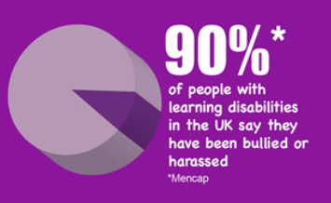
A hate crime is when someone is targeted because of certain characteristics such as being disabled, or from a particular race or religion.
Why is bullying a police issue?
The police take bullying, or hate incidents and hate crime, very seriously.
Notes:
Ask the question – why is bulling a police issue? How might it progress and escalate to a situation when the police might become involved?

Slide 9
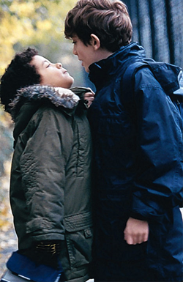
The definition of respect – due regard (thoughtfulness/politeness) for the feelings, wishes, or rights of others Bullying is a behaviour choice. We can respectfully disagree with each other i.e. we don’t have to be best friends or always agree with each other but we do have to respect each other We all need to choose to respect each other both face to face and online Bullying is serious – you can help by thinking about your own actions and offering support to others Questions ?
Say good-bye to bullying,
and hello to respect!
Notes:
Read through the slide
Ask, and allow time for any questions, thoughts, or comments – it can be anything at all…

