Slide 1
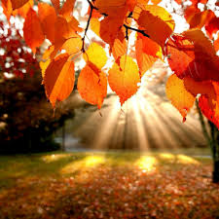
Autumn Days

Slide 2
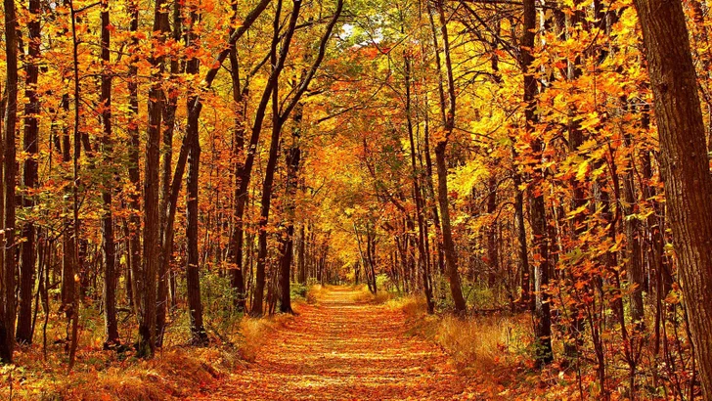
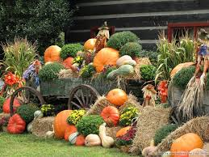
With leaves turning golden
And nights drawing in

Slide 3
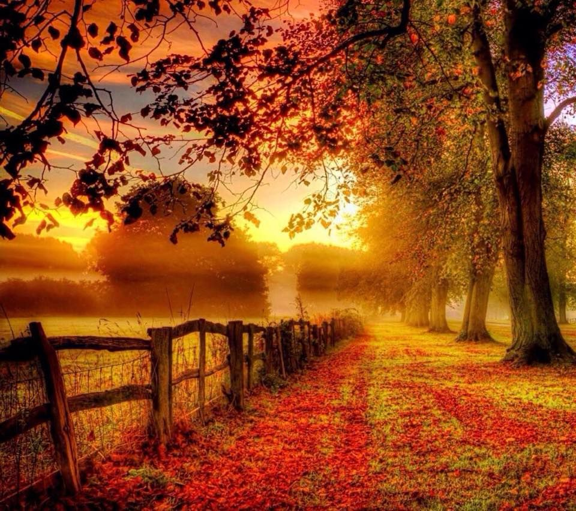
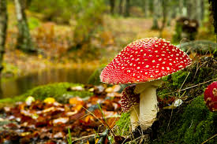
A chill in the air
So Autumn begins

Slide 4
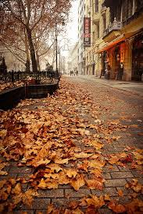
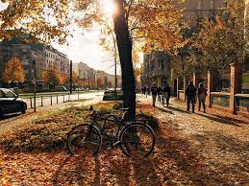
The season of golds, oranges and browns
These earthy hues decorate our towns

Slide 5
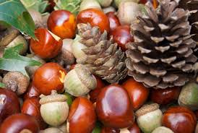
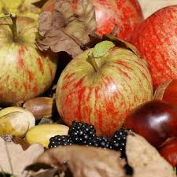
The fruits of the summer begin to fall
Conkers and acorns, fun for all

Slide 6
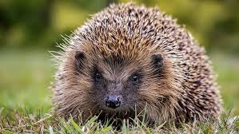
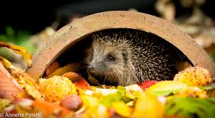
And it’s time for the hedgehogs to find somewhere to rest
Asleep for the Winter in a nice cosy nest.

Slide 7
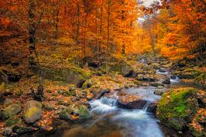
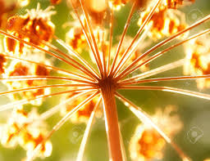
And the world all around us is changing each day
Summer is over. Autumn is on her way..

Slide 8
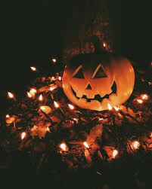
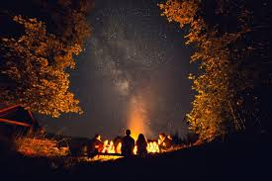
Autumn brings bonfires and Halloween nights
Children and families enjoying the sights

Slide 9
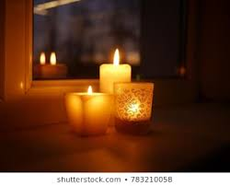
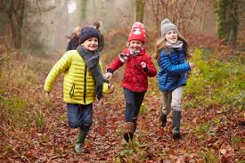
Candles on windowsills, hot baths and bed
Scarves and gloves, woolly hats on our heads

Slide 10
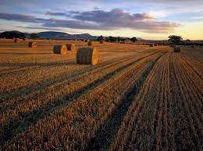
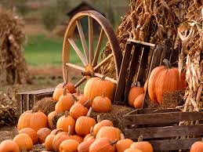
The farmer in his fields, no time to stall
Harvesting his crops, providing food for us all

Slide 11
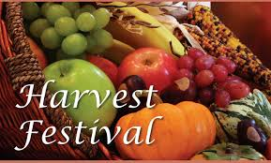
Harvest is a Christian festival. It reminds Christians of all the good things that God gives them.
Harvest is celebrated by singing, praying and decorating our churches with baskets of fruit and food. It is a time for families to come together and celebrate all of the good things in their lives.
In America this is called ‘ Thanksgiving.’
Churches donate the baskets of fruit to people less fortunate that we are. This lets them know that we are thinking of them.

Slide 12
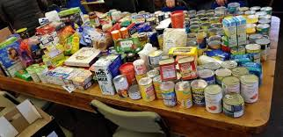
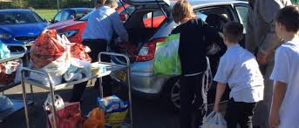
Every year at Blakehill, we collect food for the Bradford Food Bank. We donate food such as cereals, pasta and tinned food then this is given to families in our city that are not as lucky as we are.

Slide 13
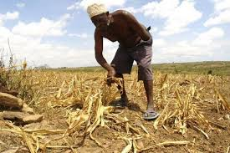
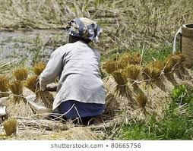
Most of us are very lucky. We have food in our cupboards and our fridges. We do not go hungry like some children in other countries.
Farmers have very little food to harvest in other parts of the world.

Slide 14
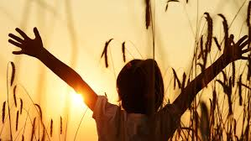
Still, the people are thankful

Slide 15
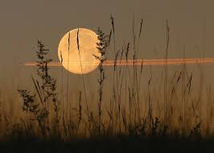
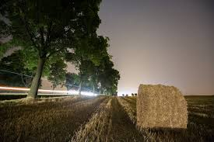
Today, think about what you are thankful for.
Autumn Days Lyrics
What a wonderful world lyrics
https://www.youtube.com/watch?v=w9mvrkQbzgc
https://www.youtube.com/watch?v=p-T6aaRV9HY

