Slide 1
Working through worry and anxiety
Notes:
Introductions

Slide 2
Group Agreement
Listen to others.
Share if you want to share.
If it’s not your story, don’t tell it.
Can you think of any more?
Notes:
We are going to be working together as a group so it would be good if we could set a group agreement so that everybody feels listened to and respected.
(Go through examples)
Can you think of any more?

Slide 3
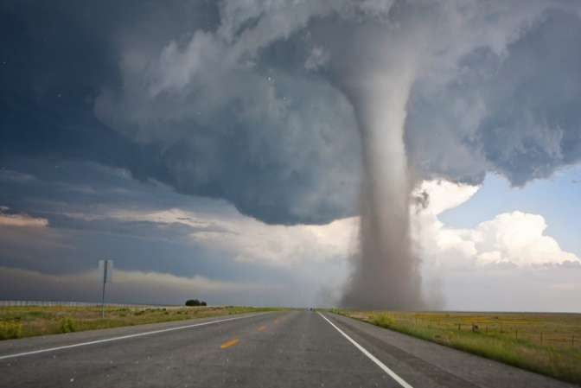
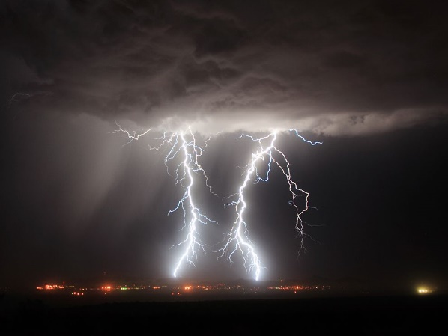
Which weather describes your mood today?

Slide 4
Aims of the workshop
To understand the difference between worry and anxiety.
To understand what worry and anxiety are.
To learn how to manage worry and anxiety.
Notes:
Today we are going to be looking at dealing with worry and anxiety…

Slide 5
What is worry?
Usually short-term and temporary.
Doesn’t stop you from doing activities.
Usually about something that has happened or may happen.
Thinking that something bad might happen.
Specific (e.g. ‘I have a Maths test, what if I don’t do well?’)
Worries are thoughts.
Can affect our thoughts, feelings, body sensations and behaviour.
Worry isn’t always bad, it can be a way for our brains to make sense of a situation.
Notes:
We are going to be looking at worry first. Can anybody tell me what ‘worry’ is?
(Examples in the clouds will appear upon clicking mouse).
(add transition to worries are thnoughts)

Slide 6
What worries do you have?
Write down a worry that you have had this week.
We will collect these and share with the rest of the group anonymously.
Notes:
Collect post-its after CYP have written their answers. Stick on the board and read some out. Ask CYP to act worry out (if appropriate). After reading out, ‘dispose’ of the worry:
Y3/4 – worry monster ‘eats’ post-its.
Y5/6 – put post-its in the ‘worry bin’.

Slide 7
What is anxiety?
Often linked to not knowing what will happen.
Can affect our thoughts, feelings, body sensations and behaviour.
Can stop us feeling able to do activities.
Fear-driven.
A way for our brains to protect us from danger.
Lots of people experience anxiety. Sometimes people need help to manage this.
Worry can increase anxiety.
Notes:
Introduce the fact that worry and anxiety are different and that we will be exploring the differences later on in the workshop.
Now we will look at anxiety. Can anybody tell me what ‘anxiety’ is?
(Examples in the clouds will appear upon clicking mouse).
Physical demonstration of thoughts/feelings/bodily sensations/behaviour.
Explain body sensations.

Slide 8
Why do we experience anxiety?
Notes:
End video at 2:06 mins
The fight, flight or freeze response is one of the tools your body uses to protect you from danger.

Slide 9
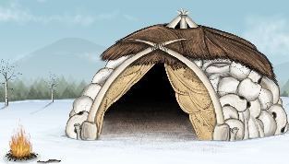
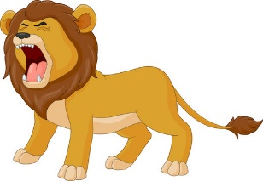
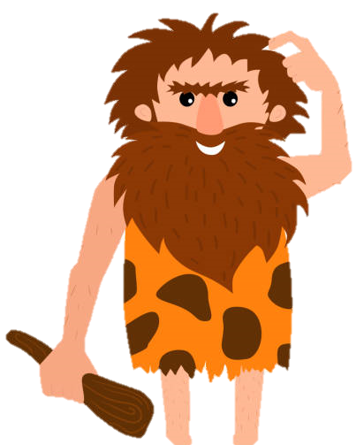
The Fight, Flight, Freeze Response
Human’s ability to protect themselves dates back to the Stone Age.
In order to survive, cave men needed to stay on high alert.
Our brains haven’t changed much since then. They are hardwired to search for danger to keep us safe.
For Modern day humans, the body’s Fight, Flight, Freeze Response still alerts the brain to danger and triggers us to take action. Sometimes, our brain can register something completely harmless to be a danger!
Notes:
Speak about the dangers that cave men would have experienced (thought bubbles).

Slide 10
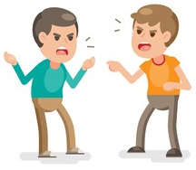
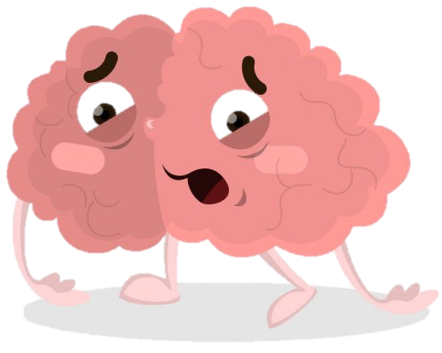
The Fight, Flight, Freeze Response
The dangers we face today are very different to those faced by cave men; however, when our brain registers danger, our body still goes into survival mode.
In survival mode, we can find it hard to think
clearly and logically.
We can experience some of the following physical symptoms: fast breathing, fast heart rate, chest pain, feeling sick, butterflies, and cold or sweaty palms.
Notes:
Move on to speaking about the dangers humans today experience (thought bubbles).

Slide 11
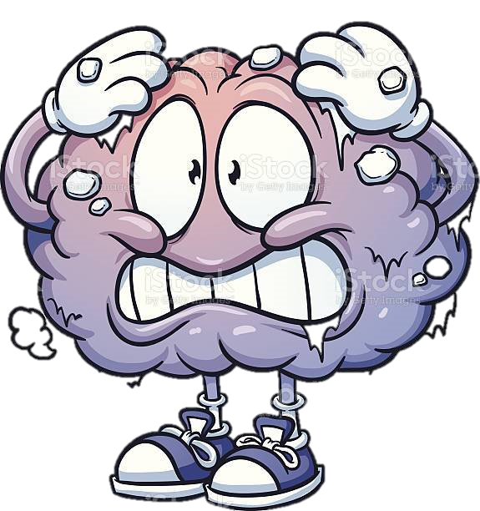
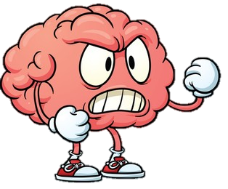
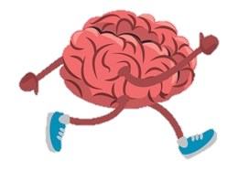
The Fight, Flight, Freeze Response
Imaginary situation:
‘Somebody coughs near you. You worry that they might have spread COVID.’
What might your Fight, Flight, Freeze Response look like in this situation?
Notes:
For each ‘F’, ask CYP to call out examples.
Fight examples = shout at the person,
Flight examples = avoid the person,
Freeze examples = ignore the person/pretend it didn’t happen,

Slide 12
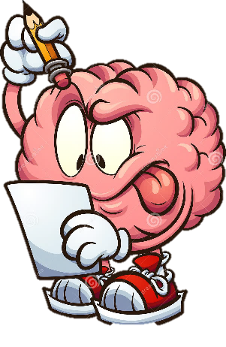
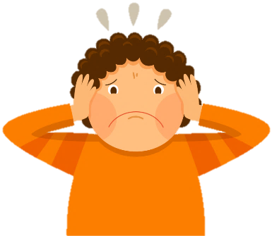
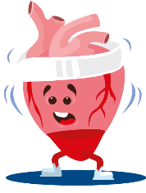
The Anxiety Cycle
Your body thinks the situation is dangerous and you start to feel anxious.
Your brain sends signals to your body to prepare for danger.
Trigger
Your body produces symptoms of anxiety (worrisome thoughts and emotions and body symptoms).
Long-term: Increase in the bodily symptoms of anxiety, more worry, loss of confidence about coping, increased use of safety behaviours.
Short-term relief.
Avoidance.
Notes:
Once you perceive your symptoms as ‘threatening’ or ‘dangerous’ you become scared of those symptoms. Your mind then reacts with the anxiety response which creates more symptoms and the cycle continues.
Avoidance = isolate/withdraw, escape, freeze, develop rituals to ‘protect’ (safety behaviours) - briefly talk through safety behaviours (i.e. things we do to alleviate our anxiety - mention we will be looking at some healthy safety behaviours later on in the workshop).
Ask what would be the easiest thing to change in this cycle – is it out automatic bosy response and thoughts or is it to challenge and change our behaviour?

Slide 13
Thoughts
Feelings
Imaginary situation:
‘Someone in the school has coronavirus’
Body sensations
Behaviour
Notes:
Introduce the idea that our thoughts, feelings, body sensations, and behaviour are interlinked – give a definition of each.
Ask CYP to work in a small group – either write on whiteboard or call out when asked.
Completed formulation model can be found in the pupil pack.

Slide 14
Worry VS Anxiety
Worry
Anxiety
Notes:
Re-introduce the fact that worry and anxiety are different and explain that this is what the next part of the workshop will involve.
Worry is usually thought based; What will happen… Anxiety; symptoms in the body e.g. fast heart rate, sweating etc.

Slide 15
VS
WORRY
ANXIETY
Short-term
SPAN
Can linger
in response to a specific threat/event
CAUSE
trigger may be unknown
Appears as physical symptoms in the body (e.g. fast heart rate, sweating, shaking, tense muscles, etc.).
Happens in our thoughts, often thinking about something that ‘might’ happen.
Can help us to stay safe, to an extent.
Happens when we think about problems that might happen e.g. ‘what if I fail my maths test?’
Can happen anywhere and anytime and can be triggered by different situations.
Can feel the same as fear, the difference is that anxiety happens when there is no danger around.
Easier to manage with practice.
Is thought-based.
May make us want to avoid situations and stop us from doing activities.
Notes:
Worry and anxiety can be very similar and are linked in many ways. There are some ways to tell them apart…
Make bigger

Slide 16
Worry or Anxiety?
Worry
‘I have a Maths test next Tuesday. My Mum will be cross if I don’t do well.’
Notes:
5 questions ‘anxiety or worry?’
I have a Maths test next Tuesday. My Mum will be cross if I don’t do well. (W)
I get a stomach ache and my heart beats fast when I go to new places. (A)
‘Nobody ever smiles at me. I take myself away from other people’ (A)
My year group are last to lunch today. What if they don’t have anything left that I like? (W)
I am going to meet new people today. My hands feel sweaty. What if they don’t like me? Why do I always feel this way? (A)

Slide 17
Worry or Anxiety?
Anxiety
‘I get a stomach ache and my heart beats fast when I go to new places.’
Notes:
- Interactive quiz

Slide 18
Worry or Anxiety?
Anxiety
‘Nobody ever smiles at me. I take myself away from other people’
Notes:
- Interactive quiz

Slide 19
Worry or Anxiety?
Worry
‘My year group are last to lunch today. What if they don’t have anything left that I like?’
Notes:
- Interactive quiz

Slide 20
Worry or Anxiety?
Anxiety
‘I am going to meet new people today. My hands feel sweaty. What if they don’t like me? Why do I always feel this way?’
Notes:
- Interactive quiz

Slide 21
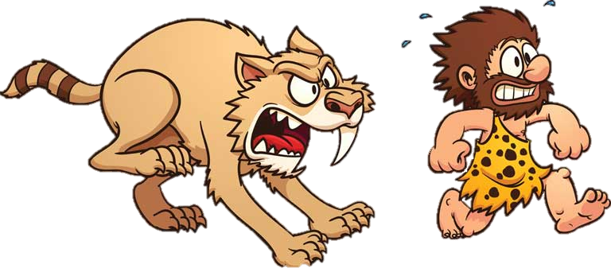
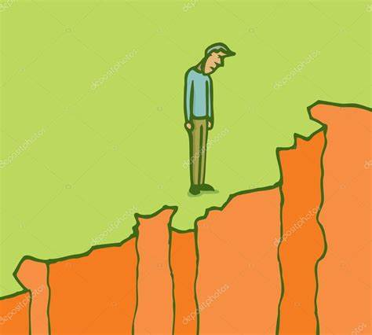
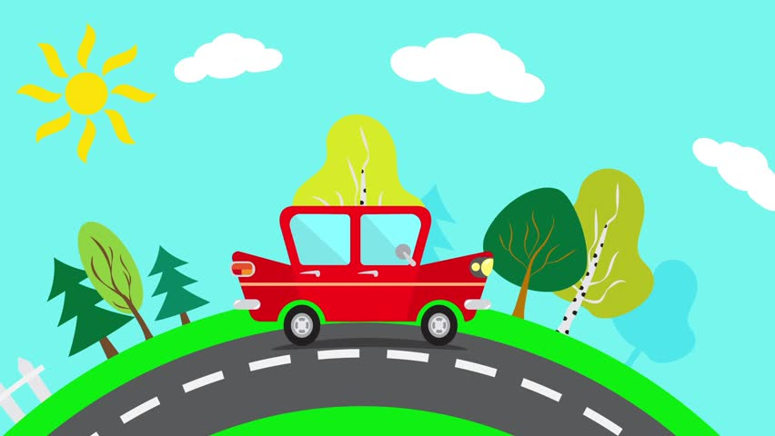
Are worry and anxiety always bad?
Feelings of worry and anxiety are not always bad.
They can help to keep us safe from danger.
DON’T TOUCH!
STAY AWAY FROM THE EDGE!
RUN AWAY!
DON’T CROSS YET!
Notes:
Worry is designed to keep us safe, but our brain can sometimes trick us and make us think we are in danger when we’re not.
The purpose of worry and anxiety and how It keeps us safe (link back to F-F-F response).
Ask CYP what worry/anxiety might make us do in these situations.

Slide 22
When do worry and anxiety become a problem?
Most people will experience some form of worry and anxiety at some point in their life. This is completely normal and can help us to keep safe.
Some level of worry and anxiety can be helpful; for example, feeling worried about an upcoming exam can motivate us to revise!
However, too much worry or anxiety can have a big impact on your day to day life and leave you feeling negative.
Notes:
Most people will experience some form of worry or anxiety at some point in their life.
Worry and anxiety can be helpful as it can help us to solve problems; however, when worry or anxiety becomes excessive, it can have a big impact on your life and leave you feeling very sad.

Slide 23
If we didn’t deal with our worries and anxieties, what would happen?
Notes:
Ask CYP to think and then pick volunteers/ask to call out.

Slide 24
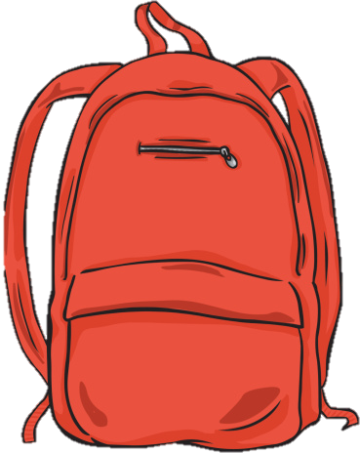
Notes:
We are going to ask for a volunteer to come up and put this backpack on. Then, a few of us are going to fill it up with some ‘worries’.
Start with specific worries ‘I’m worried about my Maths test on Friday’… etc.
If every item we put in the bag represents a worry, and we fill the bag all the way to the top, what will happen to the backpack? What will happen to the person carrying the backpack?
Rocks – sellotape ‘worries’ onto rocks

Slide 25
How can we manage worry and anxiety?
Notes:
Explain that we will now be looking at coping strategies for worry/anxiety - explain importance of managing in a healthy way.

Slide 26
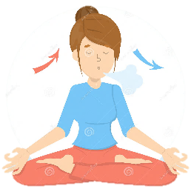
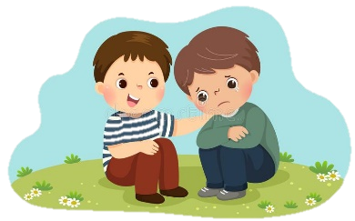
Breaking the Anxiety Cycle
Confront the situation you are scared of.
Greater belief in ability to manage feared situations.
More feelings of anxiety (temporary)
Use of coping skills, less feelings of anxiety.
Notes:
Hone in on the ‘coping skills’ to move to next slide.

Slide 27
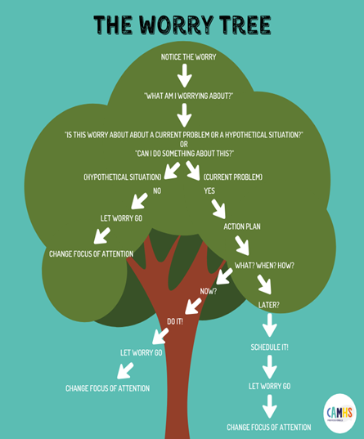
The Worry Tree
When we experience worry or anxiety, we can use The Worry Tree to help us manage it.
The Worry Tree can help us to see which worries are ‘real’ and which are ‘imaginary’.
Did you know?
Most worries and anxieties are imaginary!
Notes:
Explain The Worry Tree
Use examples from ‘the worry bag’ – ask if real or imaginary… put into piles. Visual task removing worries.

Slide 28
Dealing with ‘Real’ and ‘Imaginary’ Worries and Anxieties
‘Real’
‘Imaginary’
Problem Solving:
A way to help us solve real problems.
Steps: 1. What is the problem?
2. What are 2 or 3 solutions?
3. What is good and bad about these solutions?
4. Which a solution will you try?
5. Did your solution work? Why? What else could I try?
Worry Time:
Give yourself 10/15 minutes a day to worry! You can write about it, talk about it, or think about it. When the time is over, let the worry go and do something you enjoy.
Worry Diary:
Write down your worries as they pop into your head. Set them aside and deal with them later, like in worry time.

Slide 29
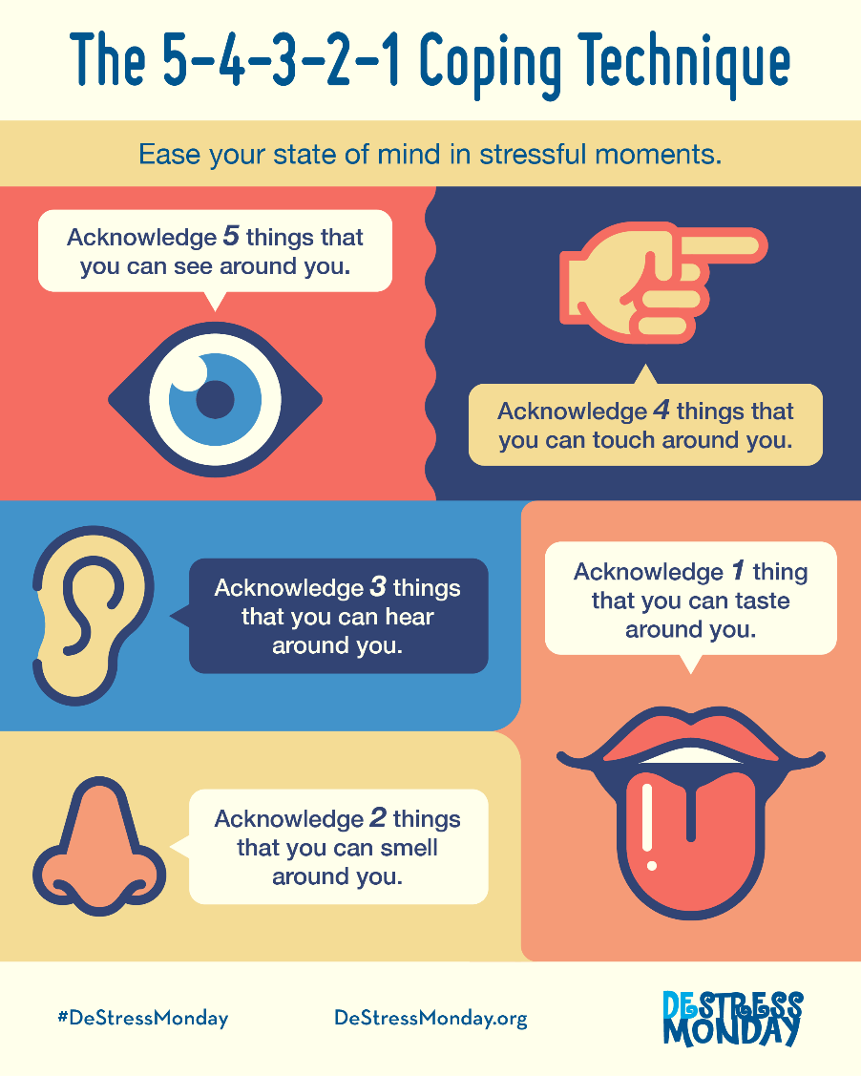
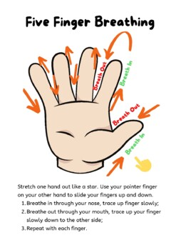
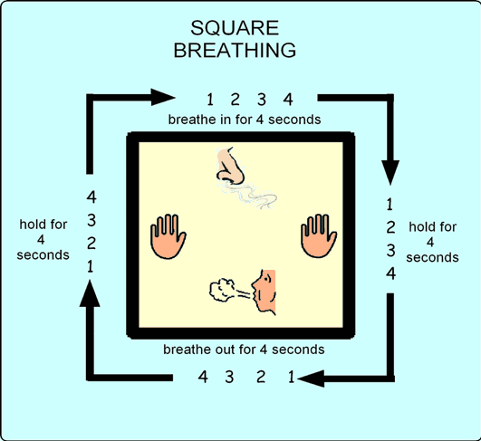
Mindfulness: Grounding and Relaxation Techniques

Slide 30
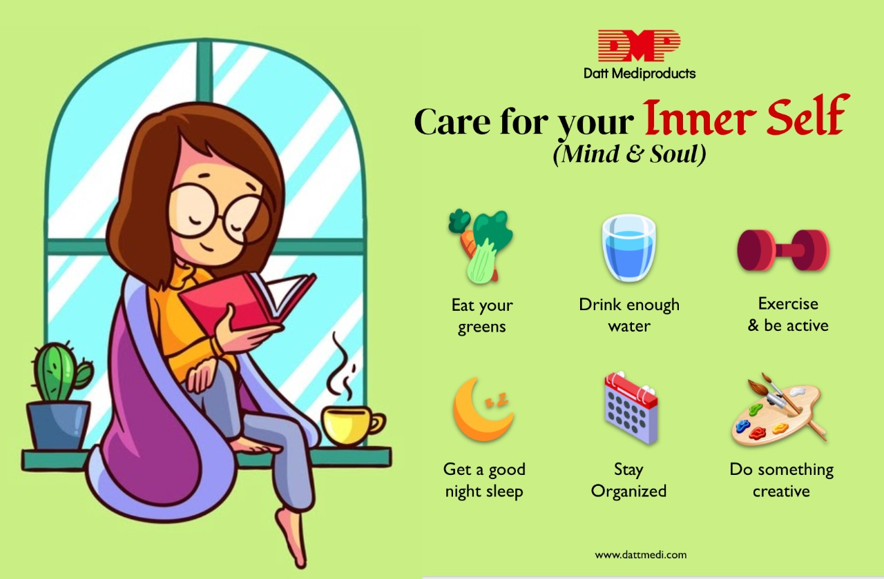
Self-care: Looking after our physical and emotional wellbeing
Self-care might be:
Eating healthily and exercising (exercise can be anything from jumping on a trampoline to going for a walk).
Doing things you enjoy (playing with friends, riding a bike, looking after a pet, reading…)
Sleeping well to make sure your body and mind are well rested for the day ahead.

Slide 31
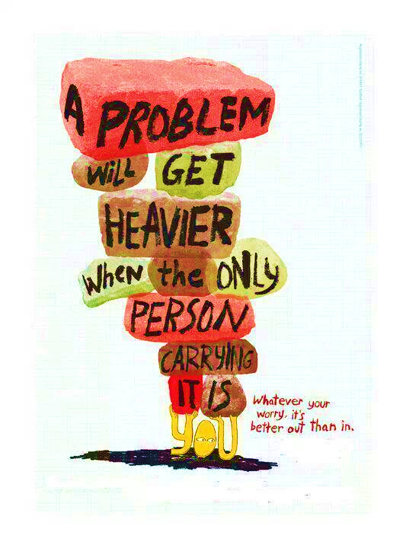
Sharing your worries
Can you think of somebody who you can share your worries with?
Notes:
Remind CYP of the worry bag – ‘how heavy was the worry bag before?’

Slide 32
Have we achieved our aims?
To understand the difference between worry and anxiety.
To learn how to manage worry and anxiety.
To understand what worry and anxiety are.

Slide 34
Thank you for listening!
Any questions?

