Slide 1
Anglo-Saxon
Artefacts

Slide 3
•Much Anglo-Saxon art and jewellery was influenced by people from central Europe, in what is now Germany. The 7th and 8th centuries are considered to be the most productive periods for Anglo-Saxon art and design.
•Anglo-Saxon jewellery used a lot of gold – more for its high cost and status than its appearance. Goldsmiths were highly respected and were given freedom to move around the Anglo-Saxon kingdoms.
•Anglo-Saxon jewellery, especially metalwork, was admired as far away as Italy. Saxon goldsmiths worked on decorations for St. Peter’s church in Rome, although few pieces have survived.

Slide 5
Both men and women liked to wear jewellery in Anglo-Saxon times. Necklaces and bracelets were made from glass beads, amber and amethyst, and women fastened their clothing with brooches.
Anglo-Saxon women also wore pieces of jewellery hanging from their waist. These were thought to indicate their role as the head of the household and probably had no practical purpose.
Some jewellers and goldsmiths became well known for their skill. Spearhafoc was appointed Bishop of London, while Mannig was said to have miraculously healed a wound in a worker’s hand.

Slide 7
•Men wore belt buckles, more for decoration than for practical reasons, and these were often large and elaborate. Women of high rank or who were wealthy wore necklaces made from silver or gold.
•Some of the finest examples of Anglo-Saxon jewellery were found in the burial site at Sutton Hoo in East Anglia. Excavations revealed a ship, household items, weapons and beautiful jewellery.
•Many items excavated from Sutton Hoo are on display in the British Museum. Highlights of the Anglo-Saxon jewellery found there include
rings, earrings, pendants and necklaces.

Slide 8
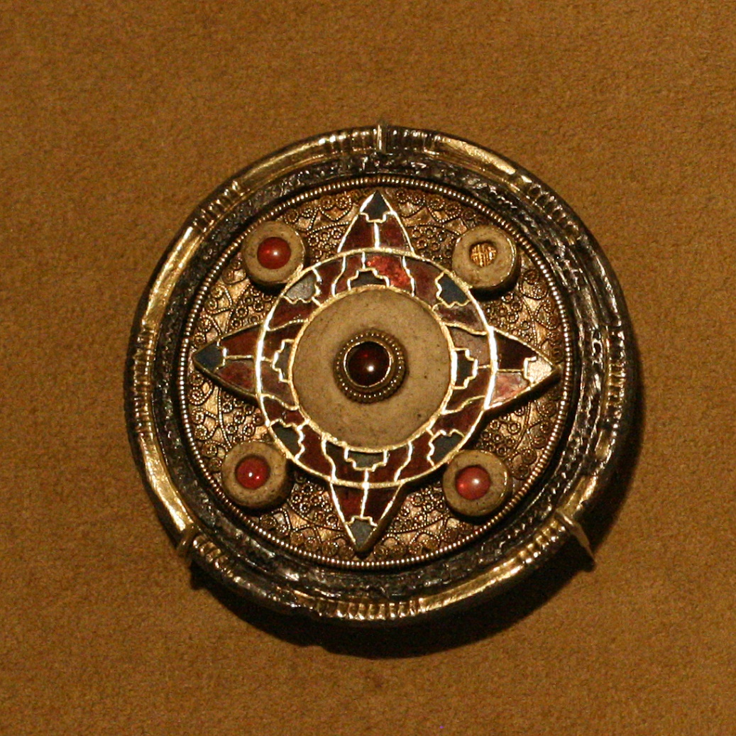
Brooches

Slide 9
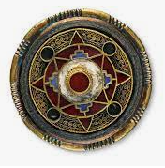
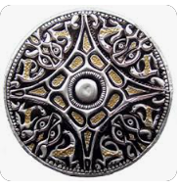
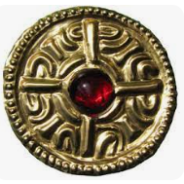
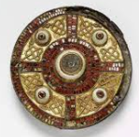
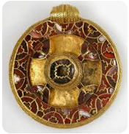
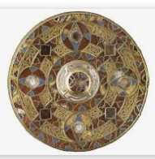

Slide 10
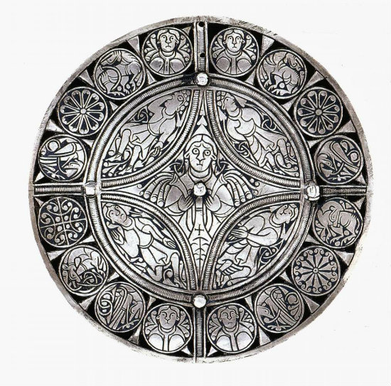
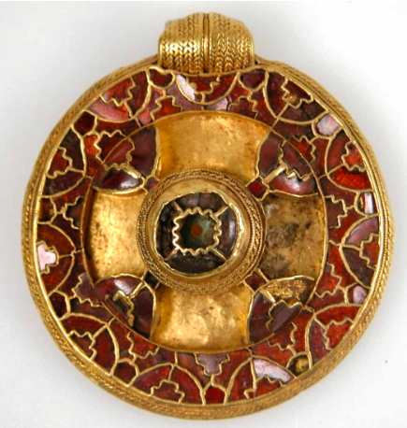
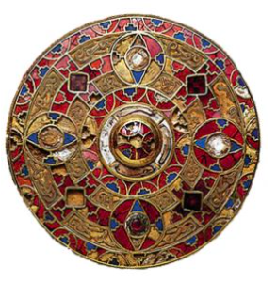
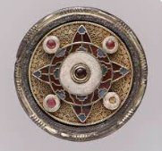
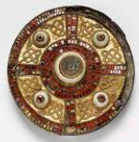
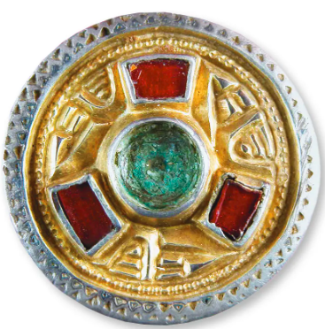

Slide 11
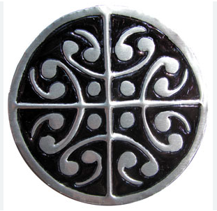
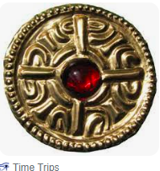
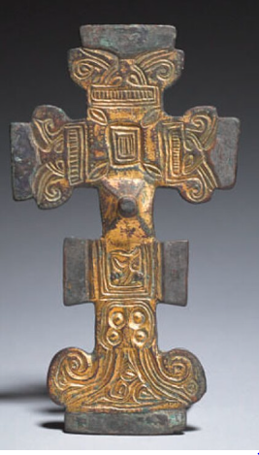
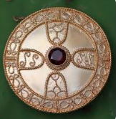
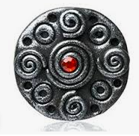

Slide 12
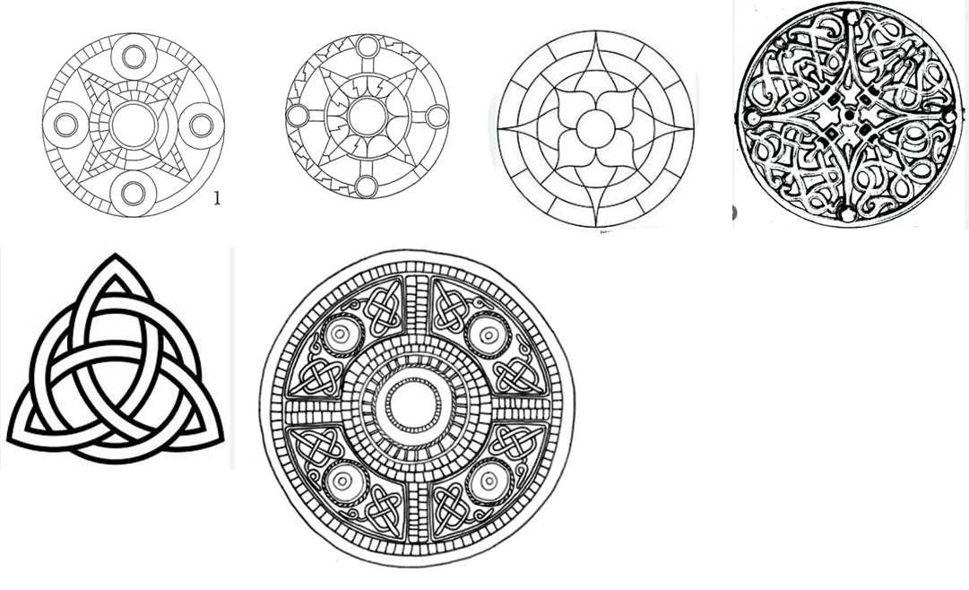

Slide 13
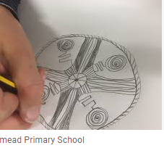

Slide 14
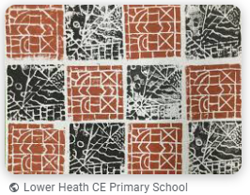
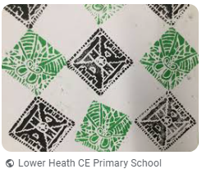
Design
Photo courtesy of electropod(@flickr.com) - granted under creative commons licence - attribution

Slide 15
