Slide 1
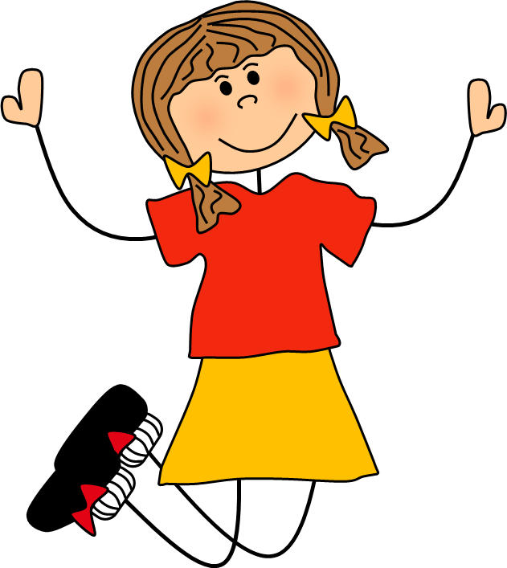
Action Words
jump

Slide 2
What are we learning?
Today we are going to learn about action words called verbs. We will practise recognising them in our reading and look at how to use interesting verbs to improve our writing.

Slide 3
What is a verb?

Slide 4
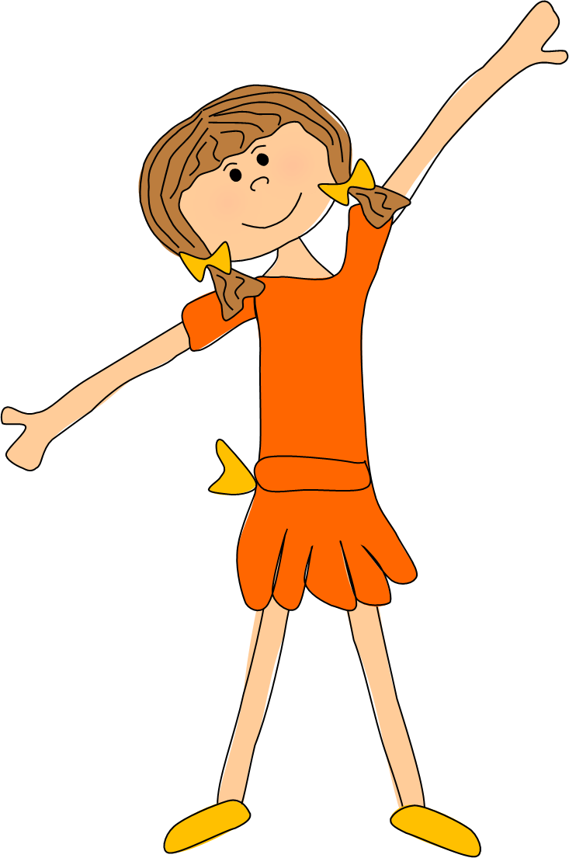
A verb is an action word. It tells us what someone or something is doing…
Alex dances well.

Slide 5
The fish swim in the sea.

Slide 6
The choir sing beautifully.

Slide 7
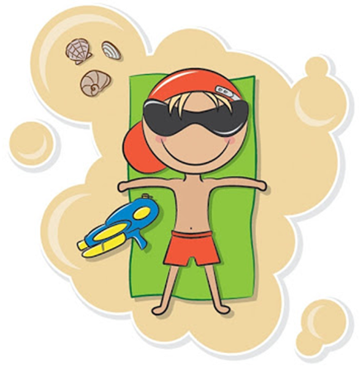
I relaxed on the beach.

Slide 8
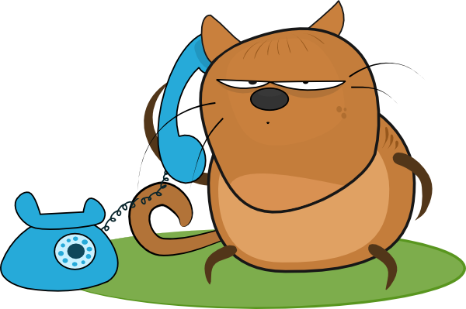
Cyril is chatting on the phone.

Slide 9
Can you think of any other verbs? Go around the class and see how long you can make a ‘verb chain’ before you run out of words.

Slide 10
Below are some of the things I can do. They are all verbs.
sleep
jump
think
argue
play
smile
skip
shout
swim
worry

Slide 11
Sort the words on the following slide into verbs and not verbs. Click on each word to send it to the correct place in the table.

Slide 12
Teacher-of-English.com
Action Words Worksheet
Sort the words below into verbs and not verbs.
Verbs
Not Verbs
Copyright 2020 Online Teaching Resources Ltd
Notes:
Worksheet to accompany activity.

Slide 13
Verbs
Not Verbs
exercise
dinosaur
impossible
joke
whisper
beautiful
strong
argue
food
more
wander
laugh
goal
frighten
bake
guitar
scream

Slide 14
The verb is the most important word in a sentence. It tell us what is being done in the sentence…
Alex is dancing.
The verb ‘dancing’ tells the reader what the subject of the sentence (Alex) is doing.

Slide 15
Read the sentence on each slide and identify the verb.

Slide 16
Teacher-of-English.com
Action Words Worksheet
Underline the verb in each sentence.
Fred is reading his book slowly.
The vicious bear growled.
The mouse nibbled the cheese.
4. Charlie ran as fast as lightning.
5. Lucy posted a letter to her friend.
Circle the verb with the similar meaning.
walk
disappear
run
push
moan
stroll
open
drive
argue
speak
vanish
dive
sprint
ride
roar
break
shove
groan
fall
grow
Change the highlighted verb to a more interesting verb.
Imran disappeared from inside the haunted house.
The baby threw her teddy out of the pram.
The stack of plates fell to the floor.
‘Please, help me,’ I said.
Gerry smiled from ear to ear.
_____________________________________________________________________________________________________________________________
Copyright 2020 Online Teaching Resources Ltd
Notes:
Worksheet to accompany activity.

Slide 17
Fred is reading his book slowly.
reading

Slide 18
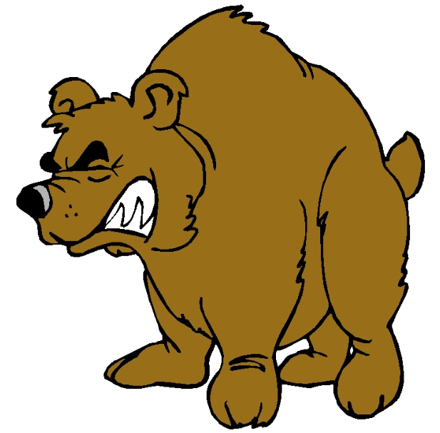
The vicious bear growled.
growled

Slide 19
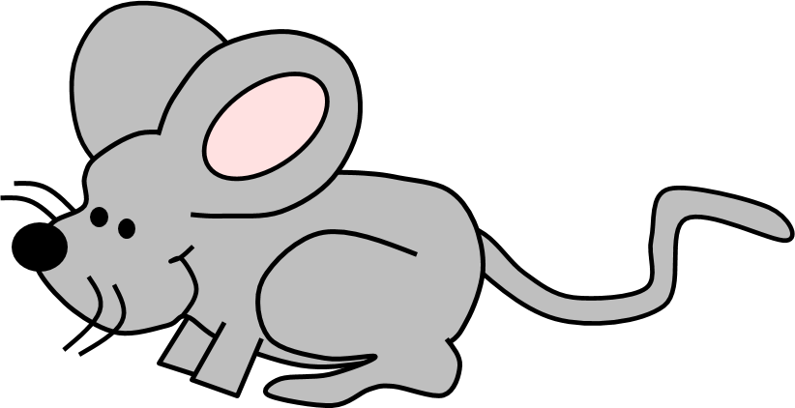
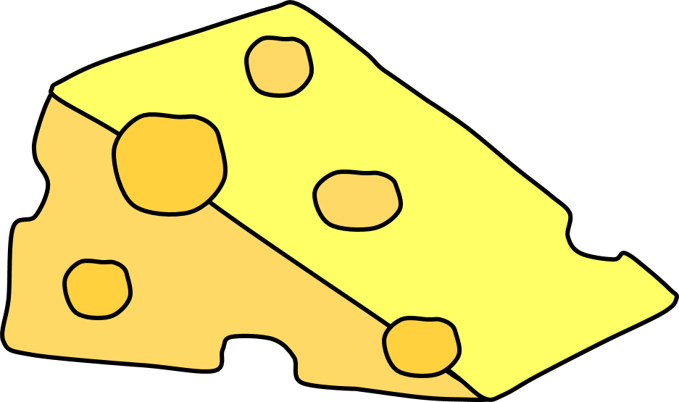
The mouse nibbled the cheese.
nibbled

Slide 20
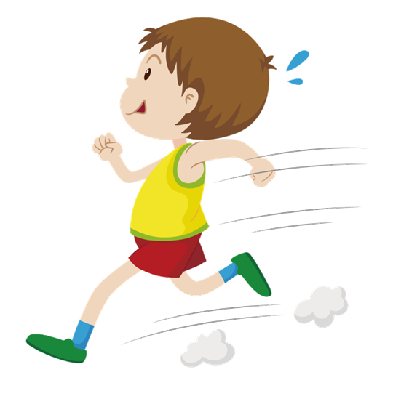
Charlie ran as fast as lightning.
ran

Slide 21
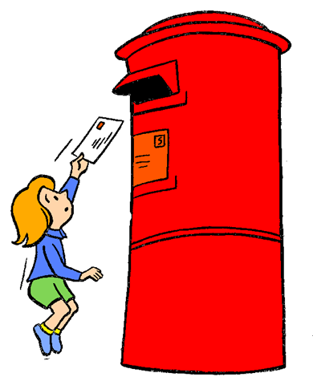
Lucy posted a letter to her friend.
posted

Slide 22
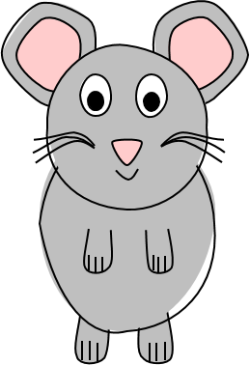
When writing it is important to use interesting verbs to make our sentences clearer and more exciting for the reader…
The mouse ran away.
becomes…
The mouse scurried away.
By changing the verb ‘ran’ to ‘scurried’ the reader has a clearer picture of the action of the mouse and the sentence becomes more interesting.

Slide 23
Can you match up the verbs with similar meanings on the following slides?

Slide 24
stroll
walk
open
drive

Slide 25
argue
disappear
speak
vanish

Slide 26
dive
run
sprint
ride

Slide 27
roar
push
break
shove

Slide 28
groan
moan
fall
grow

Slide 29
Read the sentence on each slide and replace the verb with a more interesting one. Click to reveal an answer but any suitable verb will be acceptable.

Slide 30
Imran disappeared from inside the haunted house.
vanished

Slide 31
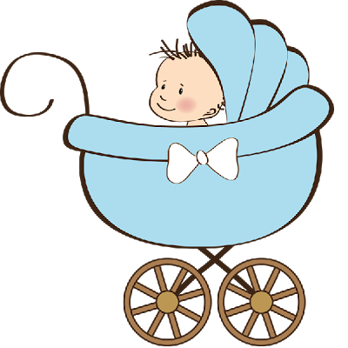
The baby hurled her teddy out of the pram.
threw

Slide 32
The stack of plates crashed
to the floor.

Slide 33
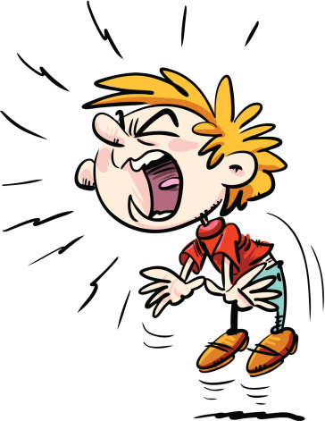
‘Please, help me,’ I screamed.

Slide 34
Gerry grinned from ear to ear.
smiled

Slide 35
Teacher-of-English.com
Action Words Worksheet
Remember: a verb is an action or doing word.
Underline the verb in each sentence.
Michael kissed his grandmother goodbye.
The flowers wilted in the sun.
Kevin scored the winning goal and leapt into the air.
The cat snoozed in front of the fire.
Saira painted a beautiful picture.
6. I thought it was time for lunch.
7. The lions roared noisily as they lay in the sun.
8. I decided to wear the purple jumper.
9. The trees rustled in the wind.
10. The scientist invented a talking vacuum cleaner.
Choose an interesting verb to complete each sentence.
The boy _______________ home from school.
The clown _______________ the children in the audience.
Sally _______________ her lunch quickly.
I _______________ into the river.
The builder _______________ the nail into the wood.
Copyright 2020 Online Teaching Resources Ltd
Notes:
Worksheet.

Slide 36
Teacher-of-English.com
Action Words Worksheet Answers
Remember: a verb is an action or doing word.
Underline the verb in each sentence.
Michael kissed his grandmother goodbye.
The flowers wilted in the sun.
Kevin scored the winning goal and leapt into the air.
The cat snoozed in front of the fire.
Saira painted a beautiful picture.
6. I thought it was time for lunch.
7. The lions roared noisily as they lay in the sun.
8. I decided to wear the purple jumper.
9. The trees rustled in the wind.
10. The scientist invented a talking vacuum cleaner.
Choose an interesting verb to complete each sentence.
The boy _______________ home from school.
The clown _______________ the children in the audience.
Sally _______________ her lunch quickly.
I _______________ into the river.
The builder _______________ the nail into the wood.
strolled
terrified
Example answers. Any suitable verb will be acceptable
scoffed
tumbled
battered
Copyright 2020 Online Teaching Resources Ltd
Notes:
Worksheet Answers.

