Slide 1
How Do Shadows Change?

Slide 2
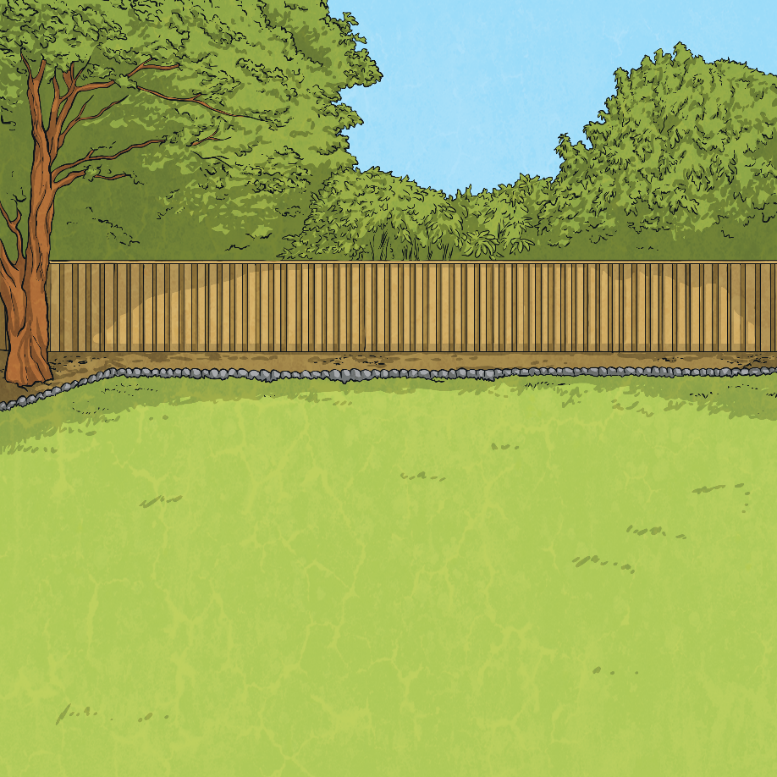
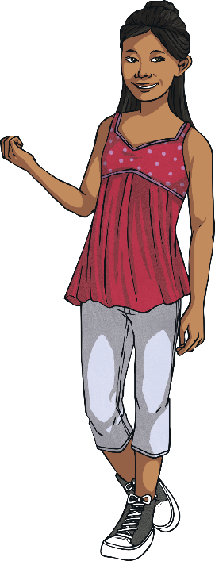
A Sunny Day
It was a lovely sunny Saturday. Having done all her homework and eaten her lunch, Eva decided to sit out and enjoy the sunshine. Having put on SPF50 sun cream, Eva put her deckchair in the sunniest part of the garden, away from the shadows of the oak trees.

Slide 3
Shadows
Eva had a relaxing time lying on her deck chair and reading her book. Gradually she nodded off to sleep. Suddenly, she woke up feeling a bit chilly. When Eva had fallen asleep, she was in bright sunshine. Now she was in the shadow of the oak trees. Eva was confused. She hadn’t moved, so why now was she in the shadow?

Slide 4
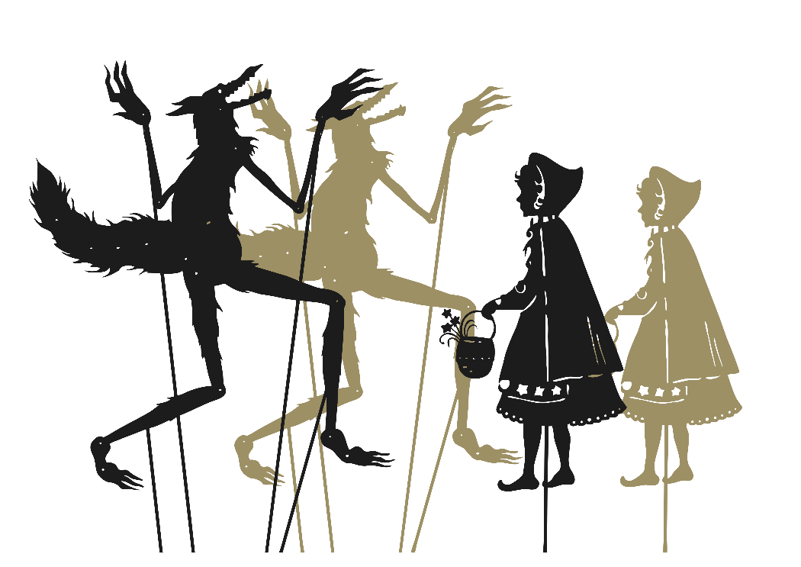
What Is a Shadow?
Light can only travel in a straight line. A shadow is formed when something blocks light.
Here is a shadow puppet show of Little Red Riding Hood. The shadows are formed when light is shone on the puppets. The puppets block the light and a shadow is formed.
What do you notice about the shape of the puppet and the shape of the shadow?
Talk About it!

Slide 5
Changing Shadows
Look at the shadow the ball makes.
What do you think will happen if the ball is moved closer to the torch? What will happen if the ball is moved further away from the torch?
Talk About it!

Slide 6
Changing Shadows
Look at the shadow the ball makes.
The closer to the light source an object is, the bigger the shadow will be. This is because the object blocks more of the light.
The further away from the light source an object is, the smaller the shadow will be. This is because the object blocks less of the light.

Slide 7
Changing Shadows
When the light source moves, the shadow will change. When the light source is directly above the object, the shadow will be directly underneath. When the light source is to one side of the object, the shadow will appear on the opposite side. The shadow will also be longer.

Slide 8
Eva
The oak trees in Eva’s garden
blocked sunlight and caused a
shadow. When Eva sat down in
the garden, it was midday so the sun appeared to be directly overhead. This meant the shadow was shorter. As the day went on, the sun appeared to be lower in the sky. This angle meant the oak trees cast a longer shadow.

Slide 9
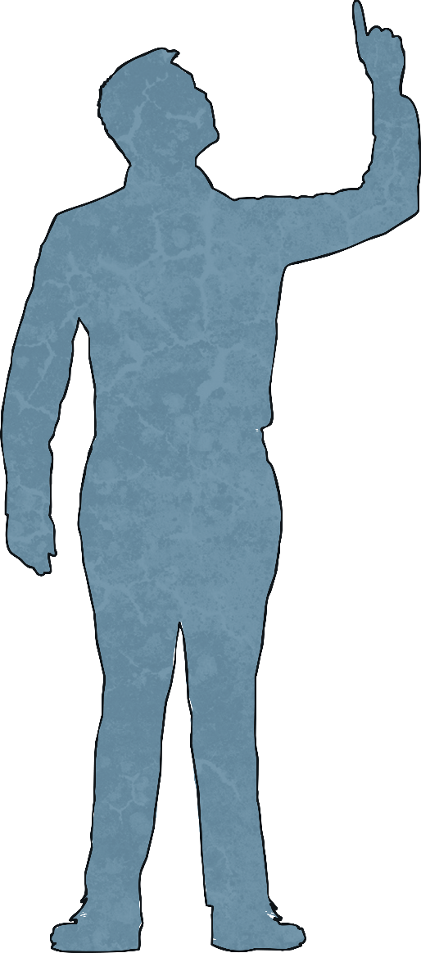
What Is a Shadow?
He hasn't got a notion of how children ought to play,
And can only make a fool of me in every sort of way.
He stays so close beside me, he's a coward you can see;
I'd think shame to stick to nursie as that shadow sticks to me!
One morning, very early, before the sun was up, I rose and found the shining dew on every buttercup; But my lazy little shadow, like an arrant sleepy-head, Had stayed at home behind me and was fast asleep in bed.
I have a little shadow that goes in and out with me,
And what can be the use of him is more than I can see.
He is very, very like me from the heels up to the head;
And I see him jump before me, when I jump into my bed.
The funniest thing about him is the way he likes to grow,
Not at all like proper children, which is always very slow;
For he sometimes shoots up taller like an India-rubber ball,
And he sometimes gets so little that there's none of him at all.
Talk About it!
Talk about this poem with your partner.

