Slide 1
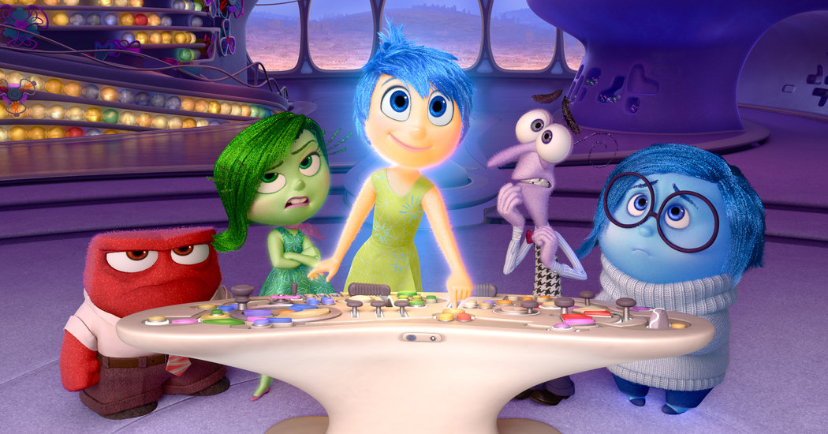
Zones of Regulation Assembly
https://www.youtube.com/watch?v=dOkyKyVFnSs
Notes:
Use nonverbal cues to identify emotions! Pause the video before revealing the emotion and have the student explain what clues they found to guess the feeling.
Bonus question in blue: Ask a child to explain what they could say or do in the situation

Slide 2
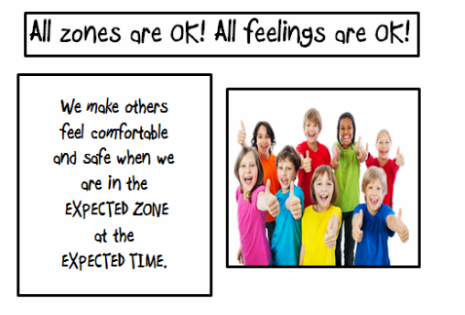

Slide 3
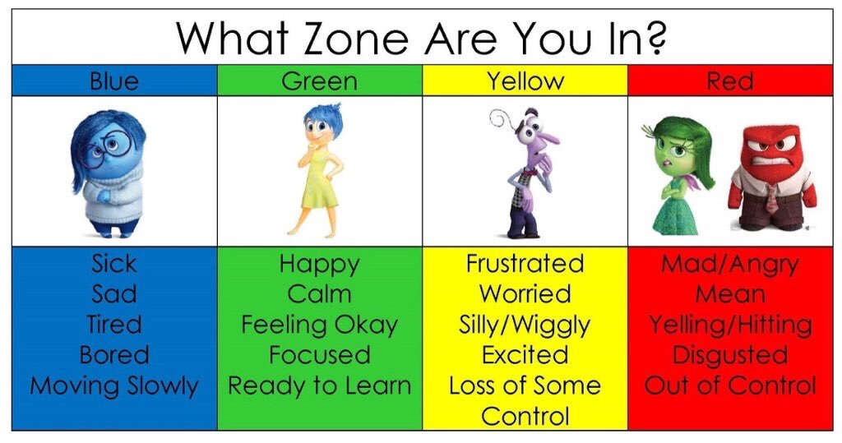

Slide 5
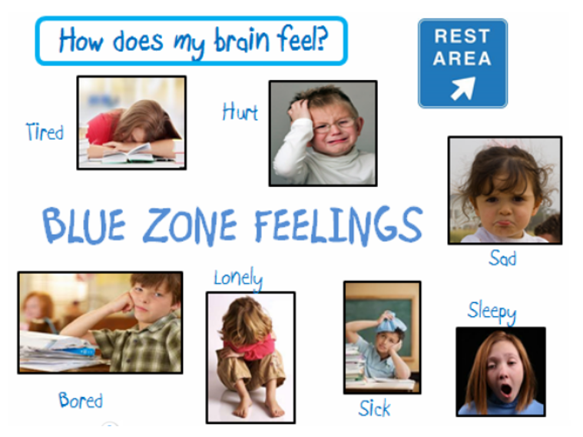

Slide 6
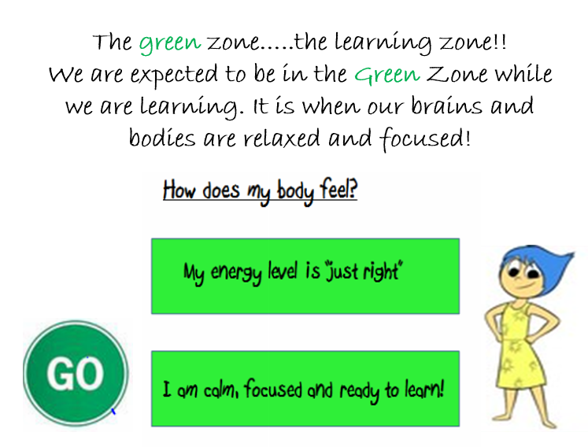

Slide 7
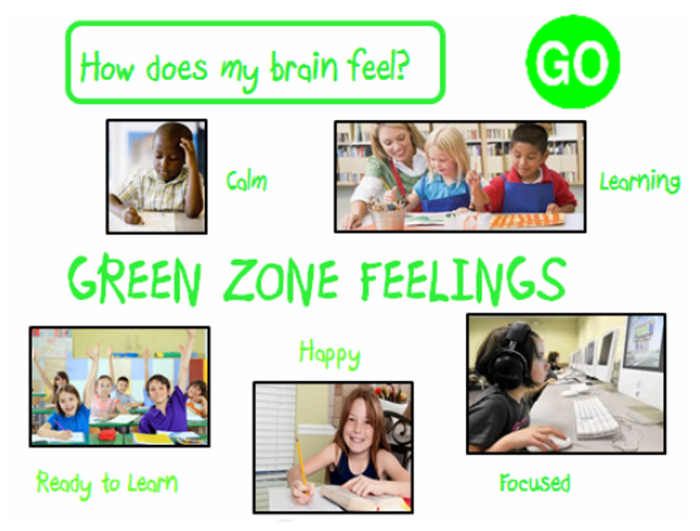

Slide 9
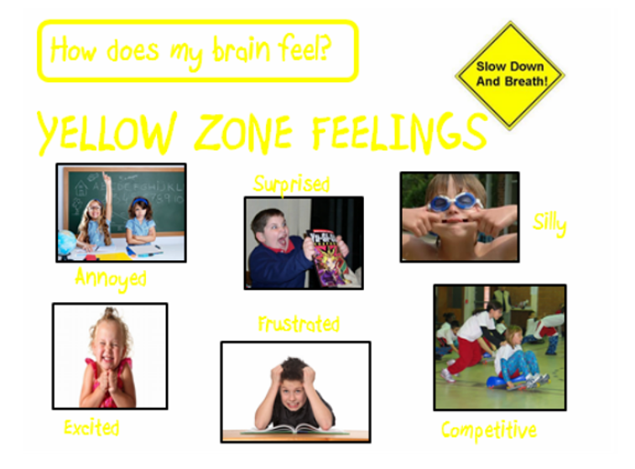

Slide 10
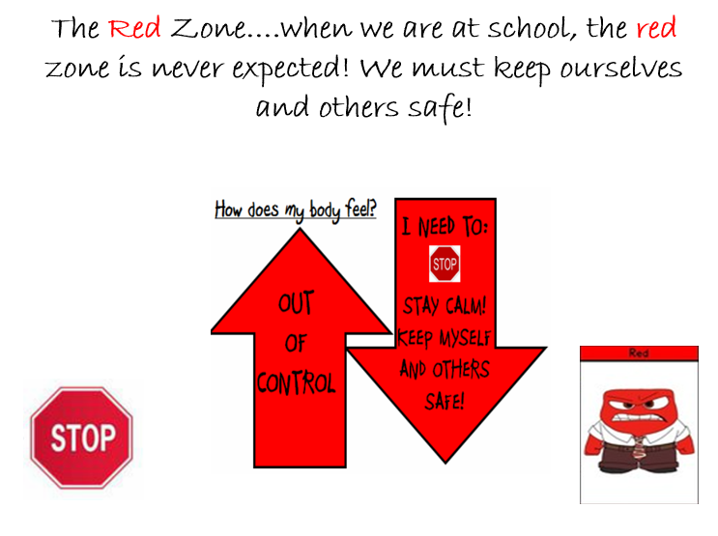

Slide 11
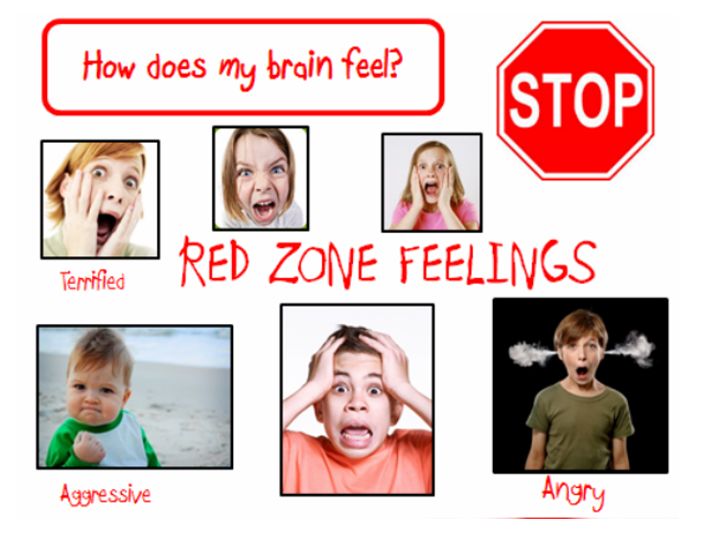

Slide 12
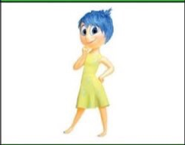
Share what makes you green

Slide 13
Share what makes you blue

Slide 14
Share what makes you red

Slide 15
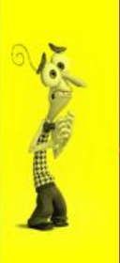
What makes you Yellow

Slide 16
What can you do when you are angry?
Good choices
Bad choices

Slide 17
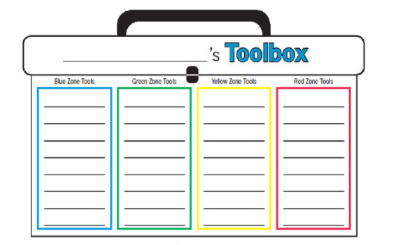

Slide 18
It is OKAY to have different emotions!
It is important to recognise your emotions and the emotions of others.

Slide 19
Notes:
For example, ask students to identify their zone before a therapy session or before the school day

