Slide 1
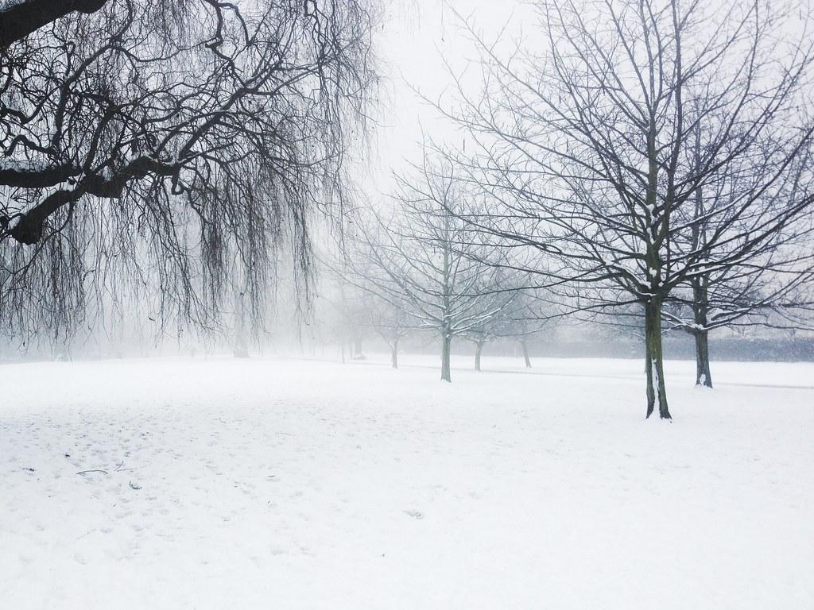
Happy Snow Day from Year One!
We are very excited that today is a snow day but we are going to miss seeing you all today. Above anything, We would like you all to have lots and lots of snow fun and stay safe! We are excited to hear all your stories and adventures when we return to school. Please send in photos of wonderful snowmen and snowball fun! We would love to see them and share them in circle time. We have popped a few learning ideas below just in case you are missing school today!

Slide 2
Phonics Home Learning
Today if you can please can you spend some time practising your reading book.
When you have done this, could you have a go at creating your own Obb and Bob game? In school we are practising hard to remember all the sounds we have learned and we are preparing for the screening test in June. We play a game with two Aliens, Obb and Bob. Could you draw or make Obb and Bob and then make a set of ten cards. On five of the cards can you write real words using the digraphs/trigraphs oa, ee, igh, ai, oo. On the other five can you think of five fake words using the same five sounds?
When you have done this can you challenge someone in your house to sort them out into real/ fake words. The real words are fed to Bob and the fake ones to Obb.
Maybe an adult could make you some cards to sort? Maybe they can trick you? Maybe you can trick them?
https://www.phonicsplay.co.uk/

Slide 3
English Home Learning
If you would like to practise some English you can have a go at writing some snowy sentences.
Snow from the window
Can you write sentences to tell us what you can see from your window?
When you do this the main focus is to practise your clear sentence writing skills. Remember, phonics sounds, finger spaces, clear graphemes, full stop at the end of each sentence and capital letter at the beginning.
Ideally we would like you to try to use some snowy adjectives to make your sentences amazing. If you bring your sentences into school, we will be giving out some house points.

Slide 4
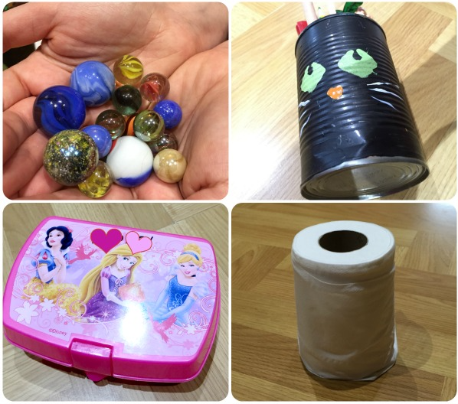
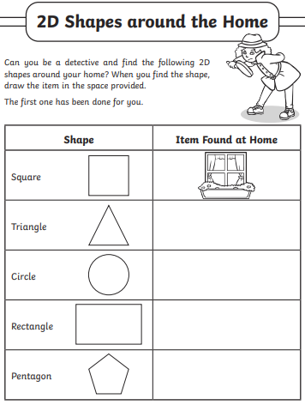
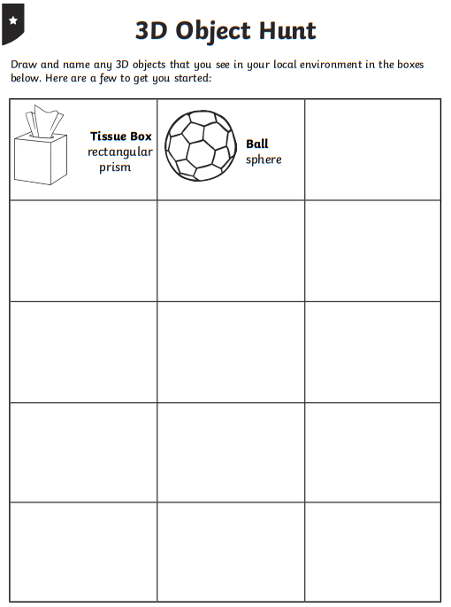
Maths Home Learning
Let's revisit shapes. Think about 2D and 3D shapes.
Can you go on a shape hunt around the house?
Think about…
Does the shape have curved sides or straight sides?
Does it have corners, how many?,
Does the shape have faces? (3D) what shape are they? Can you see another 2D shape in the face?
Record what you find. What shape is the most common in your home?
https://www.youtube.com/watch?v=guNdJ5MtX1A

Slide 5
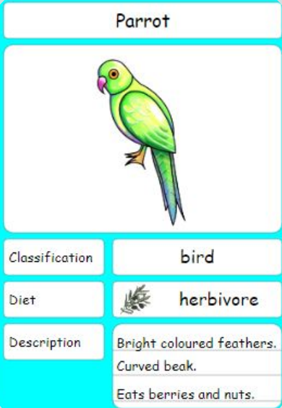
Science Home Learning
Continuing with our Science topic of Animals including Humans we would like you to make an animal classification card.
This week in school we will be focussing on different types of animals and we would like you to to choose any animal.
Think about…
● what the animal looks like and draw a picture,
● the classification it would come in, mammal,
bird, fish, reptile, or amphibian.
● the diet, is it a herbivore, omnivore or a
carnivore?
● how you would describe it, use lots of different
adjectives.
https://www.bbc.co.uk/bitesize/topics/z6882hv

Slide 6
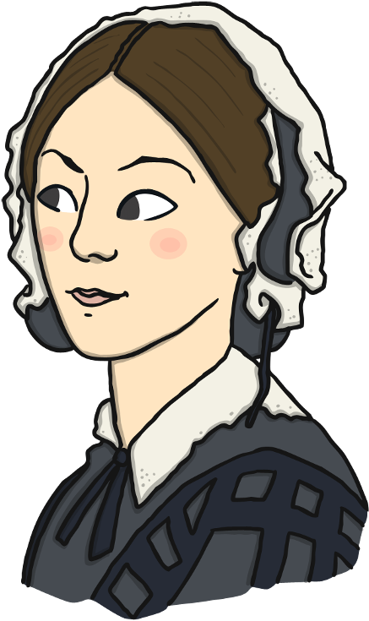
History Home Learning
Who is Florence Nightingale and why is she important?
https://www.bbc.co.uk/bitesize/articles/znsct39
What did Florence Nightingale do to make the conditions better for the soldiers?
Draw a picture of her and make a list of the improvements that she made.

