Slide 3
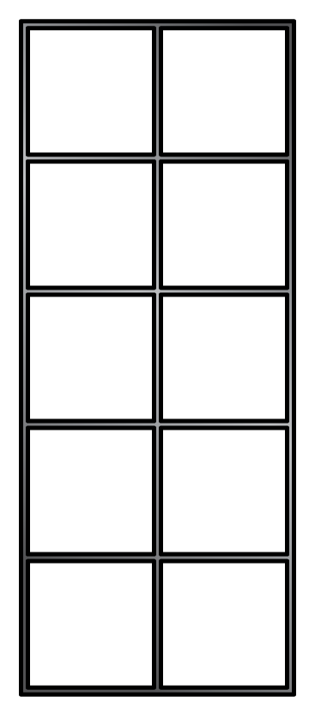
How many fives are there?
2) How many counters?
3) Complete the number line.
4) What number is the arrow pointing to?
0
10

Slide 4
How many fives are there?
2) How many counters?
3) Complete the number line.
4) What number is the arrow pointing to?
4 fives
20
0
10
20
30
40
50
5

Slide 6
Complete the 5 times-table facts.
5
4
20
$×$ $=$
Have a think

Slide 7
Complete the 5 times-table facts.
5
4
20
$×$ $=$
5
6
30
$×$ $=$
Have a think

Slide 8
Complete the 5 times-table facts.
5
4
20
$×$ $=$
5
6
30
$×$ $=$
5
3
15
$×$ $=$
Have a think

Slide 9
Complete the number track.
5 | 10 | 15
20
25
30
35
40
45
50
Have a think

Slide 10
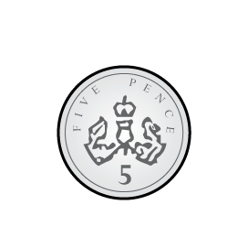
Complete the 5 times-table facts.
5
5
25
$×$ $=$
5
5
5
5
8
5
40
$×$ $=$
5
5
5
5
Have a think

Slide 11
0
5
10
15
20
25
30
35
40
45
50
5$×$0
5$×$2
5$×$4
5$×$6
5$×$8
5$×$10
5$×$1
5$×$3
5$×$5
5$×$7
5$×$9

Slide 12
Have a go at questions 1 - 2 on the worksheet

Slide 13
Mo has five times as much money as Ron.
Ron has £3
How much money does Mo have?
£15
Mo
£3 | £3 | £3 | £3 | £3
Ron
£3
Have a think

Slide 14
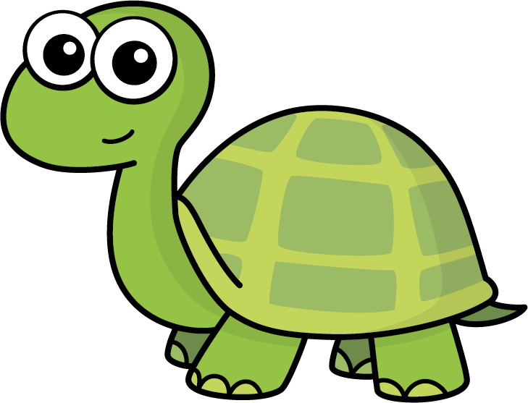
Tiny is working out some multiplications.
7
5
35
$×$ $=$
I know that 5 $×$ 5 $=$ 25
7 $×$ 5 $=$ 5 $×$ 5 $+$ 2 $×$ 5
$=$ 25 $+$ 10
5
2
5
Have a think

Slide 15
Tiny is working out some multiplications.
I know that 10 $×$ 5 $=$ 50
12
5
60
$×$ $=$
12 $×$ 5 $=$ 10 $×$ 5 $+$ 2 $×$ 5
$=$ 50 $+$ 10
Have a think

Slide 16
Have a go at the rest of the questions on the worksheet

