Slide 2
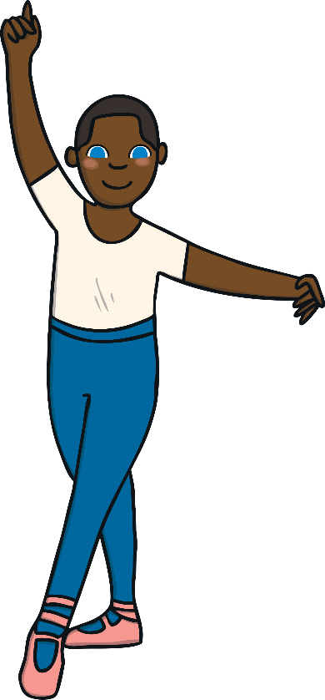
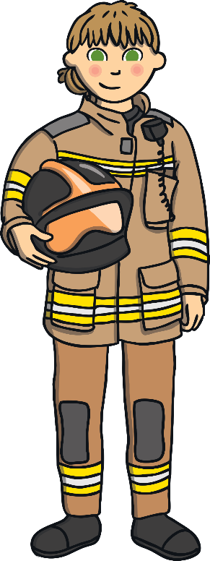
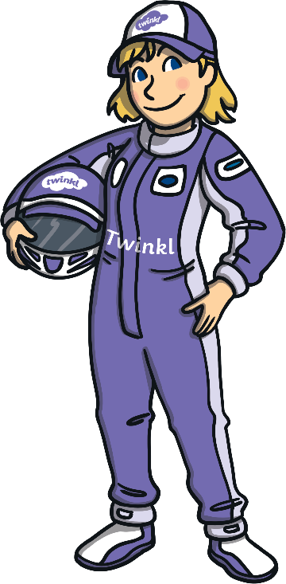
You can be whatever you want to be.
There are so many options, let’s have a look and see.
A firefighter, a ballet dancer, a race car driver who likes to zoom,
think about what’s interesting, the choice is up to you.

Slide 3
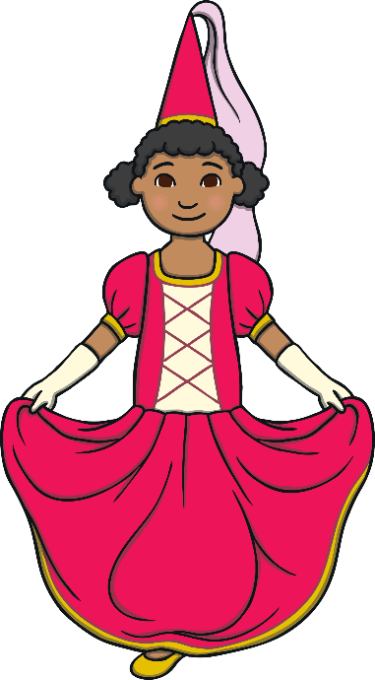
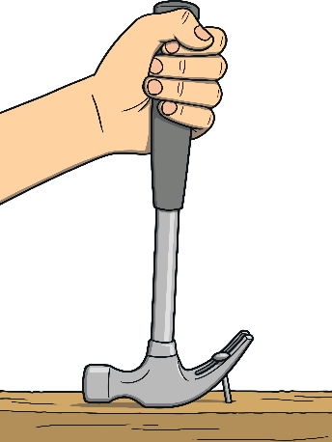
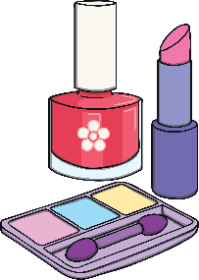
You can like any book, movie, colour or toy.
Nothing in this world is just for a girl or a boy.
Boys can like princesses and girls can like dinosaurs.
Boys can use nail polish and girls, a hammer and a saw.

Slide 4
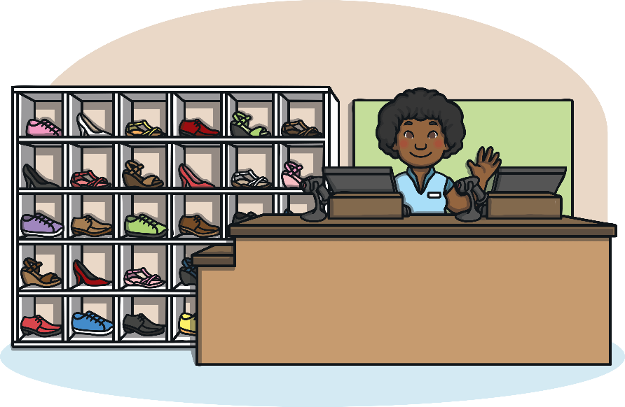
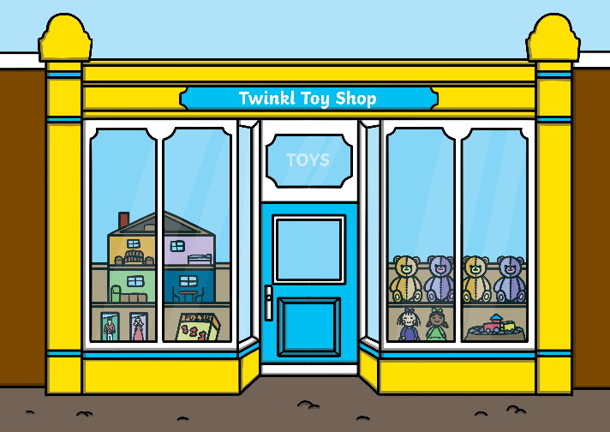
Life makes it tricky and sometimes tries to tell us what to do.
Like when you walk into a shop to buy a toy or a pair of shoes.
Just remember to make the decision that is just right for you.
Don’t feel pressured to choose what you think they want you to.

Slide 5
The colours of the rainbow can be shared by everyone.
There’s not a set of colours that you have to choose from.
Girls can like black and girls can like blue.
Boys can like pink, purple and yellow too.

Slide 6
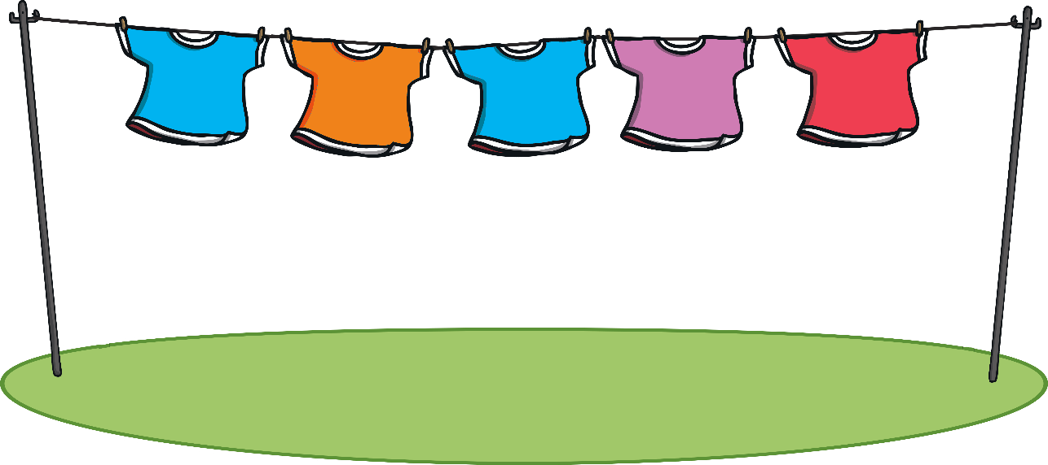
You can wear whatever you feel comfortable in.
Clothes are just fabric that protects your skin.
Dresses, shorts, t-shirts, skirts, pants and socks,
you have the option to choose from the lot.

Slide 7
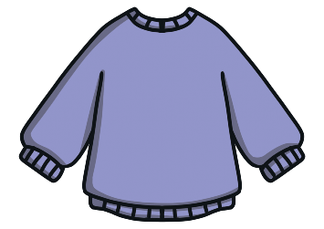
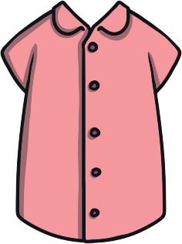
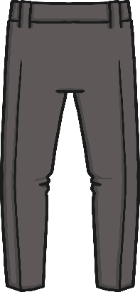
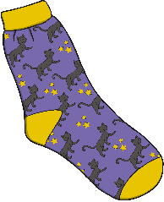
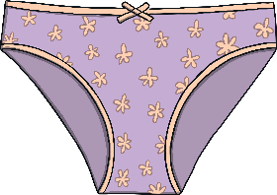
When you go shopping you might feel restricted to stick,
to a section that’s designed for a specific gender to pick.
But remember that you are unique, strong and brave.
You have the freedom to wear what you crave.

Slide 8
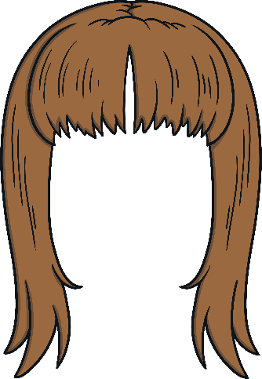
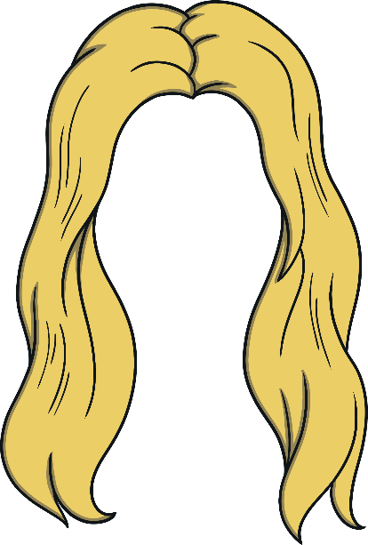
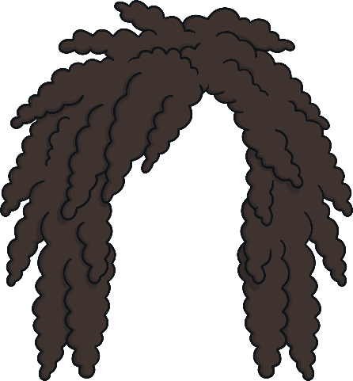
Boys and girls don’t need to look a certain way.
Long hair, short hair, anyway is OK.
You can decide to change your style,
as long as it makes you happy and helps you smile.

Slide 9
You can love and care for whoever you like.
Love anyone who adds joy and happiness to your life.
Try not to be swayed by other people’s opinions.
You are very special and are one in a million.

Slide 10
You can believe in anything you desire.
Let yourself be inspired by things you admire.
Follow your heart and choose to be true.
At the end of the day, there is only one you.

