Slide 1
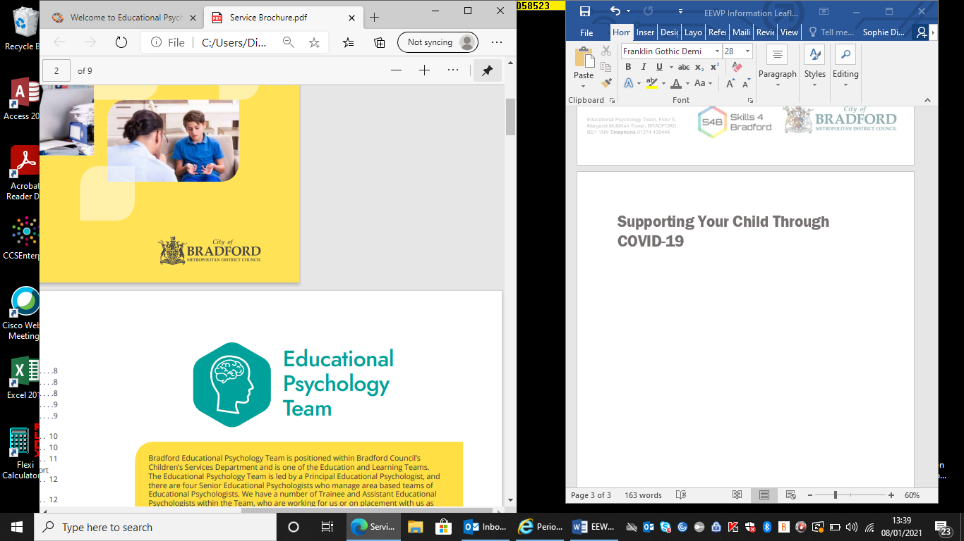

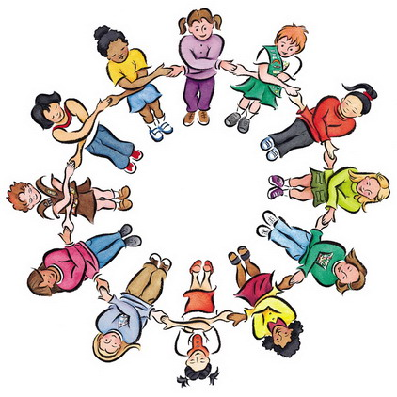

Friendship Through
COVID
Education Emotional Wellbeing Practitioner Team
Notes:
Hi, I am… and I am…. We are part of the EEWP team that work with children and young people who need help and advice about their emotional health and wellbeing. We have come into your school today to talk to you about friendships and how they have been affected by the Covid-19 pandemic. This session is 60 minutes in which we will do some activities and discussions. You also have a pack in front of you that you will need later on in the session.

Slide 2

Group Agreement
How should we behave in this session?
Share if you want to share
Keeping other people’s thoughts safe
Respect each other
Notes:
Let’s start with a group agreement. Does anyone know what an agreement is? Can you think of anything we could add to ours?
Give the CYPs chance to think of some ideas
Reveal the ones under the green box to help

Slide 3
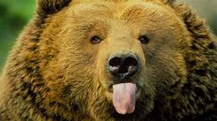

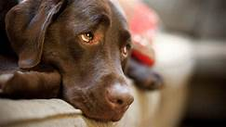
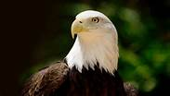
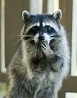

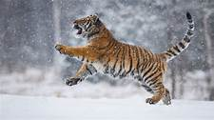
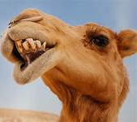
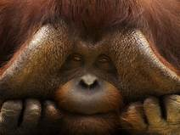
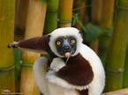
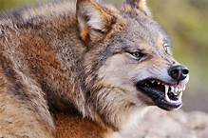
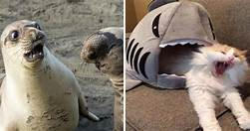
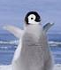
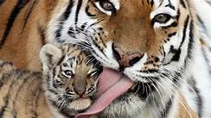
Which animal would describe your mood today?
Notes:
Let’s get to know each other.
Have a think about which type of animal would describe your mood today? Do you feel like the giraffe who looks like it is happy laughing? Or how about the wolf that looks fierce and determined?
Thank students for taking part.

Slide 4
Workshop Aims
To understand how friendships benefit our emotional wellbeing
To explore how Covid-19 and lockdown has impacted friendships
To explore skills in forming and maintaining friendships.
Notes:
So what are the aims of this workshop today? We are here to talk about how friendships benefit our emotional wellbeing. We will explore how Covid-19 and the lockdowns affected friendships and also gain some skills in forming and maintaining friendships.

Slide 5
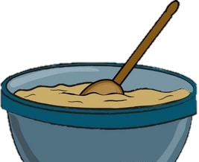
What is friendship and why is it valuable?
Like cakes, friendships are made of all sort of ingredients. What would we add to our friendship cake to make it the best?
Loyal
Listens well
Funny
Mean
Helpful
Trusting
Lies
Honest
Respect
Fun
Quiet
Fair
Dishonest
Forgiving
Demanding
Supportive
Happiness
Smiles
Good Communication
Patience
Kindness
Bossy
Caring
Laughter
Notes:
Let’s think about what friendship actually is and why it is important. If we were making a friendship cake and needed ingredients, which would we choose? Give post it’s to CYPs, invite them up to stick them on the bowl on screen
kind, bossy, caring, honest, loyal, listening, funny, angry, helpful, trusting, forgiving, bully, loud, demanding, encouraging, respectful, liar, fun, patient, controlling, quiet, fair, dishonest, supportive…

Slide 6
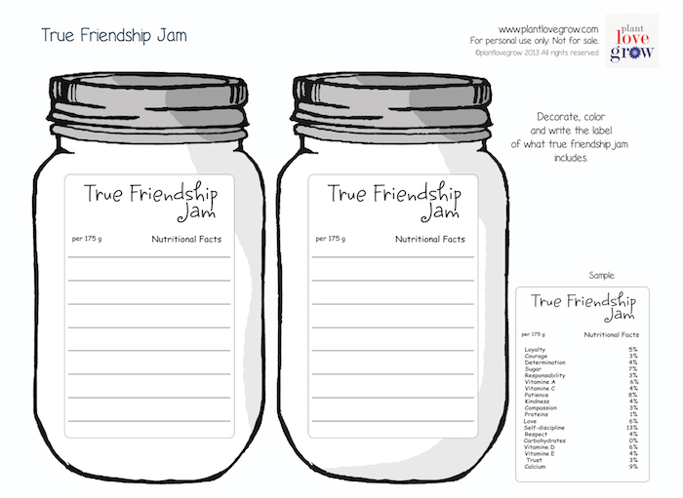
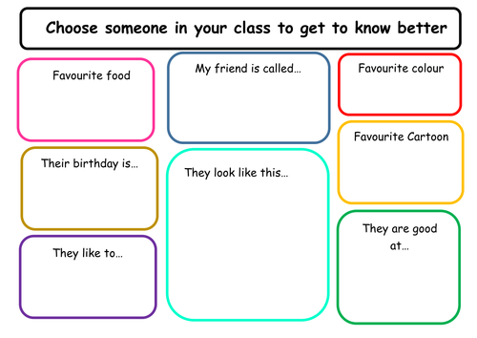
There are some worksheets in your pack for you to explore
Notes:
You may choose different ingredients for your own friendship cake. Have a go at completing one of the friendship sheets in your pack at a later time. You can design some friendship jam full of ingredients you would choose to make a great friend. Or try to complete the ‘Getting to know someone’ sheet. That one’s particularly helpful at the start of the year or when starting high school.

Slide 7
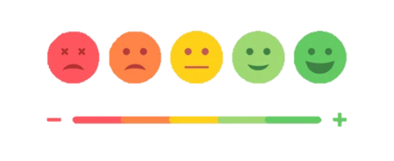
How should friendship make us feel?
Notes:
So how should friendship make us feel? Sometimes our friends can make us happy and sometimes they make us sad.
Changes in friendships can be effected by changes in mood. Let’s look at the scale on the board. What might make a friendship go towards red? If this happens frequently is it time to make a change? If you are feeling red often, it may affect your mood and emotional health.

Slide 8
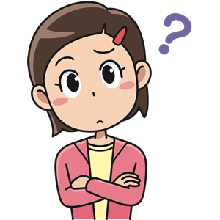
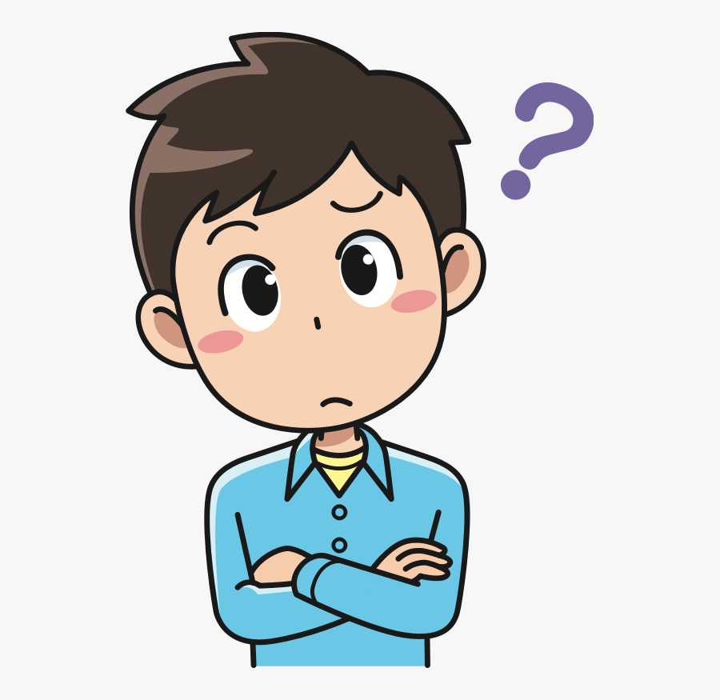
How can friendships help our emotional health?
Notes:
How can friendships help our emotional health? What do you think? Get ideas from the children-can use post it notes. Check that the CYPs know what emotional health is. E.g. supporting each other, someone to listen to you.

Slide 9
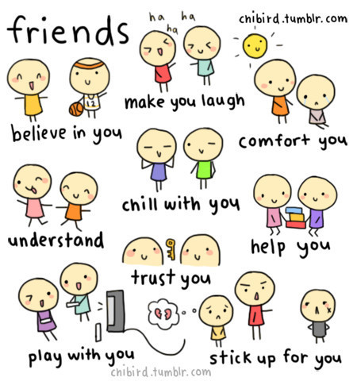

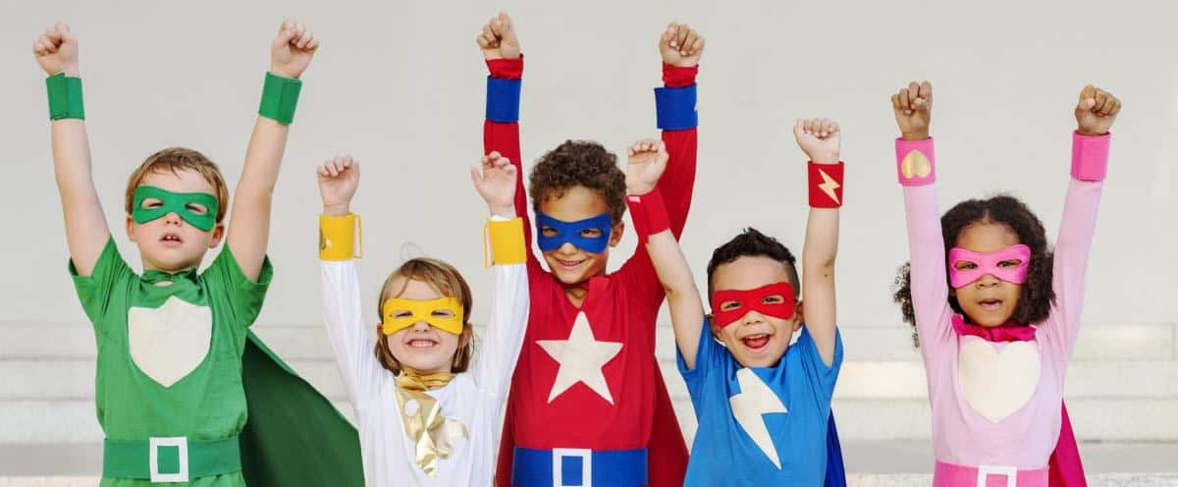
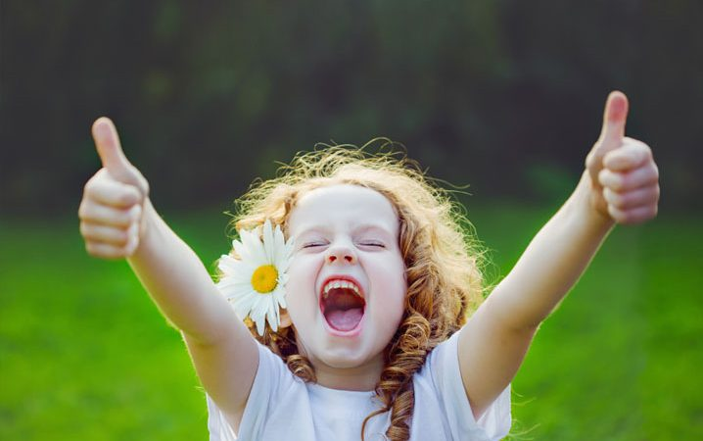
How friendships can help our emotional health
Confidence
Happy
Lower Worries
Improve Self – esteem
Improves our mood
Increases Motivation
Less Lonely
Think positively
Notes:
Our research shows that friendships help our emotional health in many ways. We feel happier, have more confidence, our worries are lowered because we share them. Our self-esteem improves and we have increased motivation to do more. Our mood improves and we feel less lonely and we think positively.

Slide 10
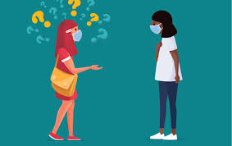
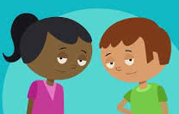
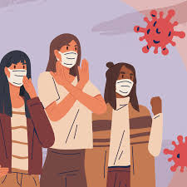
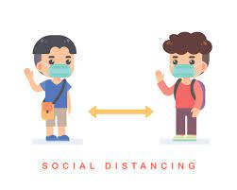
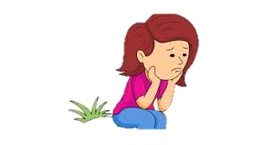


What happened to our friendships during Covid – 19?
How did we stay in contact?
Who did we see?
How did we stay safe?
Notes:
With being at home throughout the lockdowns our friendships changed somewhat. Let’s think about what happened to them. How did you stay safe? Who did you see? How did you stay in contact?
Answers on the next slide.

Slide 11

The Impact of Covid-19 on Friendships
Good things
Hard things
Having time alone (self-care)
More time to spend doing new activities
More time to spend with close family (who we live with)
A greater appreciation for our friends
Having time alone (feeling isolated)
Losing touch with others
Missing out on hobbies with friends
Being restricted
Staying indoors
Limited ways to contact friends
Heightened emotions/feelings leading to more fallouts
Notes:
Our research shows that the pandemic has affected friendships in many ways. Can you think of any?
CYPs to shout out the good things about friendships that happened in Covid – 19 – 2 minutes max
“Lets see if we got any of the answers you said”
CYP’s to shout out the hard things about friendships that happened in Covid – 19 – 2 minutes max
“Lets see if we got any of the answers you said” Thank the CYPs for taking part.

Slide 12

Notes:
One of the things we found hard during the lockdowns was keeping in contact with friends. Did anyone stay in contact with their friends by using technology during the lockdowns? Let’s check-do we know how to stay safe online?
Who do we go to when something does not feel quite right with our friends? Face to face and online?

Slide 13
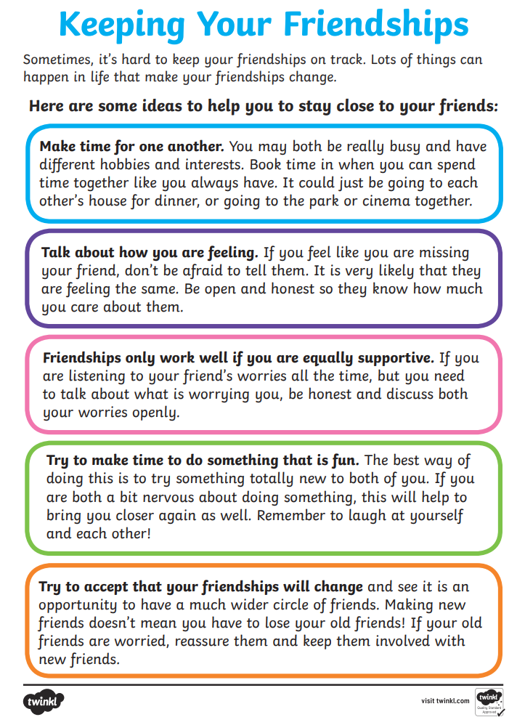

How can we build and maintain friendships?
Make quality time for each other
Be kind – treat others as you wish to be treated!
Listen and talk
Be supportive and understanding
Accept you may have different opinions
Respect boundaries
Be loyal and trustworthy
Talk through problems calmly
Notes:
Sometimes it is hard to start a new friendship-especially after a long time apart like lockdown.
Let’s think about how to make friendships last. How would you maintain a friendship with someone?
Share ideas in the session. Sheet in packs to refer to later.

Slide 14
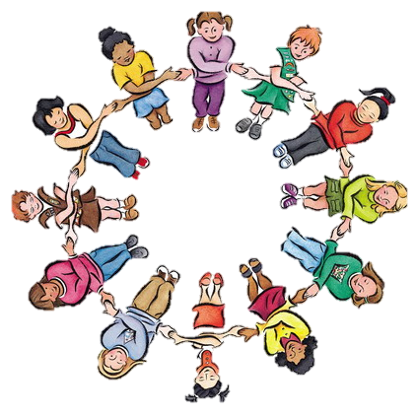
The Cycle of Friendship
Build a friendship: Listen, talk, play, spend time together
Maintain a friendship
Hurdle
Forgive and forget / move on with friendship
Form a connection
Or seek new connections
Notes:
This is the cycle of friendship. It explains how a friendship is made and maintained. First, we form a connection with someone, this can build into a friendship as you spend time together and get to know one another. Over time you continue to be friends but you may face a hurdle. Either you forgive and move on or you end the friendship with kindness and start a new one. This cycle may repeat itself every time you make new friends or come across a hurdle.

Slide 15
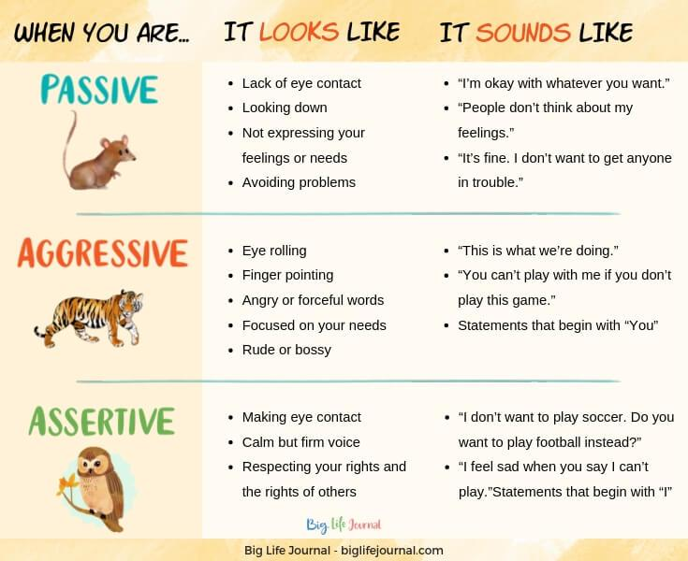
What do we do when we have a “hurdle” with friends?
Which is the best way to communicate?
Notes:
What do we do when we come across a ‘hurdle’ with friends? What would be the best way to communicate? Should we be a passive communicator who avoids eye contact and doesn’t express feelings? Should we be an aggressive communicator who points fingers and who is bossy? Or should we be an assertive communicator who speaks calmly and shows respect of others?

Slide 16
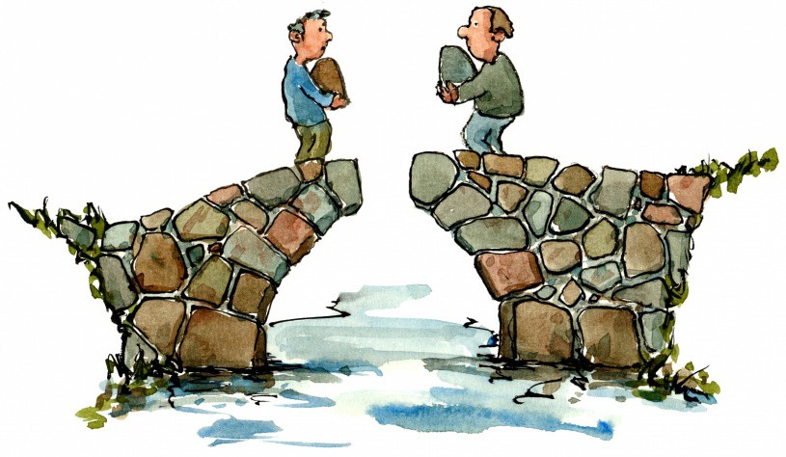
Moving On after a Hurdle
Fix it and move on separately
Fix it and stay friends
Build a bridge and pass over it
Notes:
It’s important to move on from a hurdle. Sometimes we do fall out. That’s okay. Encourage yourselves to build a bridge and cross over it. You may do this together or you may decide to go your separate ways. Talk about the hurdle. Talk about how to move forwards after it. Make a joint decision. Stay friends or move on.

Slide 17
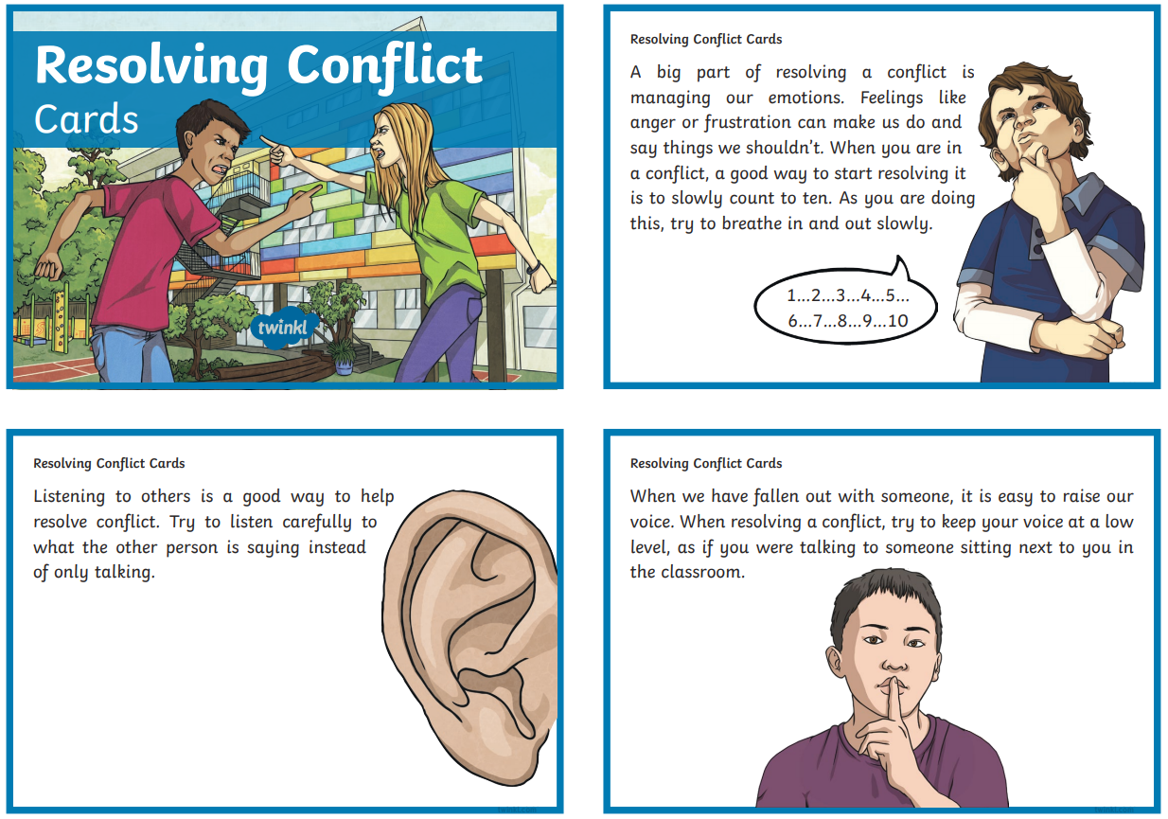
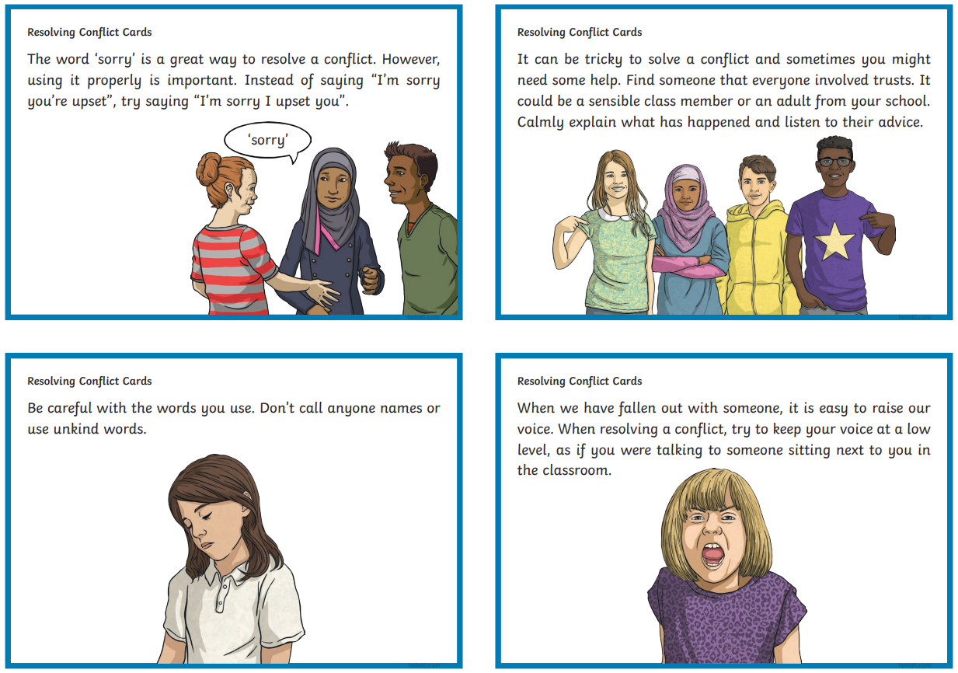
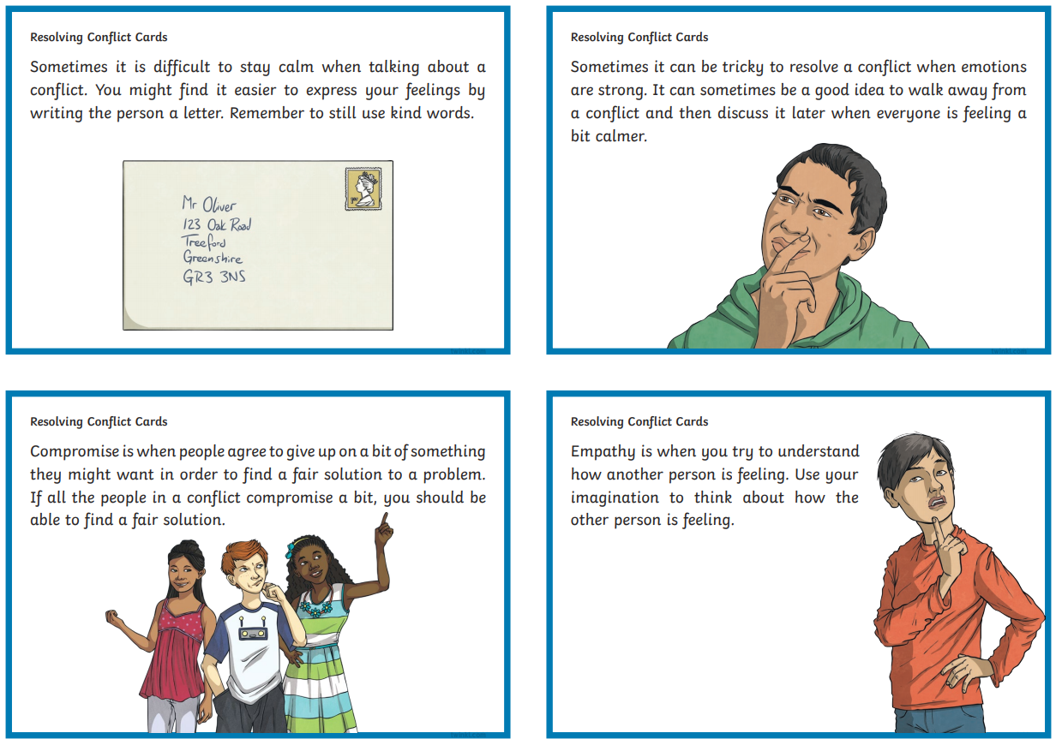
Notes:
Knowing how to manage situations when we do fall out can help maintain our friendships.
In your packs there are some hints and tips for how to do this. Think back to what happens when you hit a hurdle. Can you fix the problem together or do you need to move on separately? Read through the Resolving Conflict Cards at a later time.

Slide 18
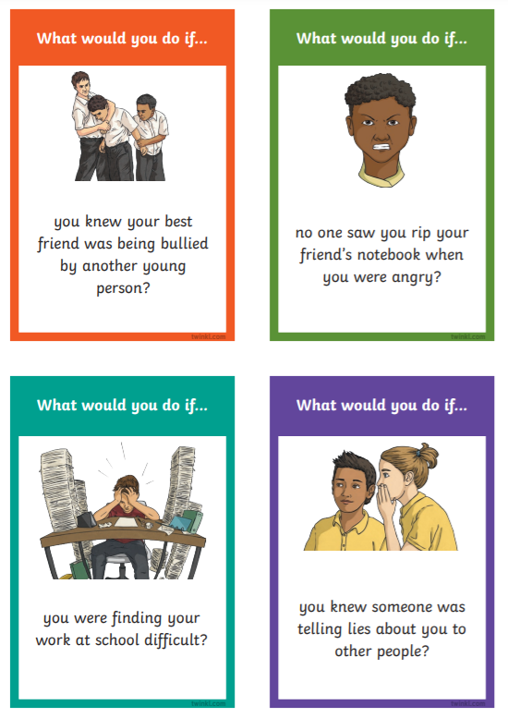
Notes:
Let’s think about some common scenarios that you may find yourselves in… What would you do if you knew your friend was being talked about behind her back? How could you help your friend? How could you be assertive about the situation? What would you do? There are more scenarios in your pack for you to look at in your own time.

Slide 19
Summary
To understand how friendships benefit our emotional wellbeing
To explore how Covid-19 and lockdown has impacted friendships
To develop our skills in forming and maintaining friendships.
Notes:
That’s the end of our session. Let’s refer back to the start of the session and our aims. Now we should have a better understanding of how friendships benefit our emotional health. We now know the impact Covid-19 and the lockdowns has had on friendships and we developed our skills in forming and maintaining friendships. These are all skills you can carry forward, share with others and make use of in the future.

Slide 20
Session Evaluation Friendship through Covid – 19
School: ________________________________________________________________
Please circle your answer
How much did you know about looking after and the importance of friendships before this session? ( 0 none – 10 a great deal)
How much did you know about looking after and the importance of friendships after this session? ( 0 none – 10 a great deal)
What was good about the session?
____________________________________________________________________________________________________________________
Is there anything you would want to change about the session?
____________________________________________________________________________________________________________________
How was the session overall? (0 poor – 10 brilliant)
0 | 1 | 2 | 3 | 4 | 5 | 6 | 7 | 8 | 9 | 10
0 | 1 | 2 | 3 | 4 | 5 | 6 | 7 | 8 | 9 | 10
0 | 1 | 2 | 3 | 4 | 5 | 6 | 7 | 8 | 9 | 10
Notes:
Just to finish, we have a short evaluation for you to fill out. It is in your packs.
We would like to thank you all for taking past in the workshop. Does anyone have any questions?

