Slide 2
Lines of Latitude and Longitude Page 84 - 87
By the end of this lesson, we will be able to:

Slide 3
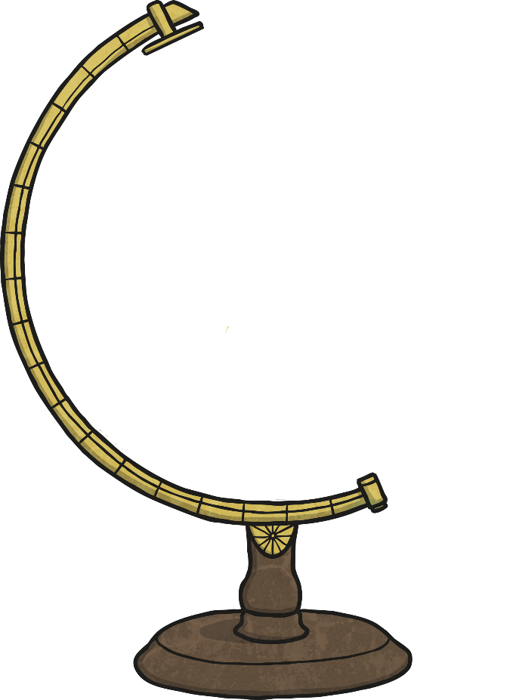
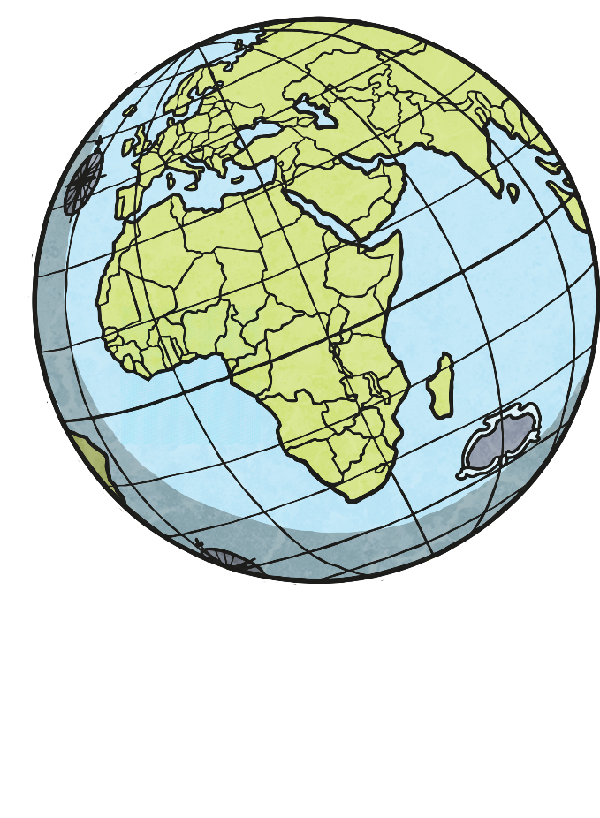
Lines of Latitude and Longitude Page 84 - 87
The globe is the model of Planet Earth.
It is the shape of a sphere or a ball.

Slide 4
Lines of Latitude and Longitude Page 84 - 87
What do we usually use the globe for?
We usually use the globe to find places on Earth.

Slide 5
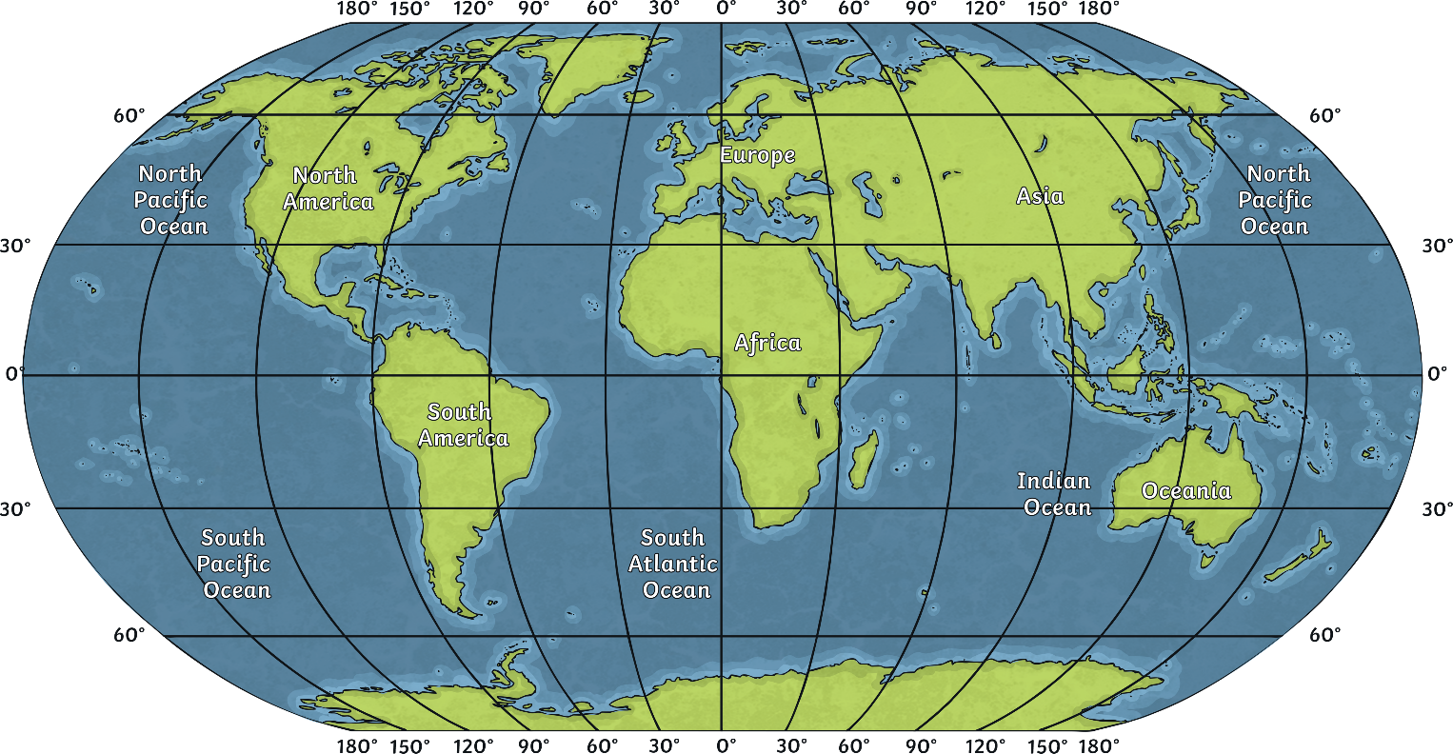
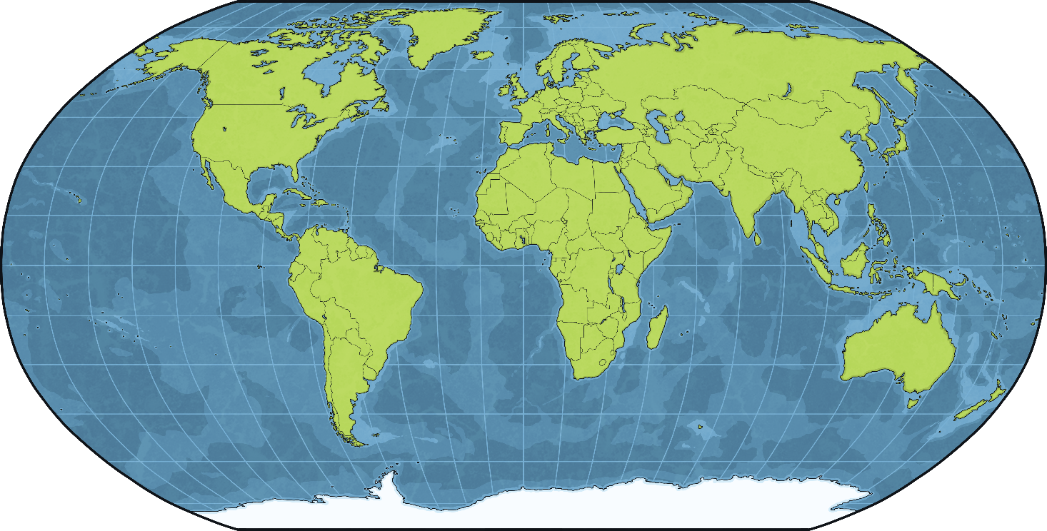
Lines of Latitude and Longitude Page 84 - 87
It is difficult to find a place on the globe. Therefore, scientists created imaginary lines to make it easier.

Slide 6
Lines of Latitude and Longitude Page 84 - 87
These imaginary lines are called lines of latitude and longitude.
These lines help us to
Locate places
Find out about climate regions
Measure distances

Slide 7
The Equator
The equator is the line that cuts the Earth into two equal parts called hemispheres.

Slide 8
The Equator
The part which is to the north of the equator is called the Northern Hemisphere.

Slide 9
The Equator
The part which is to the south of the equator is called the Southern Hemisphere.

Slide 10
Lines of Latitude
Lines of latitude are parallel to the equator. They never meet together.

Slide 11
Lines of Latitude
They run East to West. They get smaller as they get closer to the North and South Poles.

Slide 12
Lines of Latitude
They are used to locate places on the globe and determine all climate regions around the world.

Slide 13
Lines of Latitude
They are measured by degrees (°). The equator is 0° latitude.

Slide 14
Lines of Latitude
There are 90 lines of latitude to the North of the equator and 90 lines to its South.

Slide 15
Lines of Latitude
Arctic Circle
Tropic of Cancer
The Equator
Tropic of Capricorn
Antarctic Circle
Each 1 degree of latitude is almost equal to 112 kilometers
The most important 5 lines of latitude

Slide 16
Lines of Longitude
The lines of longitude are perpendicular to the lines of latitude. All lines of longitude run through both the North and South Poles.

Slide 17
Lines of Longitude
The lines of longitude are also called Meridians. They all have the same length.

Slide 18
The Prime Meridian
It is the line of longitude which passes through Greenwich, England, is internationally agreed to be the line 0° line of longitude.

Slide 19
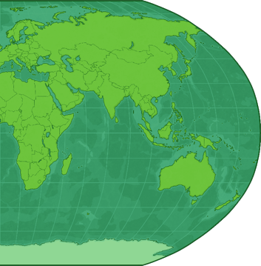
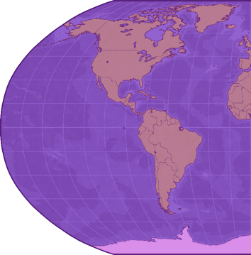
The Prime Meridian
The part to the East is called the Eastern Hemisphere.
The part to the West is called the Western Hemisphere.
It cuts Earth into two equal halves

Slide 20
Lines of Longitude
There are 180 degrees of longitude to the East of the Prime Meridian and 180 degrees of longitude to its West.

Slide 21
Lines of Latitude and Longitude Page 84 - 87
Lines of Latitude
Determine physical characteristics of geographic locations
Lines of Longitude
Locate a place on Earth and determine time between different places

Slide 22
Lines of Latitude and Longitude Page 84 - 87
Northern Hemisphere
Western Hemisphere
Eastern Hemisphere
Southern Hemisphere

Slide 23
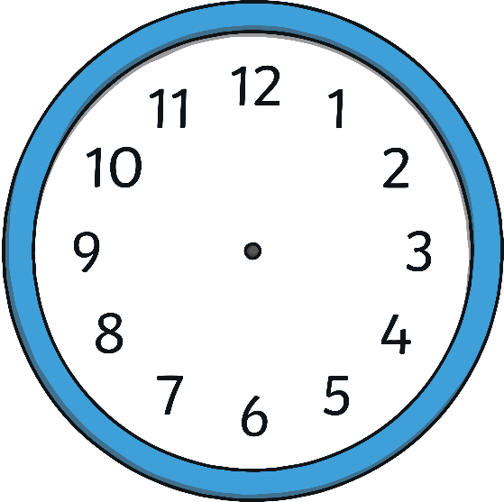
Lines of Latitude and Longitude Page 84 - 87
New York
London
Tokyo
Since the lines of longitude determine time in each place on the globe, this means that each place has a different timing at the same time.

Slide 24
Lines of Latitude and Longitude Page 84 - 87
New York
London
Tokyo
All timings are usually referred to and calculated according to the one internationally fixed timing of London, UK, since it is found on the Prime Meridian which is at 0° longitude.

Slide 25
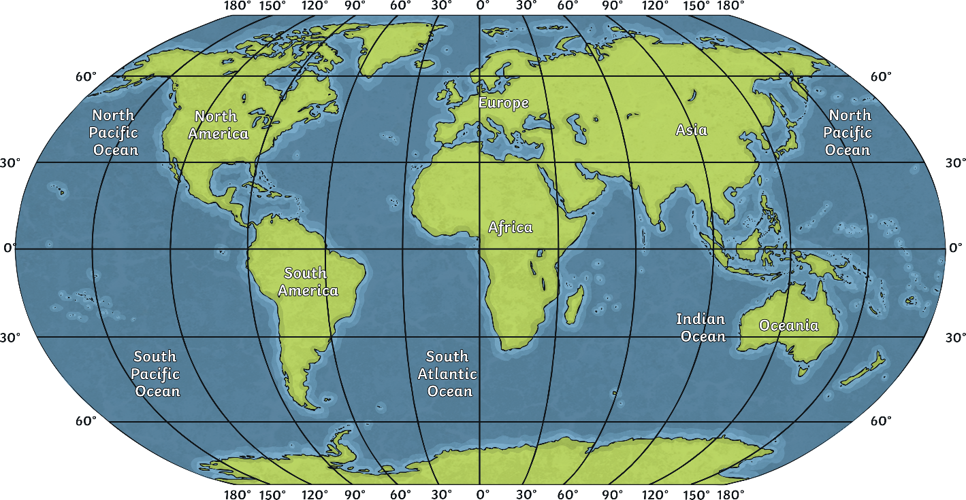
Lines of Latitude and Longitude Page 84 - 87
London
This line passes exactly through Greenwich. This town is the source for the name of the international timing GMT (Greenwich Mean Time).

Slide 26
Lines of Latitude and Longitude Page 84 - 87
Using this line, the world was divided into 24 geographic areas called time zones. A time zone is made up of a group of countries following the same timing according to the prime meridian or GMT line.

Slide 27
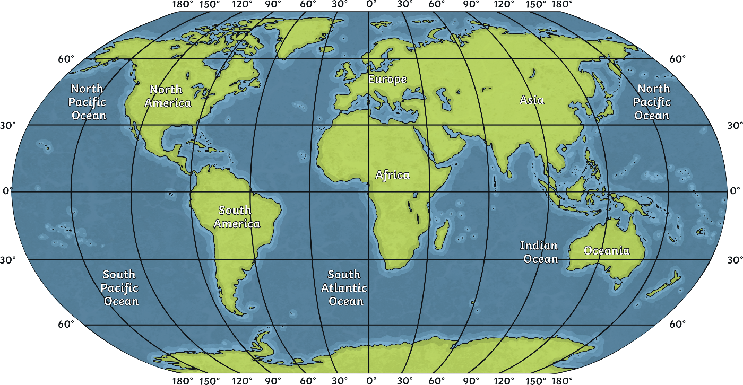
Lines of Latitude and Longitude Page 84 - 87
There are 12 zones East of GMT and 12 zones to the West of it. The zones that are East of GMT increase by one hour.

Slide 28
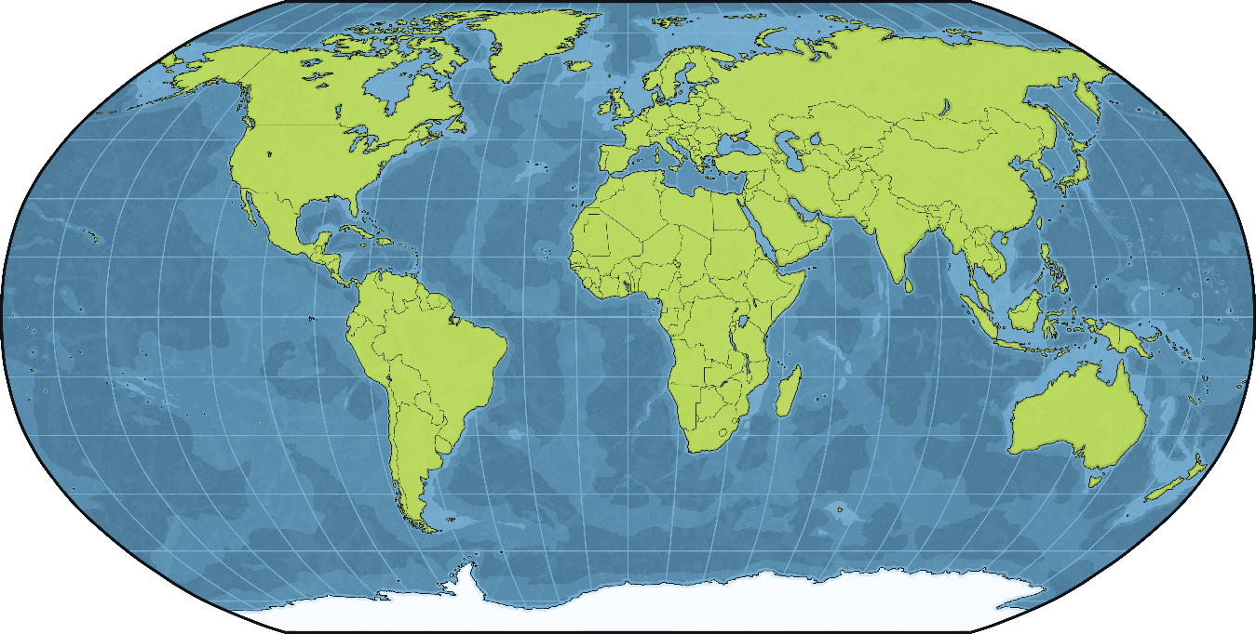
Lines of Latitude and Longitude Page 84 - 87
The first zone increases by one hour, the second zone increases by two hours, and so on.

Slide 29
Lines of Latitude and Longitude Page 84 - 87
Countries to the West of GMT decrease their time by one hour. For example, if it were 12:00 P.M GMT, then it would be 11:00 A.M in the countries of the first zone, 10:00 A.M in the second zone, and so on.

Slide 30
The International Date Line
It is the line on the other side of Earth opposite to the prime meridian.
It also passes through both the North and South Poles.

