Slide 1
Dyslexia
andrew@peoplefirsteducation.com
Instagram @andrewwsen
Twitter @andrewwsen
FB: Andrew Whitehouse at People First Education
LinkedIn: Andrew Whitehouse

Slide 2
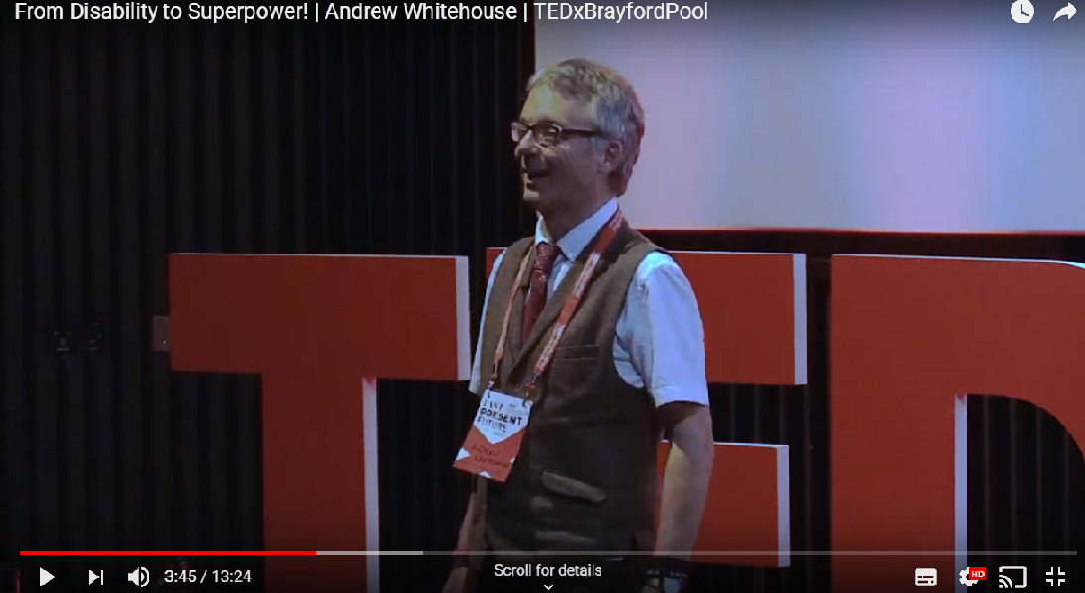
TEDx Speaker
Bamford Lecturer
Hearing Ambassador
Forensic SEN Consultant
SEN Short Course Provider @ Bishop Grosseteste University, University of Lincoln

Slide 3
A quote:
It has been so fantastic to find Andrew who fully understands how my son will learn letters words and numbers. As a parent, when Andrew discussed the various learning strategies, I found them to be very simple and straightforward. When my six year old son started using these methods, his life changed instantly.

Slide 4
It was as if an orchestra was playing the most fantastic music and it was the first time he had ever heard a sound. My son's eyes, his facial expression, he was amazed at what the written word could do. Not just a lot of jumbled up letters in no particular order, but words in rows in straight lines.
It's amazing! My son is able to read books!
Joanne, NHS Professional

Slide 7
What is Dyslexia?

Slide 8
Dyslexia is
BIG

Slide 9
Who are we talking about?
Range of ability levels
Some very able
Many extremely creative
Difficulty expressing themselves
Particularly written
Often verbally
Probably extremely frustrated
Emotionally damaged

Slide 10
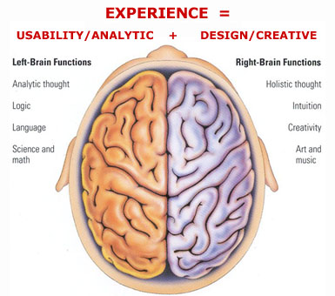
Who are we talking about?
People who favour the right side of the brain

Slide 11
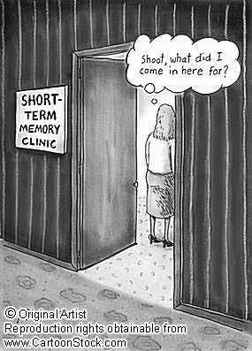
What is Dyslexia?
Dyslexia means ‘Difficulty with words’
It affects the ability to read, spell and write.
It can also affect the processing of information,
motor skills,
sequencing,
short term memory,

Slide 12
Visual issues
Useful visualisation strategies:
Ask learner to look at word,
Close eyes,
Visualise
(tap forehead)
See the word in colour
Any colour you like

Slide 13
Have fun
v
i
s
u
a
l
i
s
e
Visualise
v
i
s
u
al
i
s
e
visualise
Visualise
visualise
visualise

Slide 14
Somewhere familiar
visualise

Slide 15
Visual issues
Now write it down!

Slide 16
Visual issues
Look
Cover
Manipulate
Write
Check

Slide 18
What is Dyslexia?
left/right orientation,
awareness of time.

Slide 19
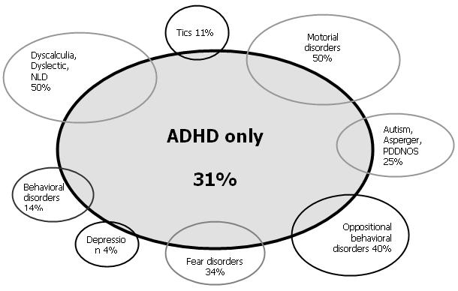
Comorbidity

Slide 20
Effects on the learner
Auditory assimilation: difficulties in auditory short-term memory, remembering series (eg telephone numbers), polysyllabic words and remembering mathematical formulae

Slide 21
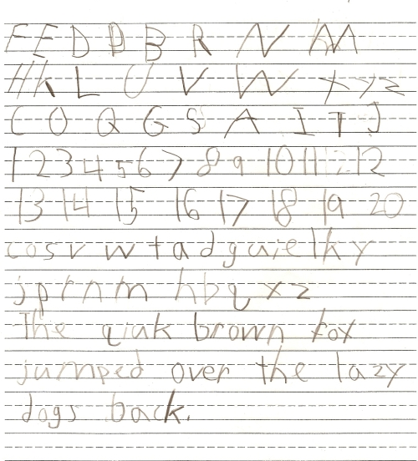
Effects on the learner
Handwriting: letters may not be joined, printing may be found to be of help

Slide 22
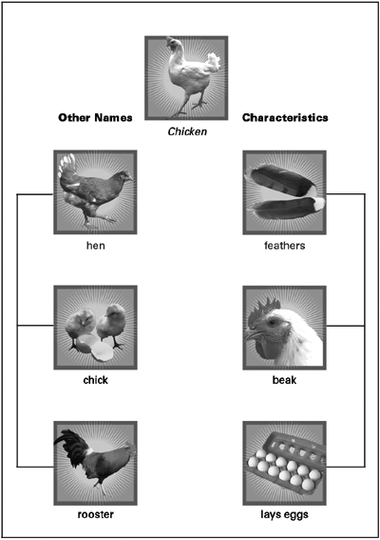
Effects on the learner
Vocabulary: language acquisition will take longer as more examples of a new word or sentence structure are required before they are learned

Slide 23
5 times presentation of a word before being able to use it accurately/consistently
What are they?

Slide 24
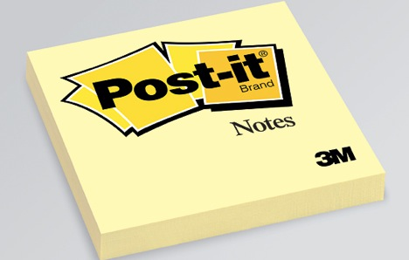
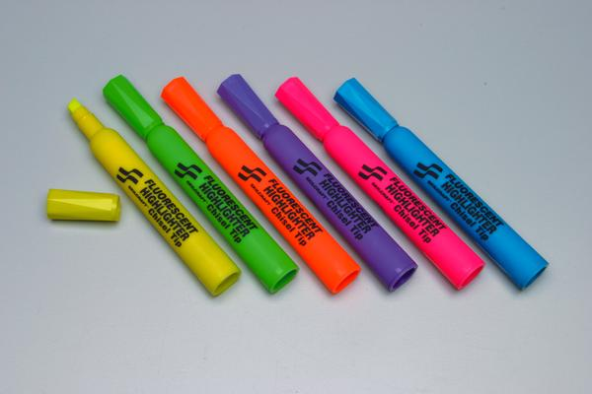
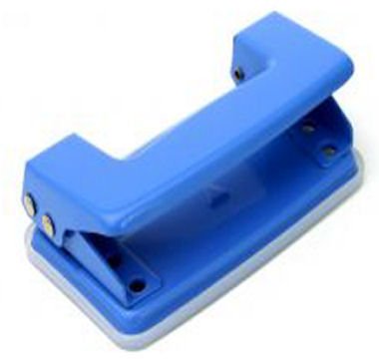
Implications for teaching
Equipment
Highlighter
Post it notes to mark pages
Hole punch for handouts.
Date everything for easier retrieval.

Slide 25
Some questions: group
What do you do to spell words you aren’t sure of?
How do you try to remember…
stuff?

Slide 26
Yale
It may not be enough to change what we do to include these learners
We need to work on empowering the learner with dyslexia
Strategies and interventions need to be intensive and adhered to by the learner and the educator
What we are born with isn’t what we end up with
Yale: re-educating the brain

Slide 27
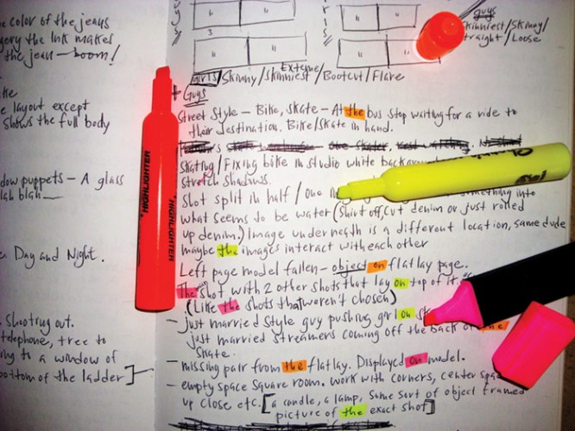
Visual issues
Text moving around
Encourage learner to circle each letter/word in turn from left to right
This encourages eye tracking movement

Slide 28
Essential tools
Highlighters
Post its
Prompt/memory cards
Multi coloured pens
A squidgy something
Word bank

Slide 29
Using colours
Dyslexic learners often employ a strong visual approach to learning.
Using colours adds another visual element.

Slide 30
The perfect world
Peace and quiet – for concentration
Low sensory
Freedom to experiment without being over pressured
Respond quickly to my questions (allowing confidence)
Pictures with text
Word banks (alphabetical)

Slide 31
Using colours
Highlighters:
Highlight difficult parts of a word –
Two elements – shape and colour
Highlight important facts – visual memory
Different coloured bullet points – differentiating lines

Slide 33
Using colours
Black on white causes visual distortion
Coloured paper
Overlays
IWB – change background colour
Experiment with colours
Worksheets?

Slide 34
Auditory/aural
Small chunks of verbal
Time to review
Can physical movement go with the sound?
(especially initial letter sounds)
Encourage chanting,
repeating (good assessment/monitoring)

Slide 35
Kinaesthetic
Drawing in the air
Writing on hands with fingers
Writing on a friend with fingers
Writing with squeezy bottles
Tapping out syllables
Trace letters on whiteboard rubbing out letters as they go

Slide 36
Kinaesthetic
Cut out letters
Sandpaper
Brain gym
Wake n shake
Active8
Move to a different spot in the classroom
Any other kinaesthetic ideas?

Slide 37
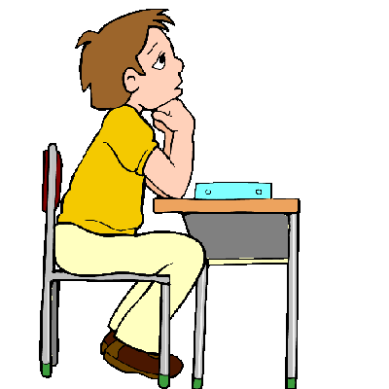
Monitoring comprehension
Teach learners to:
Track their thinking
Notice when they lose focus
Stop and go back
Reread
Identify what is confusing
Select the best strategy

Slide 38
Monitoring comprehension
Describe different reading techniques
Skimming
Scanning
Reading for pleasure
Reading for detail

Slide 39
Monitoring comprehension
Skimming: reading main headings, introduction and conclusion. Use skimming to check whether you want to read more of the text.

Slide 40
Monitoring comprehension
Scanning: looking for a key word or phrase. Before you start scanning, ‘see’ the word in your mind, then look down the page. Focus on the middle of each line as you look down the page

Slide 41
Monitoring comprehension
Reading for pleasure: you may want to take longer, use more visual imagery. Reading for escapism. You should be relaxed.

Slide 42
Monitoring comprehension
Reading for detail: reading every word very carefully and even rereading some words or sentences to ensure accurate comprehension.
Focus: accuracy

Slide 48
Please look at these texts
What makes them appropriate for learners with dyslexia?
What are the benefits?
What are the downfalls?

Slide 49
b/d Confusion

Slide 50
b/d /p/q Confusion
Focus on the correct letter formation with lots of hand writing practice on paper and in the sand/salt tray.
With eyes open
With eyes closed.
Every time the learner writes the letter they have to say the letter name and sound.
The mnemonic we have been using is the word "puppy".
Talk about the shape of the letter resembling the puppy's head
The descender being the floppy ears
The "face" , being ......
the round bit!! ( sorry)

Slide 51
"puppy" always looks towards the next letter because puppies love to meet new friends.
Puppies also like you to "stroke"(write) their ears first ( - they droop below the face/ line) then around their face.

Slide 52
Other activities:
Circle 'p' in words
Circle the letter using the 'p' shape
Adding 'p' to complete words
Listening for 'p' in words
Writing it in the correct box
Colouring a hollow 'p' by writing the shape inside with lots of different colours so it resembles a rainbow - this way they write 'p' loads of times.
Making 'p' out of plasticine - pink or purple if you can get it.

Slide 58
The confusion with bdp nu etc suggests weakness in visual skills –
Discrimination
Memory
Tend not use the computer for letter confusion
Multisensory - "hands on" approach more effective.
Computer programmes are good revision/ reinforcement activities.

Slide 59
Can you design activities for:
b
d
q

Slide 60
"Battleword"

Slide 61
Purpose: to practise spellings that have already been taught.
Aim: to find out where your opponent has hidden their words in the grid.

Slide 62
1) Choose, in advance, the group of spellings to be practised. 4-8 words are best, depending on the age and ability of the learner.

Slide 63
2) Prepare suitably sized grids. If 2 people are playing, each will need a pair of grids. Continue vertical alphabetic co-ordinates down second grid to avoid confusion between grids. Number horizontal co-ordinates. See example:

Slide 64
 | 1 | 2 | 3 | 4 | 5 | 6 | 7 | 8 | 9
H |  |  |  |  |  |  |  | t
I | w |  |  |  |  |  |  | h | d
J |  | a | g | a | i | n |  | o
K |  |  | t |  |  |  | o | u
L |  |  |  | e |  | g |  | g
M |  |  |  |  | r |  |  | h
N |  |  |  |  |  |  |  | t
again
thought
laughed
water
good
things

Slide 65
3) Each player writes the same chosen words on a line in between their two grids. Check for correct spellings at this stage.

Slide 66
4) One player hides the words in his top grid. One word per horizontal line in any order and any position as long as it fits in. Likewise, the other player hides the words in his bottom grid.

Slide 67
5) Players take turns to say one square reference eg B 6. the other player says which of his letters (or nothing) is in that square. The letter- or, for nothing, a blob- is entered in the appropriate grid.

Slide 68
6) Players try to predict where their opponents' letters are and can fill in the rest of the letters of words if they are sure of the positions.

Slide 69
7) The first player to find and mark the positions of all his opponent's words is the winner. These need to be checked for confirmation.

Slide 70
This game can be played by any age of learner. It can also be played with a group where the teacher puts a grid on the board and each learner has one grid plus a list of the words which are to be found.
The learners take turns to identify a square and the teacher (who has prepared the word positions on a separate piece of paper) marks the relevant letter or blob on the board.
The winner is the first learner to find out the correct positions of the teacher's words.

Slide 71
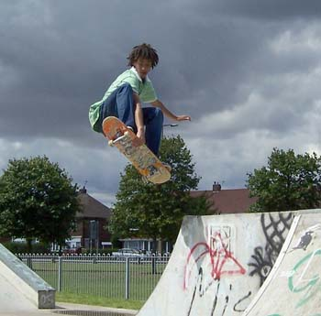
These young people see and experience life in a unique and different way.

Slide 72
Conclusion
The mass media presentation, general perception, and general ignorance of Dyslexia is disturbing in the least.
Correctly nurtured and guided these members of our society can live happy, full, creative, and successful lives.
Andrew Whitehouse 2005

