Slide 1
Disclaimer/s
We hope you find the information on our website and resources useful.
Animations
This resource has been designed with animations to make it as fun and engaging as possible. To view the content in the correct formatting, please view the PowerPoint in ‘slide show mode’. This takes you from desktop to presentation mode. If you view the slides out of ‘slide show mode’, you may find that some of the text and images overlap each other and/or are difficult to read.
To enter slide show mode, go to the slide show menu tab and select either from beginning or from current slide.
You may wish to delete this slide before beginning the presentation.

Slide 3

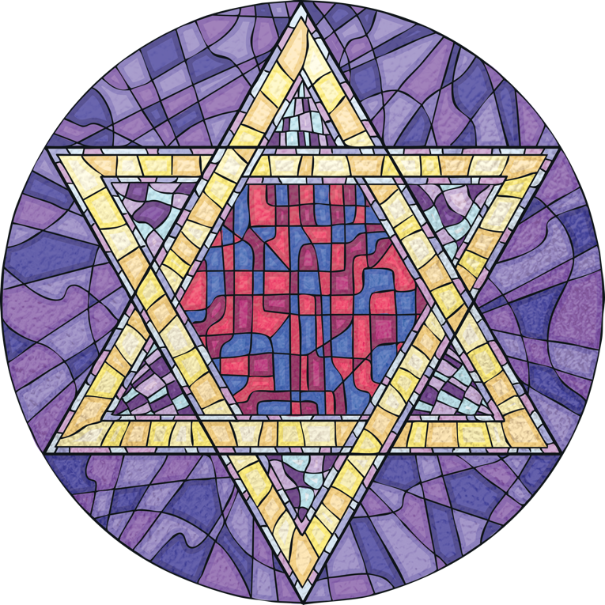
Judaism
Judaism is one of the world’s six major religions. The others are Christianity, Islam, Buddhism, Hinduism and Sikhi.
Jewish people believe in one God, like Christians and Muslims do.
Judaism teaches that all life is special and belongs to God. Jewish people believe that God is the creator of all life.

Slide 4
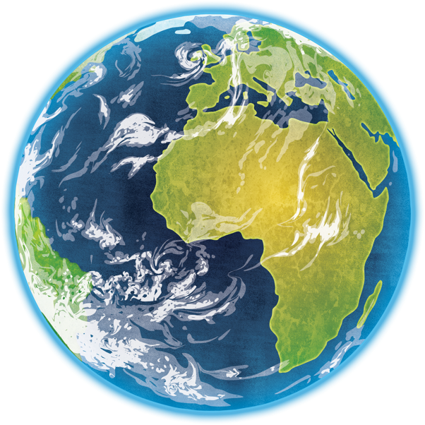
Tikkun Olam
Tikkun Olam is the name of a teaching in Judaism.
Tikkun Olam is a Hebrew word that translates in English as ‘world repair’.
Jewish people believe that God created the world in a perfect and harmonious state but purposefully left room for us to improve and maintain it.
It is used to describe something that anyone does that serves the world and helps to improve it.

Slide 5

Rabbi Isaac Luria
Rabbi Isaac Luria
Luria taught that when God created the world, He sent light to Earth. However, the vessels carrying the light could not contain it so the light was scattered all over the Earth. Luria taught that it is the job of the people to gather the light sparks.
Rabbi Isaac Luria was a Jewish teacher.
He lived between 1534 and 1572.
Some Jewish people believe that his teachings are myths but others believe that he transformed the meaning of tikkun olam.
Luria spoke about how the Torah is a guide and when someone reads it or fulfils a commandment, these actions will release light sparks of God and the Earth will be repaired and restored.

Slide 6
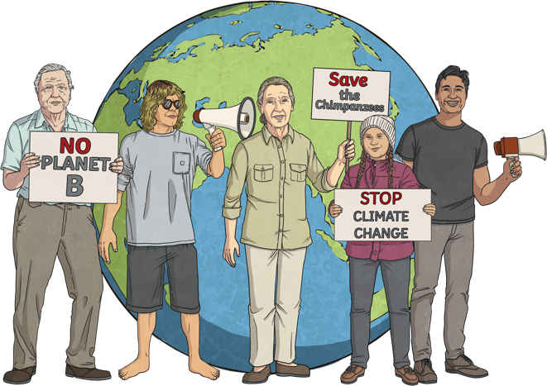
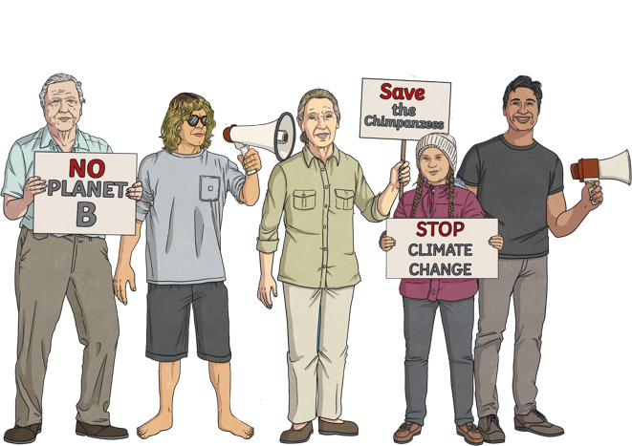
Tikkun Olam
Over time, tikkun olam became associated with social justice and environmental action.
This means that people stand up for those less fortunate and fight for equal opportunities for everyone.
It means changing the things in the world that damage the environment and finding more sustainable ways of living.
By doing this, Jewish people believe that they are helping restore the world to the perfect state it was in before the sins of humans.

Slide 7
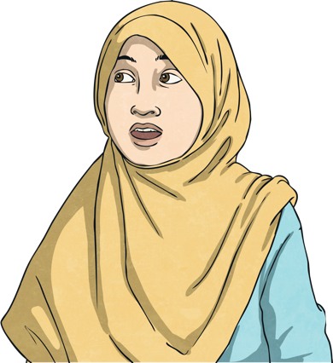
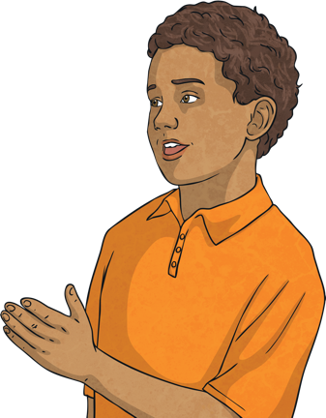
Who Can Perform Tikkun Olam?
Anyone can perform tikkun olam, help to make the world a better place and help reveal God to those who do not know Him.
What are other examples of ways that you have seen other people fixing the world?
What are some ways you’ve helped to repair the world?
Talk About It!

Slide 8
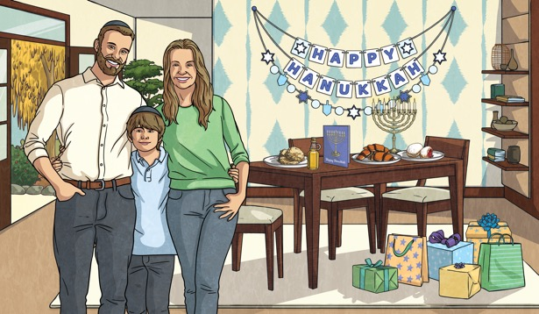
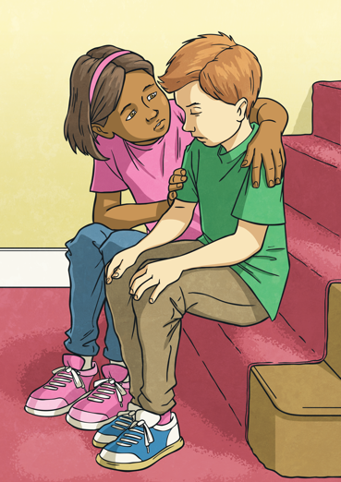

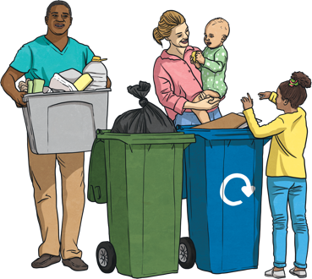
Examples of Tikkun Olam?
Even some of the simplest tasks in life can be examples of tikkun olam.
Treating people with kindness and respect.
Recycling your rubbish.
Giving to charity.
Spending time with family during Shabbat. This is the holy time each week when Jewish people spend time together and read the Torah.

Slide 9
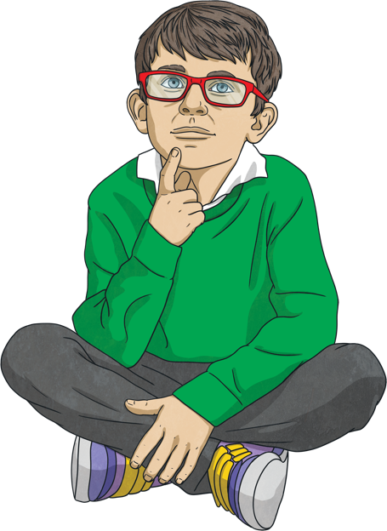
How Can You Perform Tikkun Olam?
Think about some ways that you can make the world a better place.
It could be something small.
What could you do at school?
What could you do at home?
What could you do in the community?
What could you do in the wider world?

