Slide 1
Maths
LO: To times by 5

Slide 2
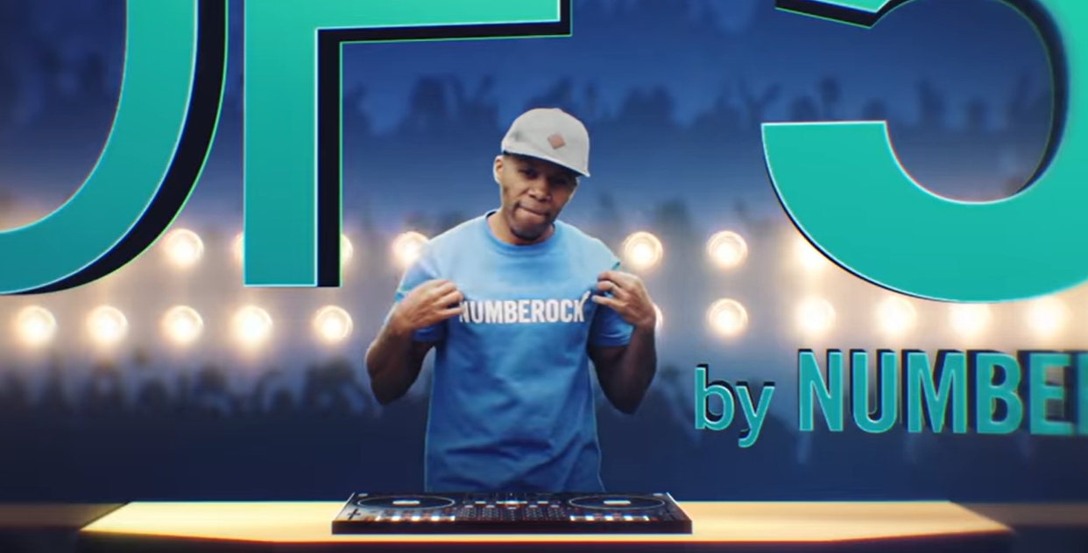
Website: https://youtu.be/LZAqhF_2vvs
Copy and paste this in a browser and watch the 5x table video/song!

Slide 3
3 lots of 5 =
5 lots of 5 =
2 lots of 5 =
7 lots of 5 =
You may want to count up in 5s on your fingers OR draw it on a piece of paper to help you!

Slide 4
8 x 5 =
9 x 5 =
4 x 5 =
6 x 5 =
11 x 5 =
What do you notice about the answers?
Is there a pattern?
Can you create yourself a top tip to help you remember?
You may want to count up in 5s on your fingers OR draw it on a piece of paper to help you!

Slide 5
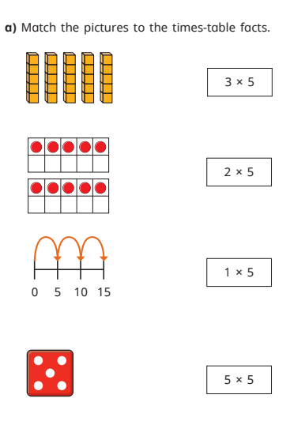
Use the pen on the toolbar to draw the lines to match

