Slide 1
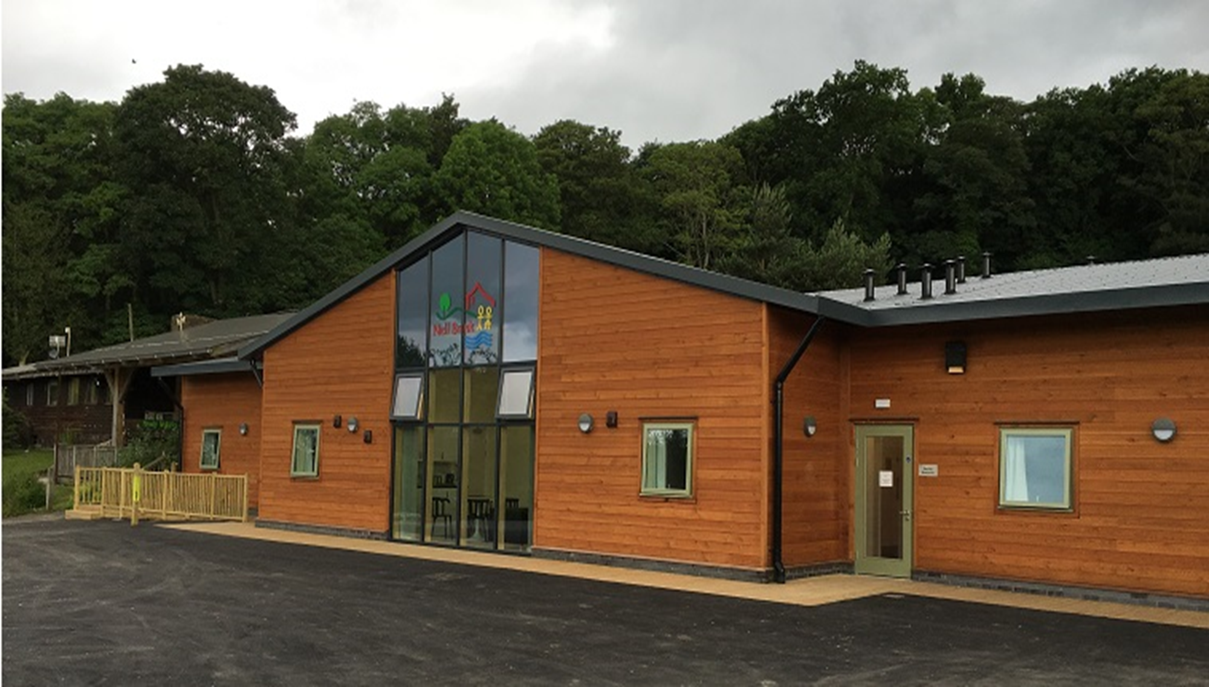
Year 4 Residential to Nell Bank
Monday 21st October to Wednesday 23rd October 2024

Slide 2
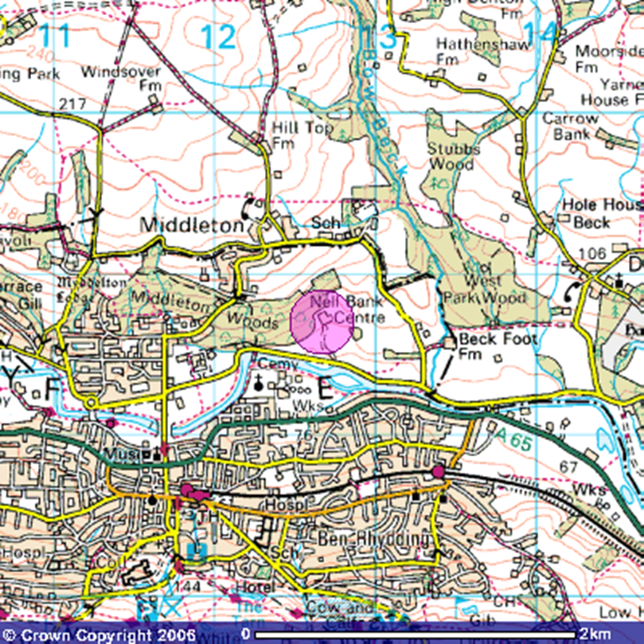
Location
Nell Bank is located on a south facing slope overlooking Ilkley moor.
The centre is sheltered by 100 acres of bluebell woodland.
This is a 50 minute drive away from school. We leave school at around 11am on Monday the 21st and arrive back at school at around 1pm on Wednesday 23rd. Children to be collected from school at 3.15.

Slide 3
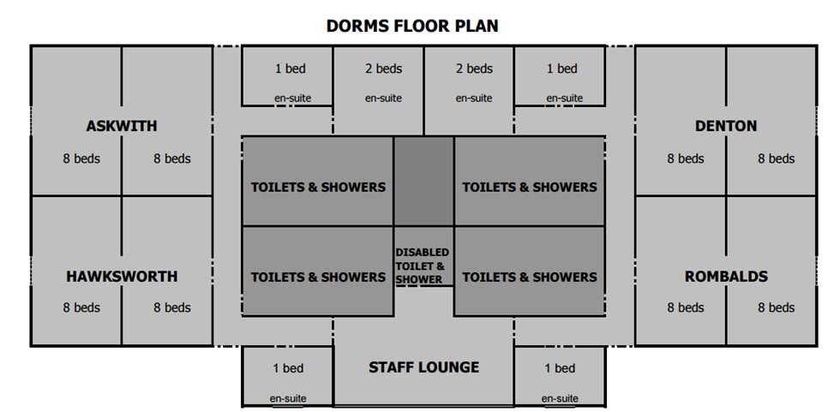
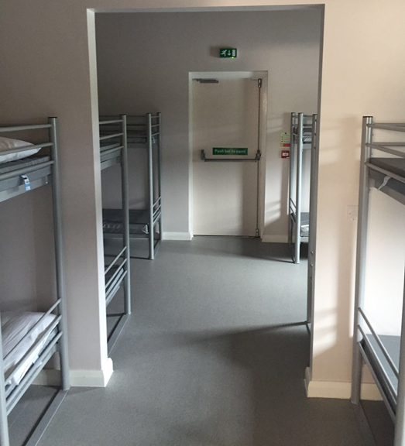
Accommodation
The dorms accommodate 64 children and 8 adults.
Each dorm has 8 bunk beds and sleeps 16 children. There is a partitioned wall between the 4 bunk beds.
Boys and girls are separated and each have their own washing areas which include showers, toilets and a sink area.
The outside doors are fitted with door alarms and the windows have a limit on how wide they open.
Before visiting, children will be able to choose who they want to share a room with and this is taken into account when organising the sleeping arrangements. Children will not find out who they are sharing with until they arrive at Nell Bank.

Slide 4
Food
Day 2
Lunch
Ham, cheese, tuna or egg sandwich
Walkers crisps, drink (water, apple or orange juice)
Homemade biscuit or flapjack
Apple
Evening meal
Butchers Sausages
Or
Vegetarian Sausages
Or
Halal Burger
Served With Gravy, Creamed Potatoes & Peas And Carrots
Homemade Bakewell Slice
Day 3
Packed lunch – This is from the kitchen at school and is included in the price.
Day one
Lunch
Bring your own or order a packed lunch from the kitchen at school.
Evening meal
Pasta Bolognaise Served With Crusty Bread
Or
Halal Chicken Curry Served With Chapatis
Or
Cheese & Tomato Pasta Bake Served With Crusty Bread
Homemade Jam Sponge
&
Custard

Slide 5
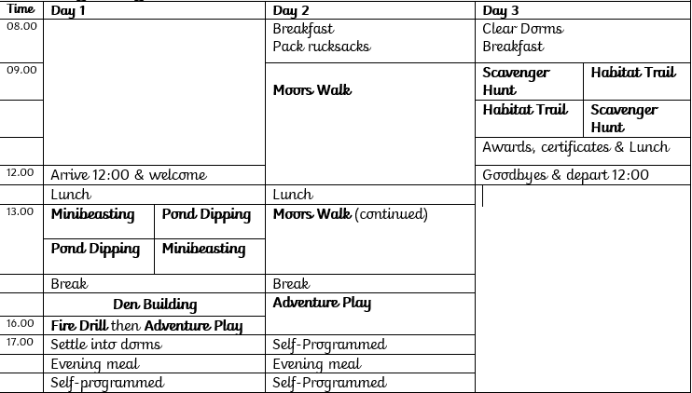
Residential Activities

Slide 6
Mini beast hunt Science
https://www.blakehillprimary.co.uk/website/nell_bank_residential/577505
Orienteering
Geography/PE
All the activities have a link to the objectives taught in year 4.
Pond Dipping Science
Adventure Playground
PE
Rivers and Settlements Geography/History
Den building
Moors Walk
Geography
Team Building

Slide 7
Kit list and cost
The cost of the trip will cost £148.50.
A payment will be set up on Parent Pay
and you will be informed once this goes live.
A non refundable deposit of £30 will need to be paid to secure your child’s place before Thursday 29th February.
Payments can be made in instalments.
The payment will need to be made in full by September.

Slide 8
Questions

