Slide 5
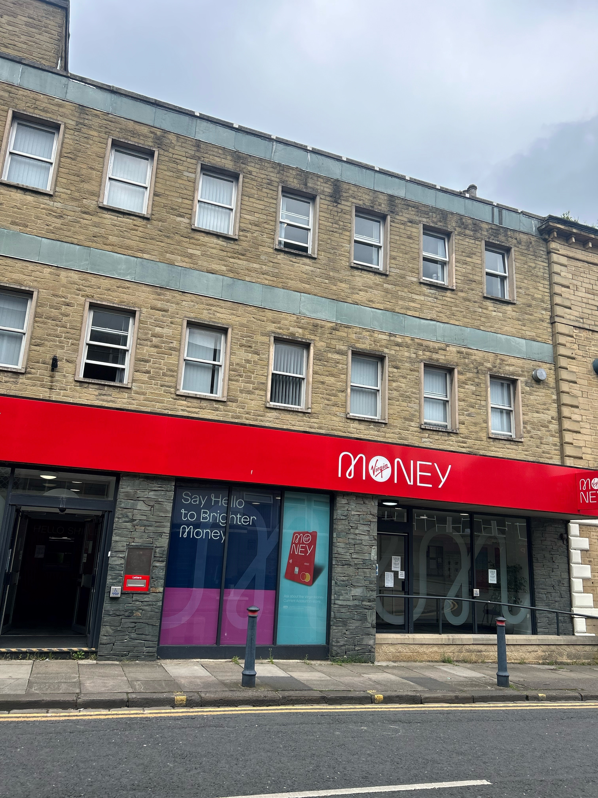
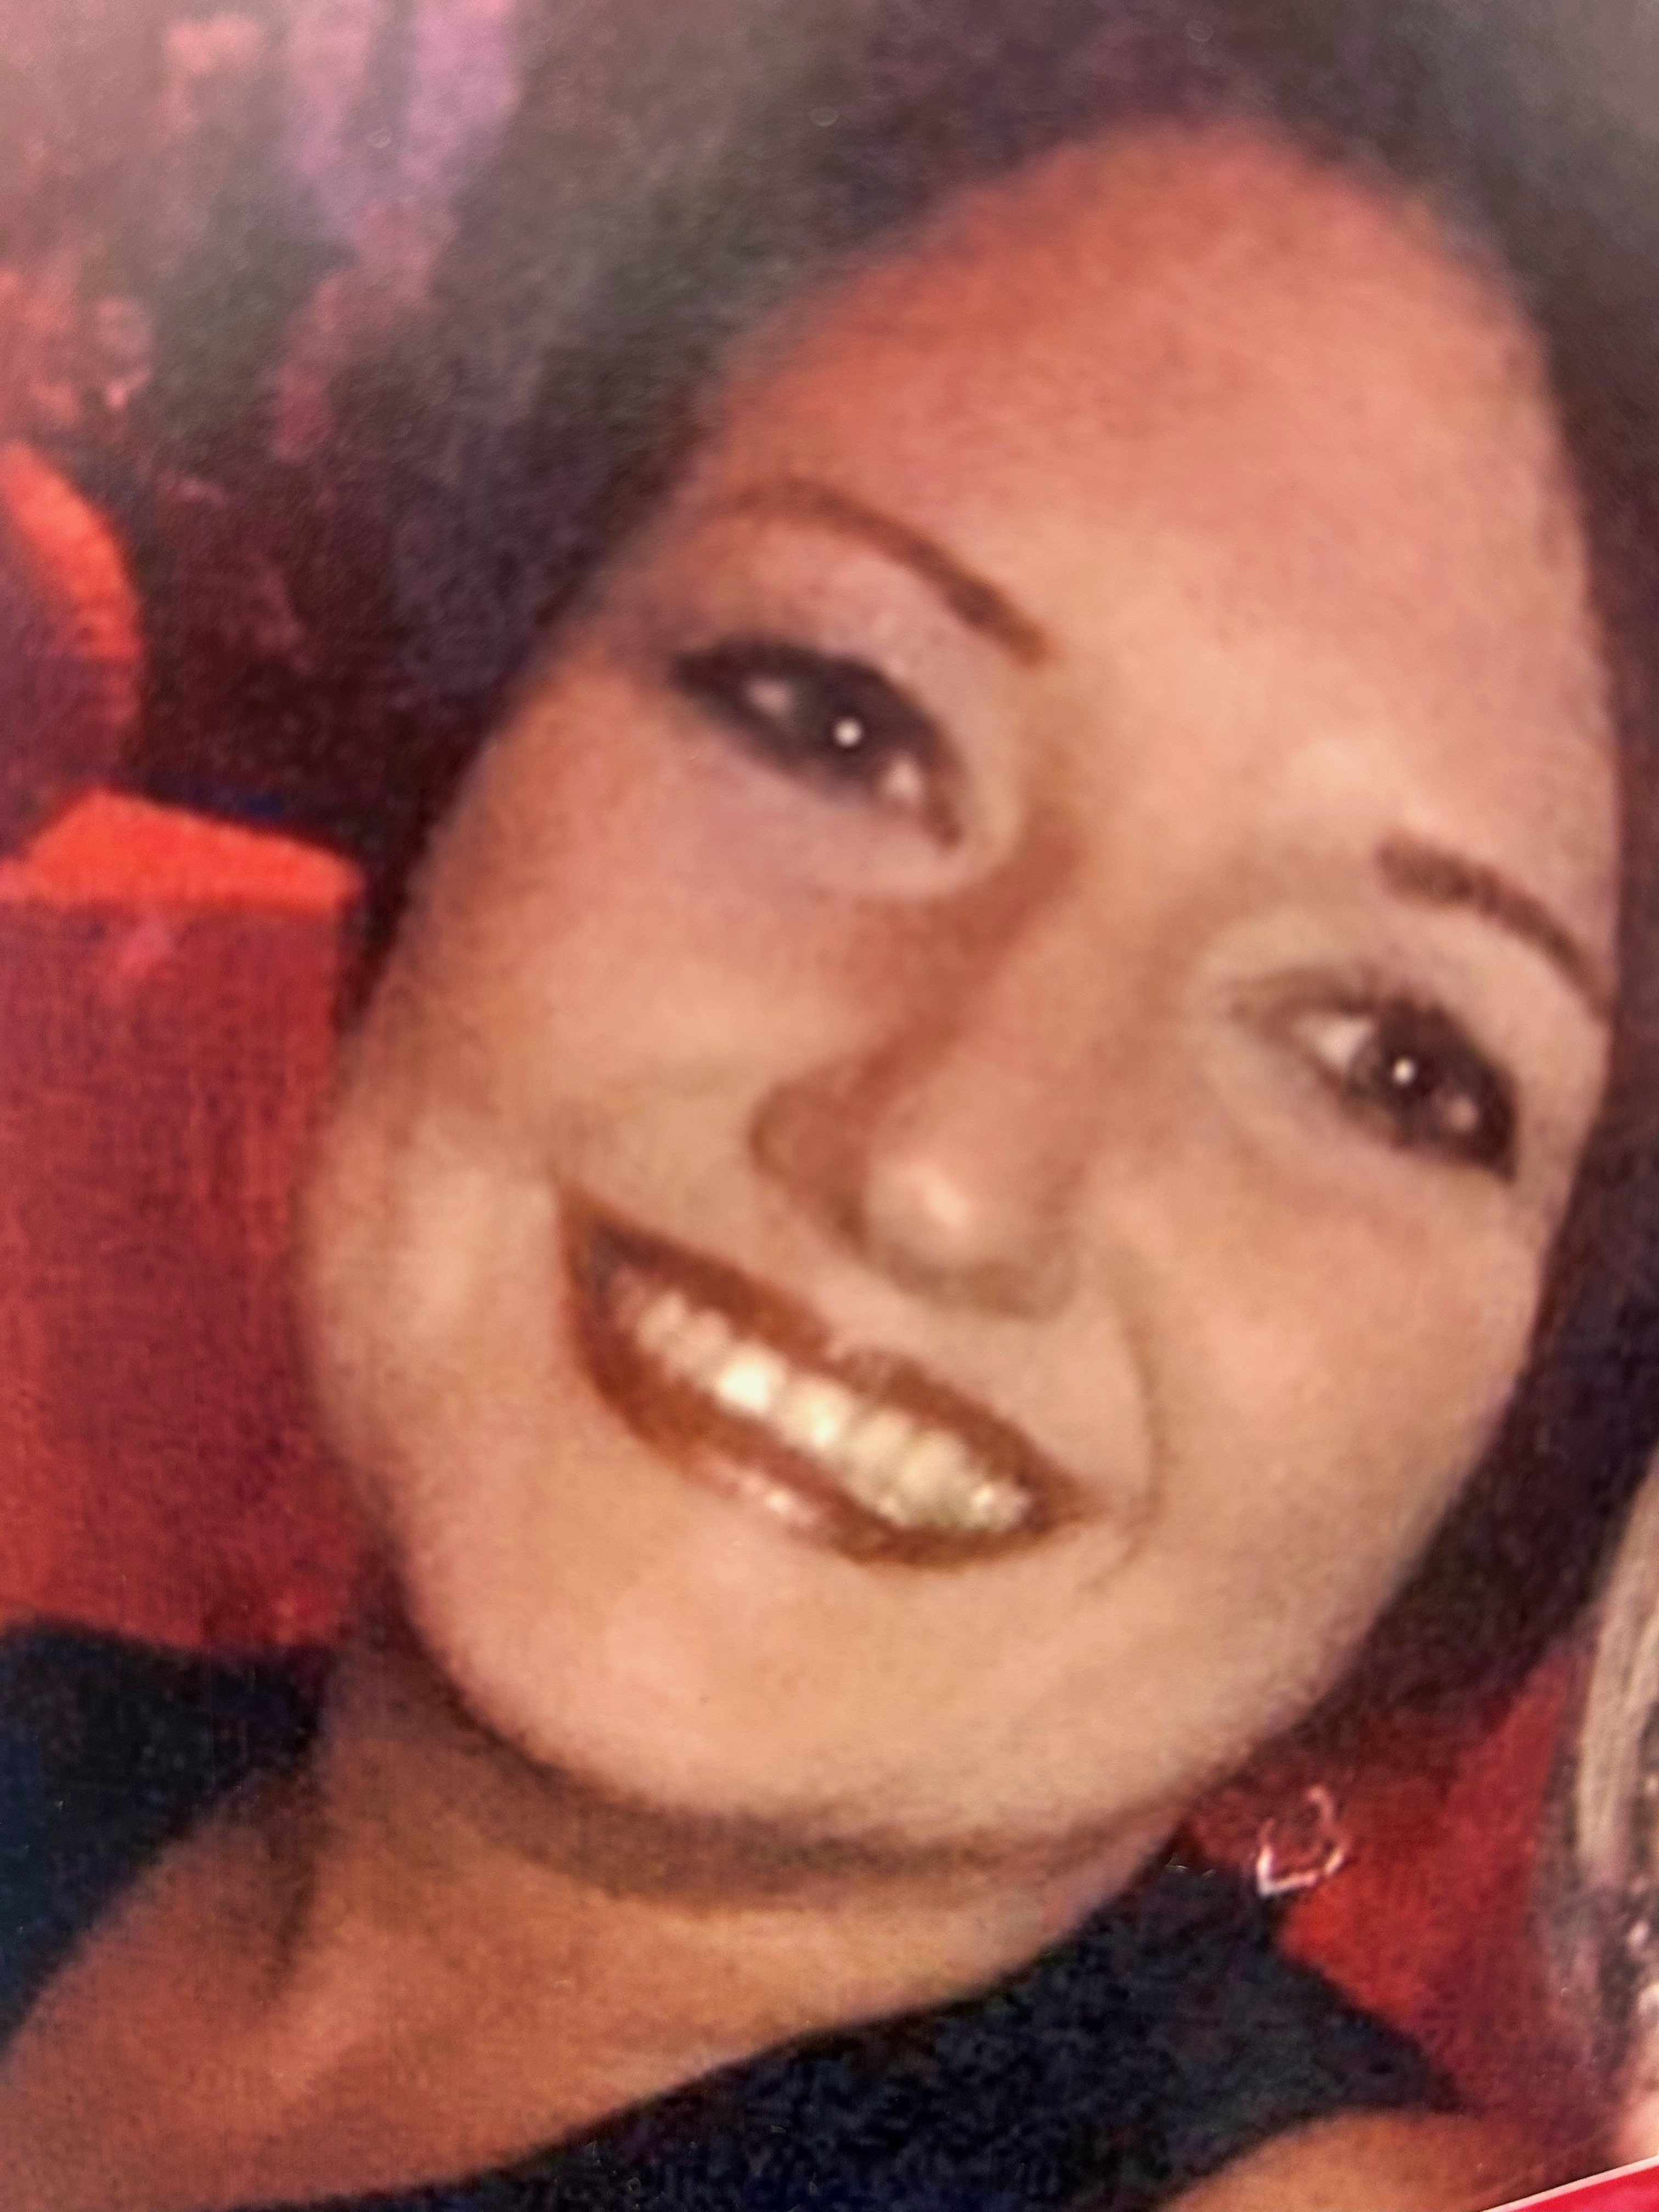
About me…
I live in Leeds with my husband Chris, my daughter & my son.
My daughter Olivia is a PE teacher in this school.
The picture is the store I work in - Shipley
I’ve worked at Virgin Money for 33 years.
My job is customer consultant.

Slide 6
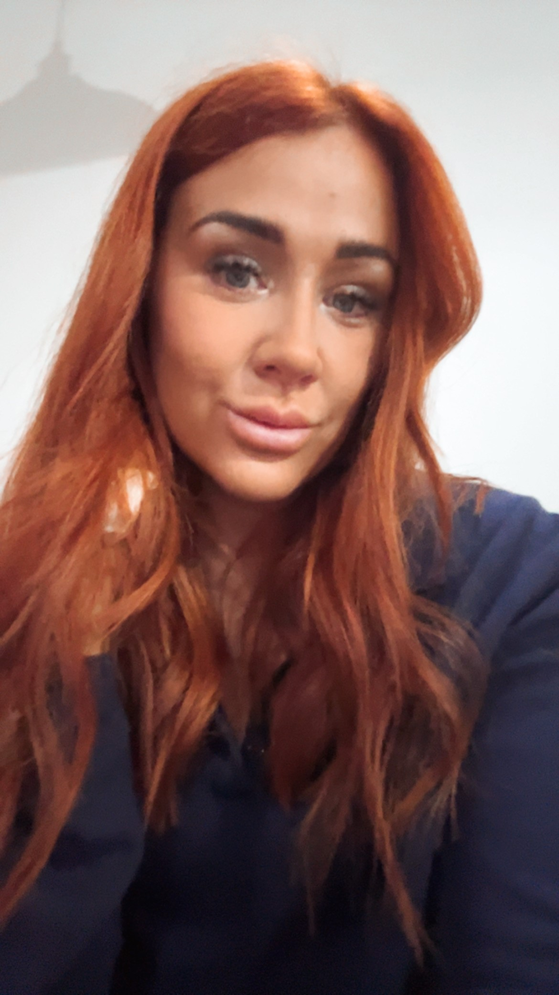
About me…
I live in Bradford with my partner, my daughter & my twin boys.
I work in Shipley Store with Rebecca.
I have worked at Virgin Money for 16 years.
I am the Store Manager in at Virgin Money in Shipley.
My cousin works in your school, Miss Lawrence.

Slide 7
What does a bank do?

Slide 8
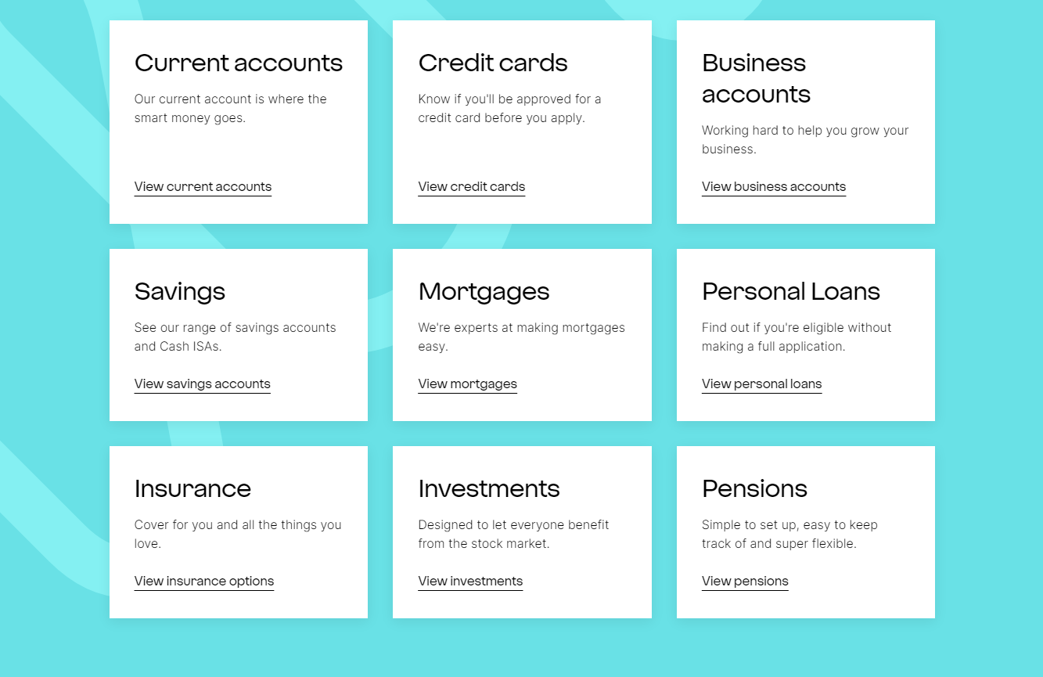
What does a bank do?

Slide 9
What is an entrepreneur?

Slide 10
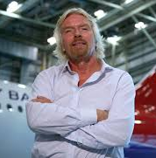
Richard Branson…

Slide 12
Make £5 Grow - YouTube

Slide 13
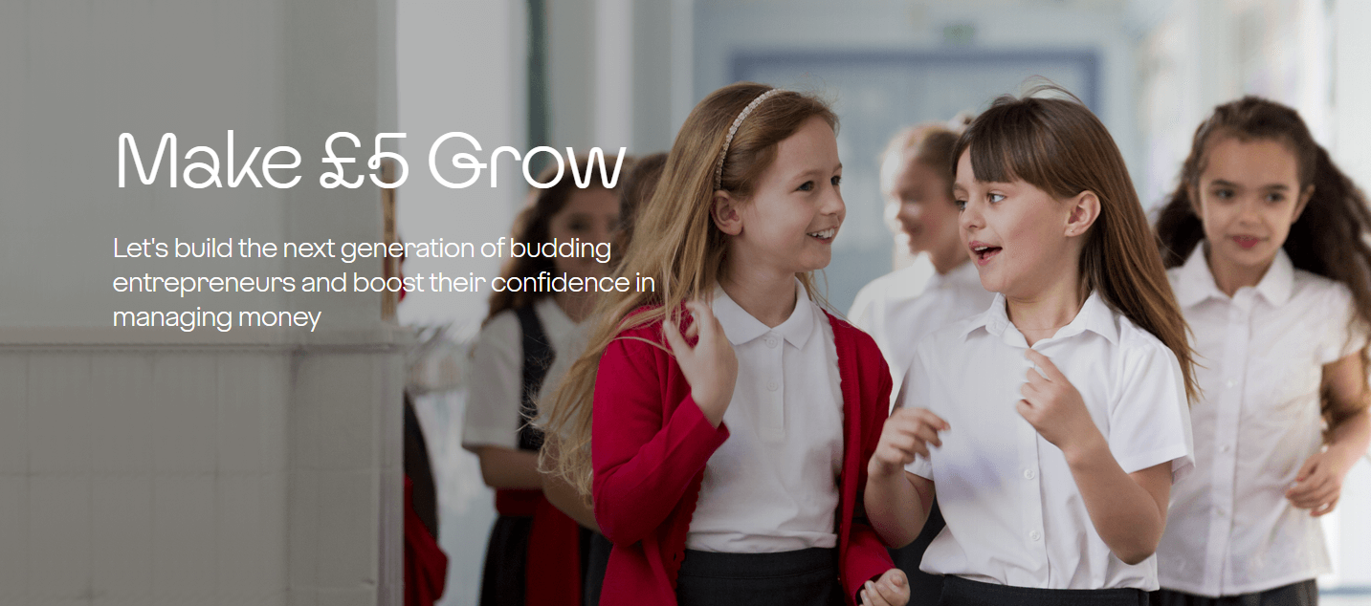

Slide 14
Make £5 Grow – Lets sum it up
Virgin Money loans £5 to each of you.
You will set up a small business with your business idea.
Use the loan to create and promote your product or service.
You return the £5 loan to Virgin Money.
The class keeps the profit and you choose together with your teacher how to spend it.

Slide 15
Inspiration station
Products
Services
Cake, sweets, hot chocolate
Car wash
Bookmarks
Football penalty challenge
Paintings
Tattoo transfers
Festive cards/crafts
Nail painting
Jewellery
Connect 4 challenge
The sky is the limit with your ideas!

Slide 16
Good luck!

