Slide 1

Y1 Parents Meeting October 2023
Mrs Watts & Miss Morley

Slide 2
What we will cover
Learning to read
Phonics and the DfE Phonics Screening Check
Spellings
End Of Year Expectations for Reading/Writing/Maths
  How you can help your child
Key Instant Recall Facts - KIRFs
Behaviour expectations

Slide 3
Let’s start with learning to read
If you think about what is involved in learning to read, you will realise that this is a very complex process.
Learners need to recognise the individual sounds (phonemes) which make up the words we speak. They also need to recognise the different shapes that letters form on the written page (graphemes). Then they have to make a connection between the letters they see and the sounds that the letters represent. This is called grapheme-phoneme correspondence.
But when learning to read English, this is not the entire story because grapheme-phoneme correspondence in English is not always regular and predictable. Learners have to learn that one letter can sometimes represent several sounds, and one sound may be represented by different letters. The letter "c", for example, is sometimes pronounced as "k" and sometimes as "s", while the "k" sound is sometimes written with a "k" and sometimes with a "c".

Slide 4
How do we approach Reading and Phonics at Blakehill?
At Blakehill we teach daily phonics for all children from Reception until Year 2.
We use Bug Club Phonics to help us to plan and provide resources.
A phonics lesson lasts for about 20 mins.
Spellings and High Frequency Words
In addition to a focused phonics lesson daily we also teach phonics through Reading and English lessons.

Slide 5
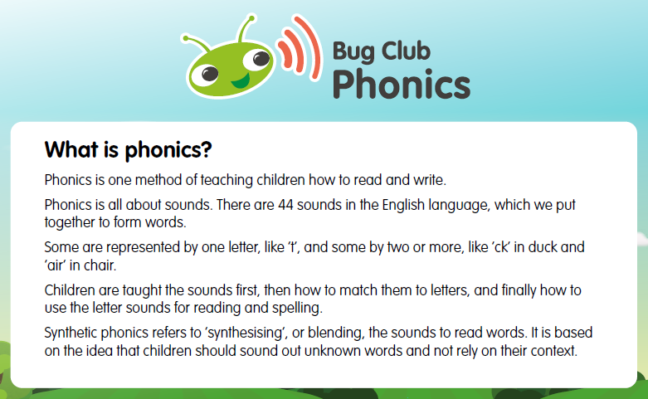

Slide 6

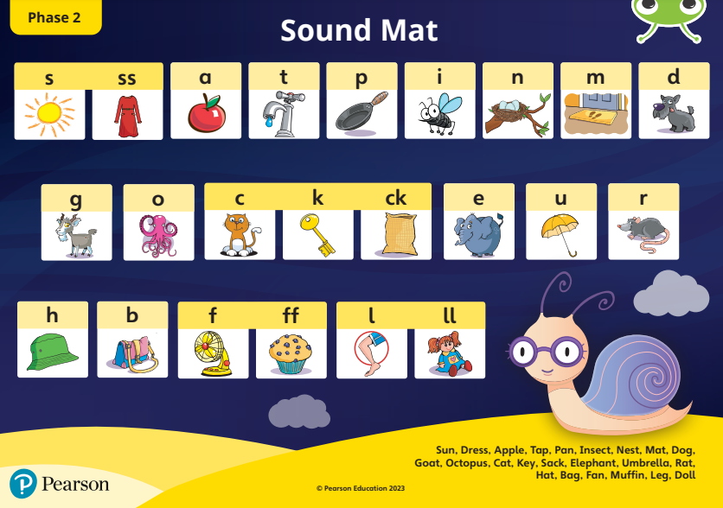
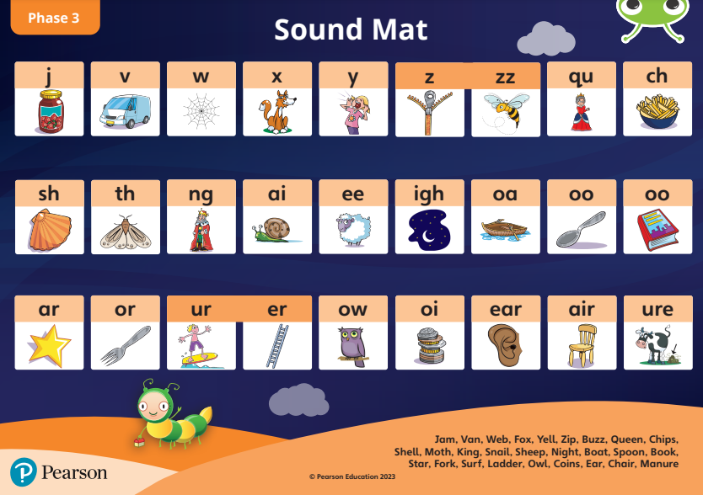
Phase 2 and 3
During Reception the children are exposed to phases 2 and 3. In phases 2 and 3 children will learn individual phonemes and graphemes. They will also learn some digraphs and some trigraphs.
Children don’t learn their phonemes and graphemes alphabetically.
They learn graphemes in lower case form only to begin with, it is confusing when adults use capital letters.
This can be confusing for parents, let's explain what we mean…

Slide 7
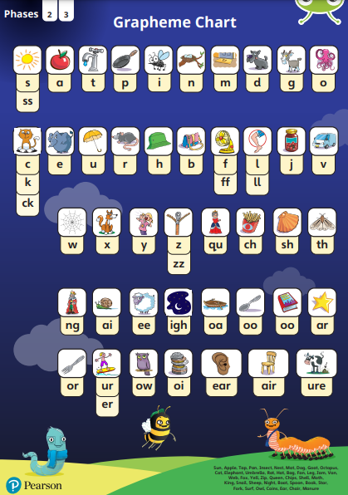
Pronunciation
You are probably thinking I have no idea if I am saying the sounds correctly.
How can I help them to remember the individual phonemes?
Get the pronunciation correct. A QR code will link you directly to a sound board with clear pronunciation
Along with the pronunciation children also are shown a picture and a corresponding actions

Slide 8

Phase 4
Phase 4 is a time at the end of reception and the start of Year one where we recap and practise blending and segmenting.
These words will have more
sounds in them and be harder to
blend.

Slide 9
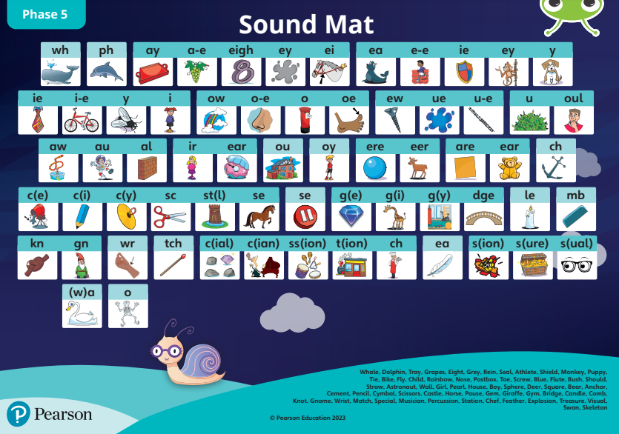
Phase 5
Is what we will be teaching in Year One.
It looks at alternative ways to spell sounds. For example-
ai as in tail
ay as in play
a-e as in make

Slide 10
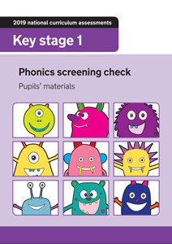
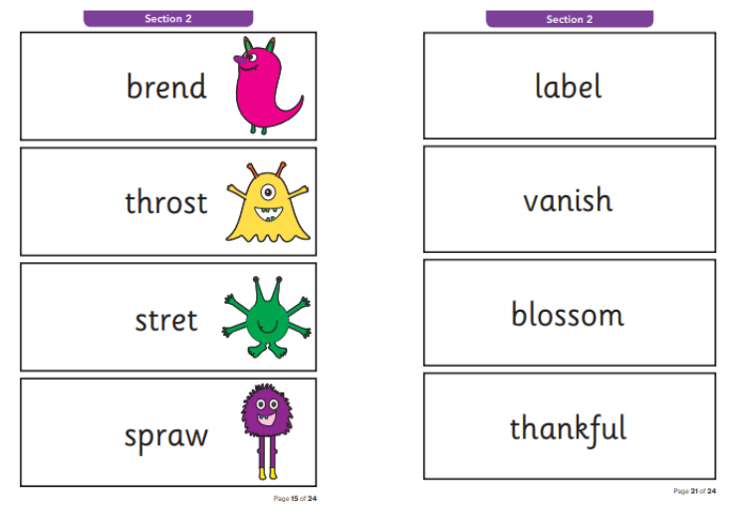
Phonics Screening Check
It is a statutory test that will take place in June.
They will read 40 words out loud
20 words will be real and 20 will be Pseudo words (or nonsense words).
They get progressively harder as the test moves on.
Notes:
All children will take the test in a quiet space with a familiar adult, date will be released by Dfe
These are a collection of letters that will follow phonics rules your child has been taught, but don’t mean anything – your child will need to read these with the correct sounds to show that they understand the phonics rules behind them

Slide 11
Phonics Screening Check
Children can sound a word out but adults can’t give any help or support.
They can only have one attempt at the test. If they don’t pass they can retake it in Year Two.
The pass mark last year was 32 out of 40
Can you have a go?
  Single sounds are represented with a dot, digraphs (2 letter) or trigraphs (3 letter) sounds are represented with a line
Notes:
There are some examples on your tables.
We would like you to put the appropriate sound buttons on the words and then read the word.

Slide 12
Spellings
Spellings are taught weekly in Year 1 during phonics lessons.
These words vary between sight words which do not follow a spelling rule or words with a phonetic spelling pattern
The children are given different spellings set each week. Before the test on Friday we encourage practice at home as we do at school.
Games are a great way to help children practice their spellings.
Spelling games are available on our class pages.

Slide 13
Spellings - connect 3
Choose a colour or a counter each.
Choose a word and cover it up.
Write the word, if spelt correctly you can colour it in.
First to get 3 in a row wins.
rain | afraid | wait
train | paid | rain
wait | train | afraid
Notes:
Next week spellings

Slide 14
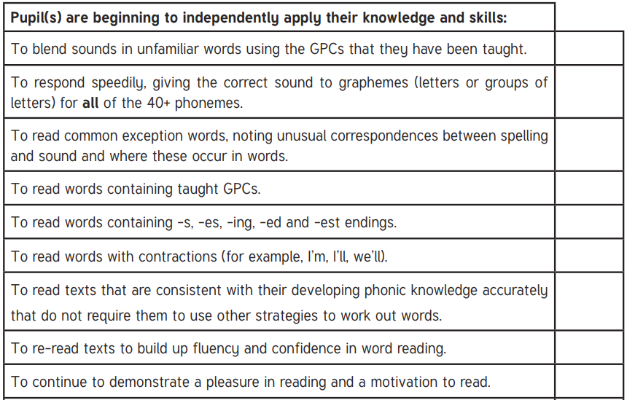

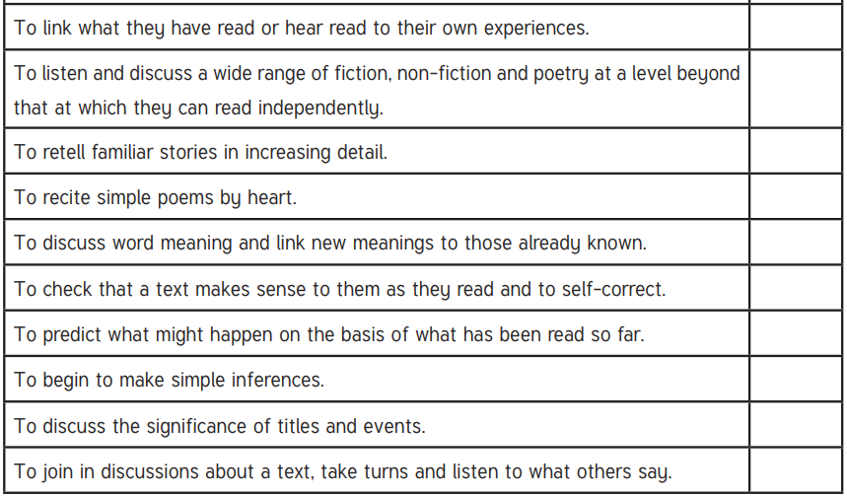
End of Year expectations - Reading

Slide 15
How can you help your child with reading?
Practice High Frequency words which helps fluency.
Model- share stories together, ask and answer questions
Spellings
Bug Club Phonics reading for comprehension
Flashcards, sounds and words we may send home
Online Games- Phonics play website
Reading & Phonics morning- Thursday’s after half term
Daily home reading 3x a week at least. Each day focussing on a different skill this linked to how reading is taught in school…

Slide 16
Read 1 - Use of Phonics & decode
Focus on the key sounds of that specific book. This will be on the inside cover and usually has some words the children will come across in the book and may find tricky.
Can they decode them by using their phonics knowledge, if they need help you can point to each sound or ask them to point to the sounds as they read e.g. b-l-a-ck.
Can they read the word back after segmenting?

Slide 17
Read 2 - Fluency and Expression
Ask the children to look out for key punctuation. Full stop, Question/Exclamation marks, speech marks, commas.
Discuss what this is used for and model it. E.g. A full stop indicated a pause is needed. An exclamation mark indicates the use of expression, model this to them… “That castle is huge!” said mum. And ask them to copy you.
Can they give the characters different voices?
Re read the sentences or book with a quicker pace.
By the end of the week the children should be able to read more confidently or even more fluently.

Slide 18
Read 3 - Comprehension
Library book
Discuss the events in the story.
Talk about the how the characters were feeling and why
Can they retell the story in the correct order?
Can they predict what will happen next?
Are they able to answer questions about the text?
  Use the question guide in your pack
Share the book together
Is it similar to any other stories?
Predict what may happen by looking at the front cover together.
Discuss the title, spine, covers, blurb etv
What was their favourite part?

Slide 19
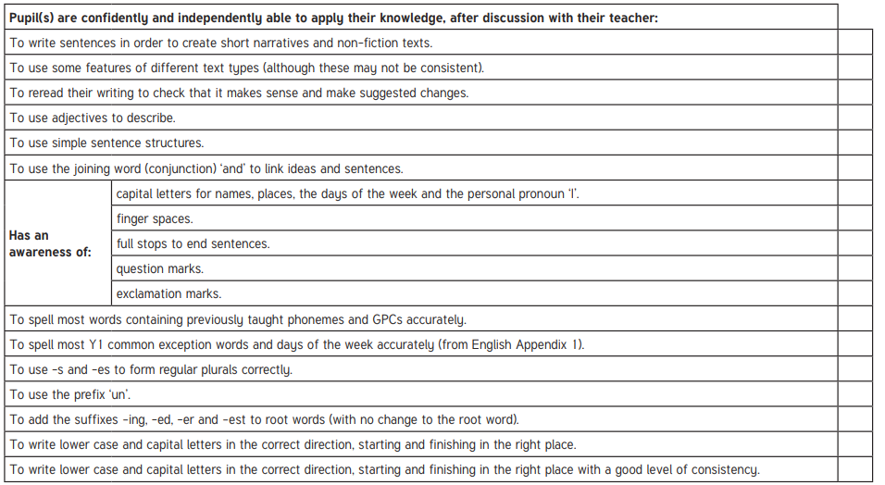

End of Year expectations - Writing

Slide 20
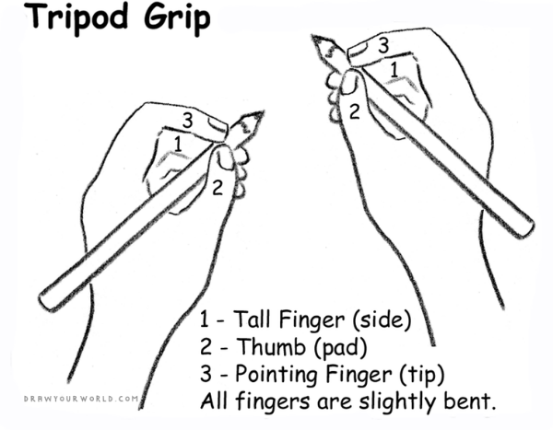
How can you help your child with writing?
Ensure they are holding their pencil correctly.
Spellings
Write in lowercase letters to model to your child.
Check they are following the correct formation and direction of letters. See handwriting guide in the pack.
Children can trace over your letters to help with any letter formation they are still working on.
Get them writing outside…chalk or an old paintbrush with water.
Drawing pictures and writing whenever possible, in cards, labels for their pictures, letters and stories.

Slide 21
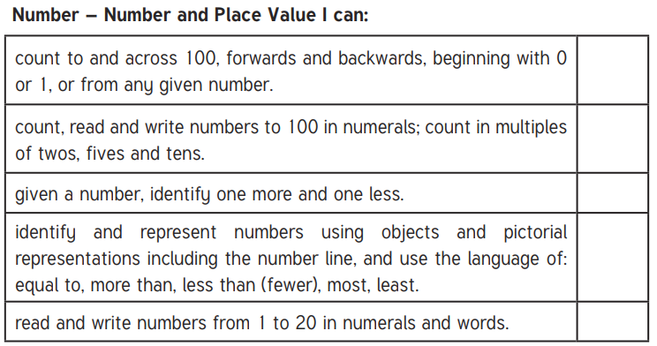
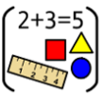
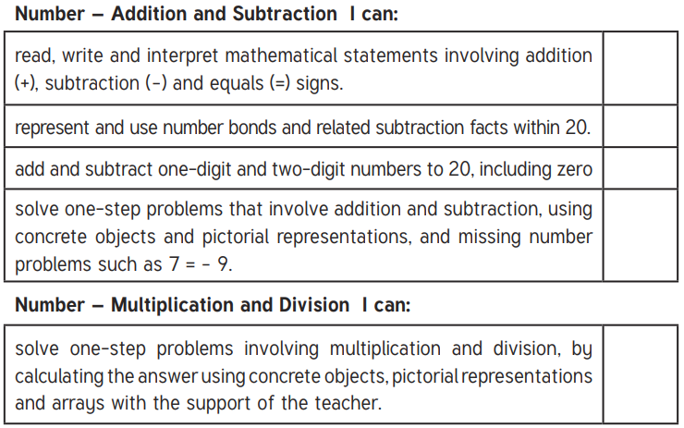
End of Year expectations - Maths

Slide 22
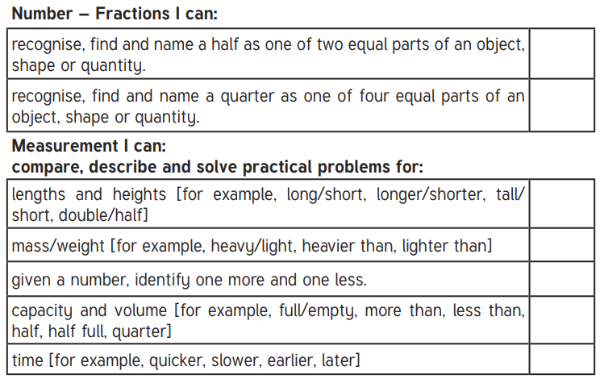
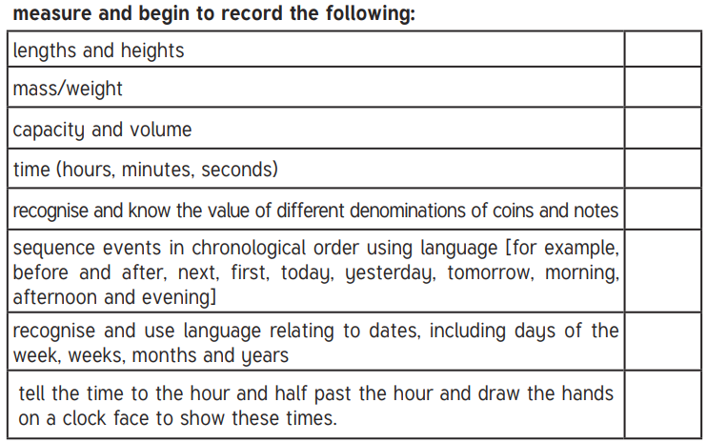
End of Year expectations - Maths

Slide 23
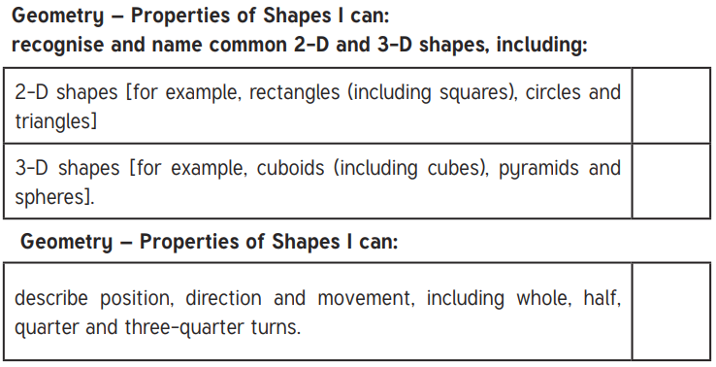
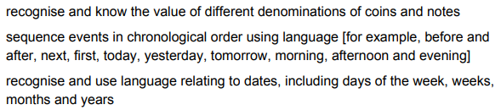
End of Year expectations - Maths

Slide 24
How can you help your child with maths?
Count count count! In 1’s/2’s/5’s/10’s, forwards and backwards to 100.
Think about two numbers which make another number, e.g. 8 = 2+6
Point out and discuss the time on a clock on the hour and the half hour
Discuss the shape of objects, talk about the sides, corners and faces.
Bake/Cook together and weigh ingredients.
Talk about things being full, empty, half full, more/less than half full/empty.
Compare lengths and height of things.
Money - look together at coins and notes, add them together, talk about the value, give them cash to buy small amounts in shops to understand change.

Slide 25
KIRFs - Key Install Recall Facts
KIRFs are practiced in our Maths lessons and each half term children will be given a specific KIRF to focus on.
At the end of the half term we will check each child to assess their understanding and confidence.
These can always be found on our class pages on the school website
Autumn 1 KIRFs
To recite the number names in order to 50 and beyond.
To know all number bonds to 5.

Slide 26
KIRFs - Key Install Recall Facts
Autumn 2
To recite the number names in order to 50 and beyond.
To know all number bonds to 5.
Spring 1
To know number bonds to 10.
Summer 1
To count in 2s to 20…in 5s to 50..in 10s to 100
Autumn 2
To know one more and one less with numbers up to 20
Spring 2
To know number bonds to 20.
To know odd and even numbers to 20.
Summer 2
Add 10 to any number.
Know all the doubles and halves of even numbers to 10

Slide 27
Blakehill behaviour expectations
“Together We Can”
Be Ready
Be Safe
Be Respectful

Slide 28

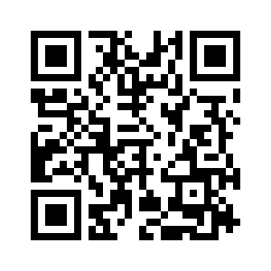
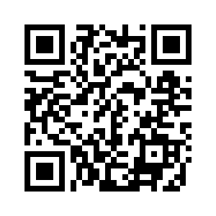
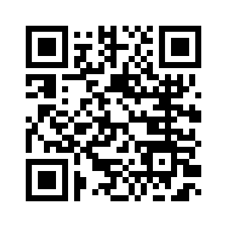
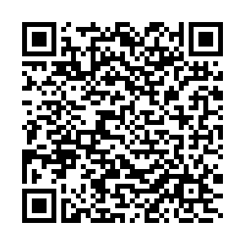
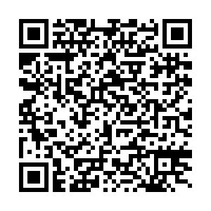
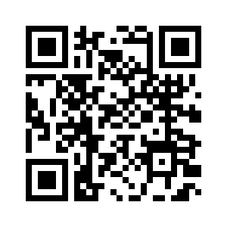
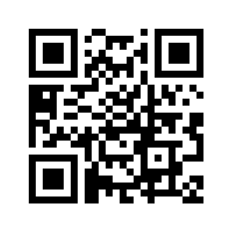
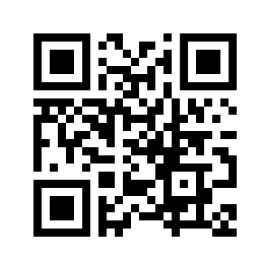
Useful Phonics resources
Phase 2 Pronunciation + Action
Phase 3 Pronunciation + Action
Phonics Screening Check materials
DfE
Pronunciation
Presentation
On class Pages
Sound mats/Grapheme charts
Any additional resources we send home, words, flash cards, phonics materials.
Free Phonics games

Slide 29
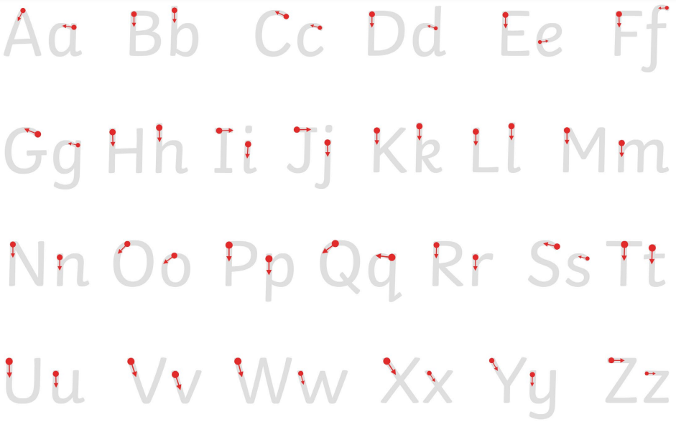

Slide 30
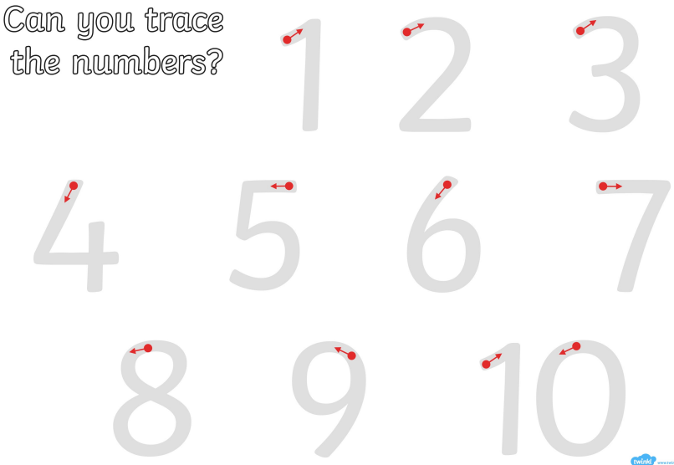

Slide 31
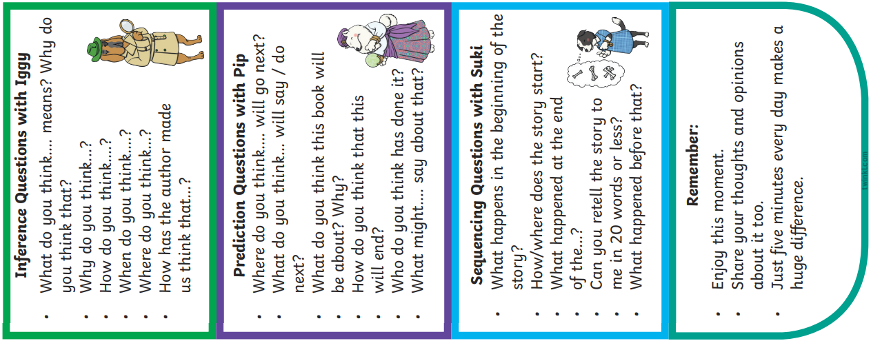
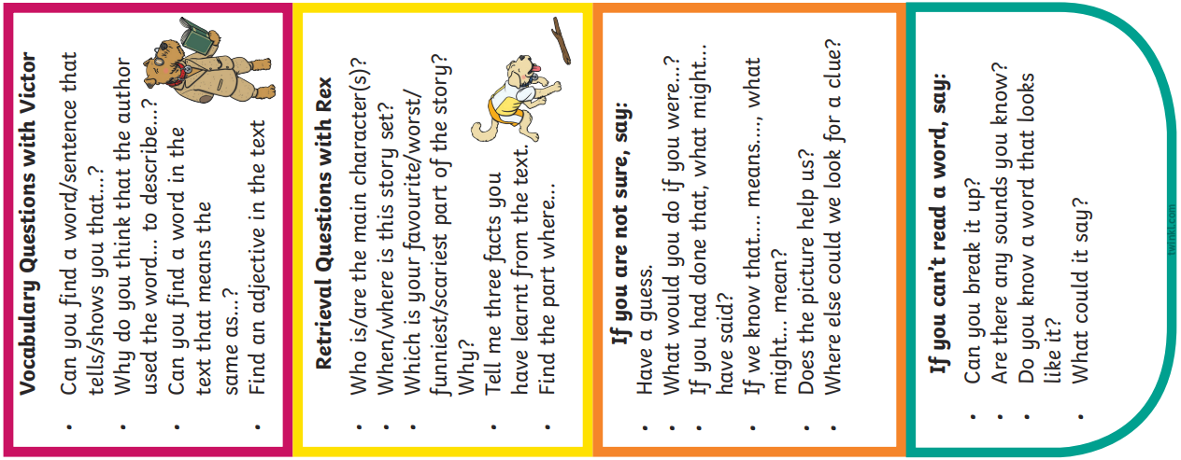

Slide 32
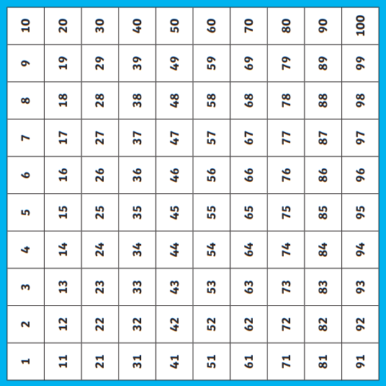
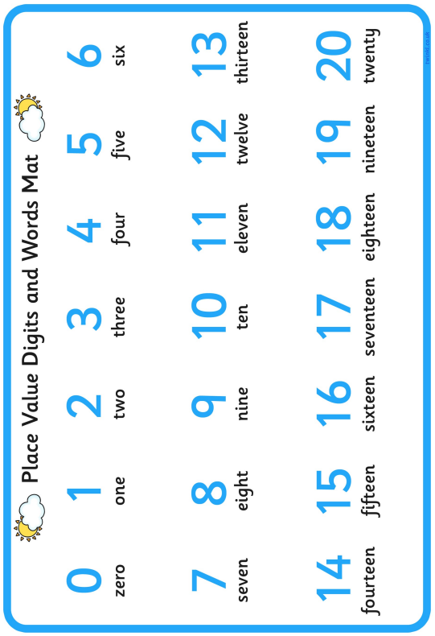

Slide 33
End of Year expectations - Maths

Slide 34
End of Year expectations - Maths

Slide 35
End of Year expectations - Reading

Slide 36
End of Year expectations - Writing

