Slide 1
Year 4 Multiplication Tables Check.
Parents’ information

Slide 2
Why are times tables so important?
Times tables are fundamental. They support children and under pin everything within Maths. It is vital that all children know their multiplication facts up to 12 x 12 by the end of Year 4.
Knowing the multiplication facts up to 12x 12, will give them the essential knowledge they need to be proficient with the Year 5 and Year 6 Curriculum

Slide 3
Purpose
The purpose of the check is to determine whether your child can fluently recall their times tables up to 12 x 12, which is essential for future success in mathematics.
It will also help your child’s class teacher identify if your child may need any additional support.

Slide 4
What does the multiplication check involve?
It is an on-screen check consisting of 25 times table questions.
Your child will be able to answer 3 practice questions before taking the actual check.
They will then have 6 seconds to answer each question.
On average, the check should take no longer than 5 minutes to complete.

Slide 5
Example:
https://mathsframe.co.uk/en/resources/resource/477/Multiplication-Tables-Check

Slide 6
When is it?
The multiplication table check is a test for all Year 4 pupils that takes place between the 6th and 24th of June 2022.

Slide 7
Access arrangements
There are several access arrangements available for the check which can be used to support pupils with specific needs. Your child’s teacher will ensure that the access arrangements are appropriate for your child before they take the check in June.
The check has been designed so that it is inclusive and accessible to as many children as possible, including those with special educational needs or disabilities (SEND) or those where English is an additional language (EAL).

Slide 8
Will I find out my child’s score?
Yes. Your child’s teacher will share your child’s score with you, as they would with all National Curriculum assessments.
There is no set ‘pass’ mark for the check; however, we are aiming for children to score as highly as possible.

Slide 9
What can I do to support my child?
We practise our timetables daily at school; we would love for your children to practise with you at home so that they feel confident when completing the test.

Slide 10
Encourage children to play Times Table Rockstars as often as possible. Small 5 minute daily sessions will help children to learn times tables more than one long session a week. The soundcheck is very similar to the multiplication check.
The easiest way is to quiz your child, e.g: 8x6 is? This could be when making dinner or on the journey to school.

Slide 11
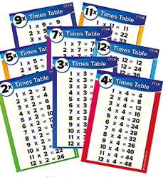
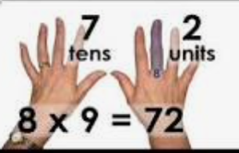
Display a poster with all of the times tables facts on at home.
Create flash cards with your children and let them play with friends, siblings, grandparents. They could write the answer on the back and test themselves.

Slide 12
We use lots of songs to teach our times tables in school, these are available on YouTube.
Let them sing along with those at home.
Children could also make their own times tables songs.
Chanting their times table is an excellent way to learn them. They could do this each time they walk up the stairs.

Slide 13
Any times tables practise that the children can do at home will really support them to become proficient in their times tables and help them with their everyday maths learning.

Slide 14
We value your support. Thank you.

Slide 15
Any questions?

