Slide 1
Mental Health Assembly

Slide 2
Welcome back!
Hello everyone!
Welcome back to the final term of the academic year.
From everyone at Blakehill, we hope that you had an enjoyable and relaxing two-week break!
This summer term is filled with lots of fun things like sports day; playing rounders in the sunshine; spending lunchtimes on the field; as well as a Year 6 leavers’ assembly to look forward to!
Today, we are going to talk all about how we work together at Blakehill.

Slide 3
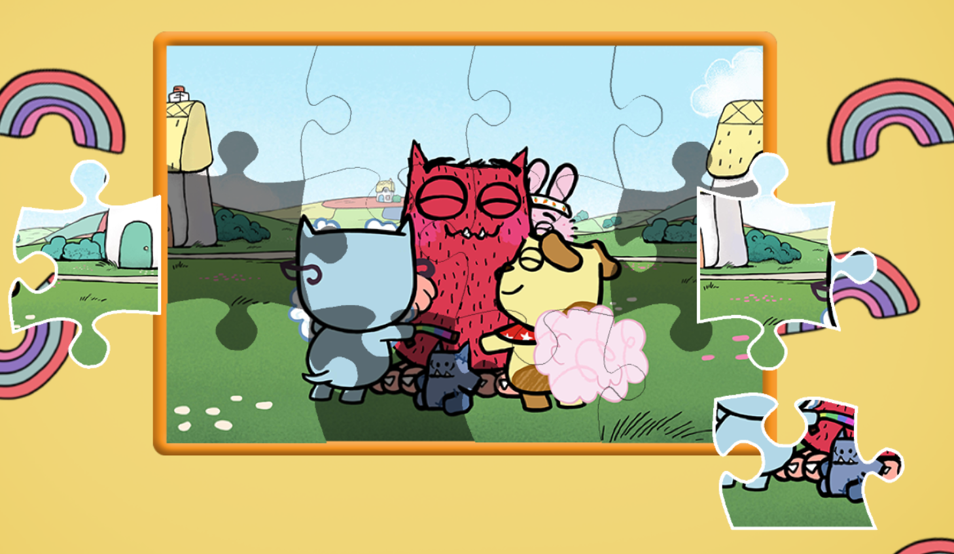
Q. What type of puzzle is this?
That’s right, it is a jigsaw! During the holidays, I completed a 1,000 piece jigsaw!
Q. How do jigsaw puzzles work?
A. It’s all about finding pieces that fit together to create something amazing.

Slide 4
As I was completing my jigsaw over the holidays, I soon realised that our school (that’s all of you as well as all of the staff) and the community of which we are a part of (that’s your parents, guardians and carers) is much like a jigsaw puzzle.
Q. Can any of you think why I might believe our school is like a jigsaw puzzle?
A. That’s right, we all ‘fit together’. We support and help each other and together we can achieve great things. Remember our school motto is: ‘Together we can’.

Slide 5
Q. What do you notice about each piece of jigsaw puzzle?
A. Each piece is colourful, interesting, challenging and unique with its cut-out bits and bobbles, and different parts of a picture on it. Each jigsaw piece has its place in the picture and without it that picture would not be complete.

Slide 6
Each piece of the jigsaw puzzle is like a different person in the school. Each person in our school is unique and wonderful, you might have a different hair colour, or different favourite hobbies, or different roles in the school. But just like the jigsaw, we all fit together in our school community to make it whole.
Q. Can you name someone in the school community and their unique role? For example, Mrs. Blackmore, our School Caretaker, makes sure that everything in school is clean and tidy and that everything works the way it should.
Your teacher can add each idea to the jigsaw pieces provided.

Slide 7
A final thought…
Remember: each and every one of you is unique and wonderful.
Each of you bring something special to our school community with your personality and talents and without them, our school would be missing an important piece.
See activity pack.

