Slide 1
Coal mining - My grandads story

Slide 2
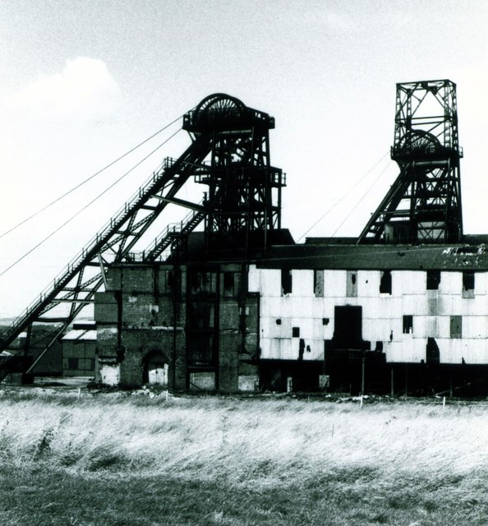
My grandad was a coal miner back in the 1980s as Glasshoughton. His shifts started at 5am and lasted 12 hours.
Miners would come to work in their own clothes and change
Into their scrubs. It was very warm when working in the pits! They would often try not to wear their thicker clothes.
The only safety gear they has was a hard hat with a light on the
Front

Slide 3
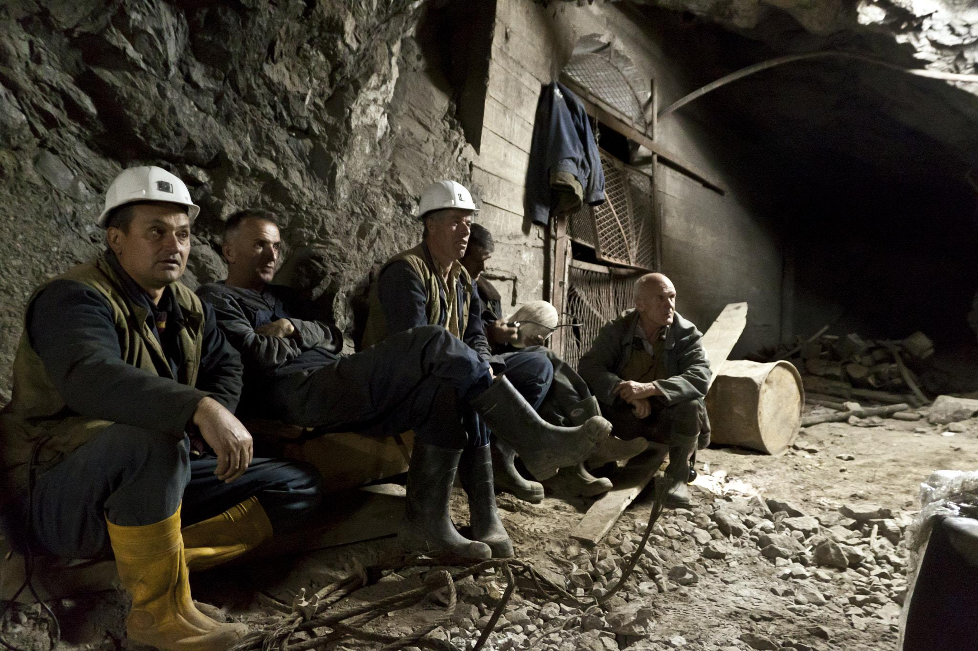

Slide 4
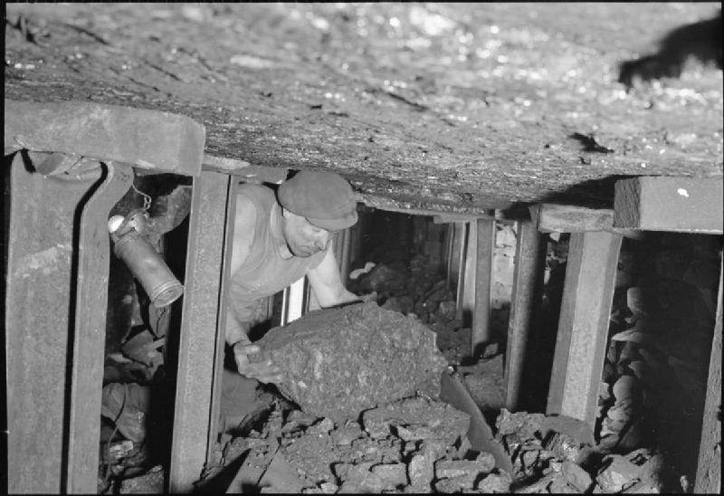
The miners would get into cages, sometimes this would be up to 15 men. They would make their descent to the coal face this was miles below the ground

Slide 5
My grandad would use a pick to hack away at the coal, although they did have modern tools like drills. He was involved in a collapse of coal which trapped many for hours until they were rescued. This is how my grandad injured his leg and his back.
Later on his return to the mine, he changed pits and went to work at the Prince of Wales colliery. That is where he became safety engineer.

Slide 6
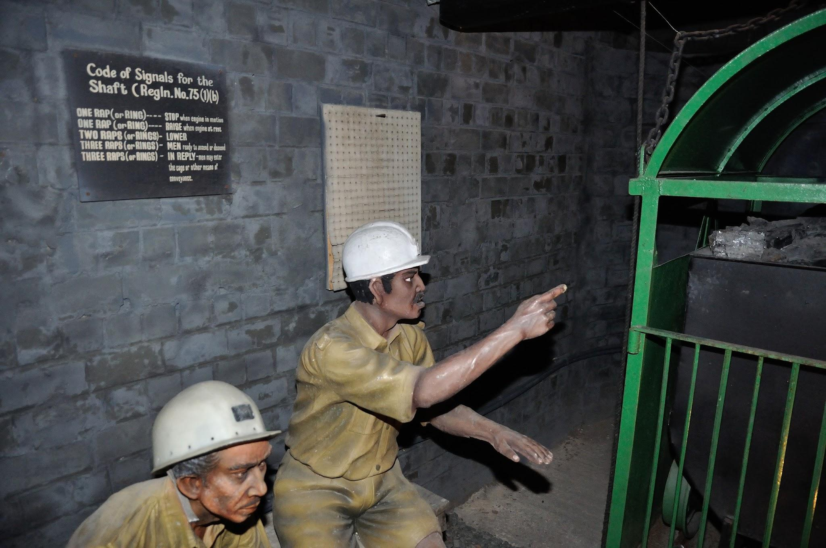

Slide 7
During the miners strike, 1984- 1985 there was much unrest between the miners. A man called Arthur’s Scargill was at the center of all the troubles. Many men refused to go to work down the pit and called those that did scabs! Families were divided, and people would spit at those whole continued to work.
My grandad had to go down the pit to ensure it was still safe for those who wanted to work! He spoke of how it was a horrible time and there used to be bused into the colliery with metal bars on the windows to protect them, the miners had to lie on the floor and cover their faces because of the picket line. Men used to throw bricks at the buses and shout Scab!

Slide 8
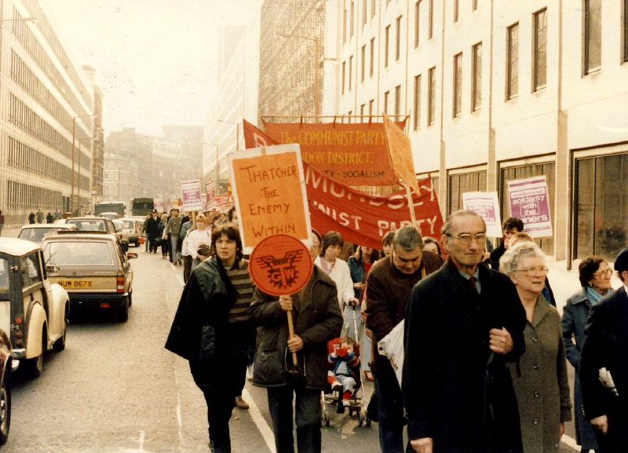
I guess you could call my grandad a key worker of his day!
When the strike ended my grandad left the industry… he had seen and heard enough of this hard profession

